Slide 2
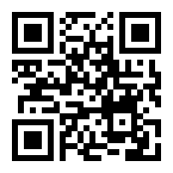
Current News Webinar Series
26 September – 6 October
Unsure what subject you’d like to study at university?
This webinar series will:
Provide a taster of university teaching
Share our latest academic research
Include interactive Q&A sessions
Register now!
Featuring:
Pharmacy, Medicine, Law, Engineering, Psychology

Slide 3
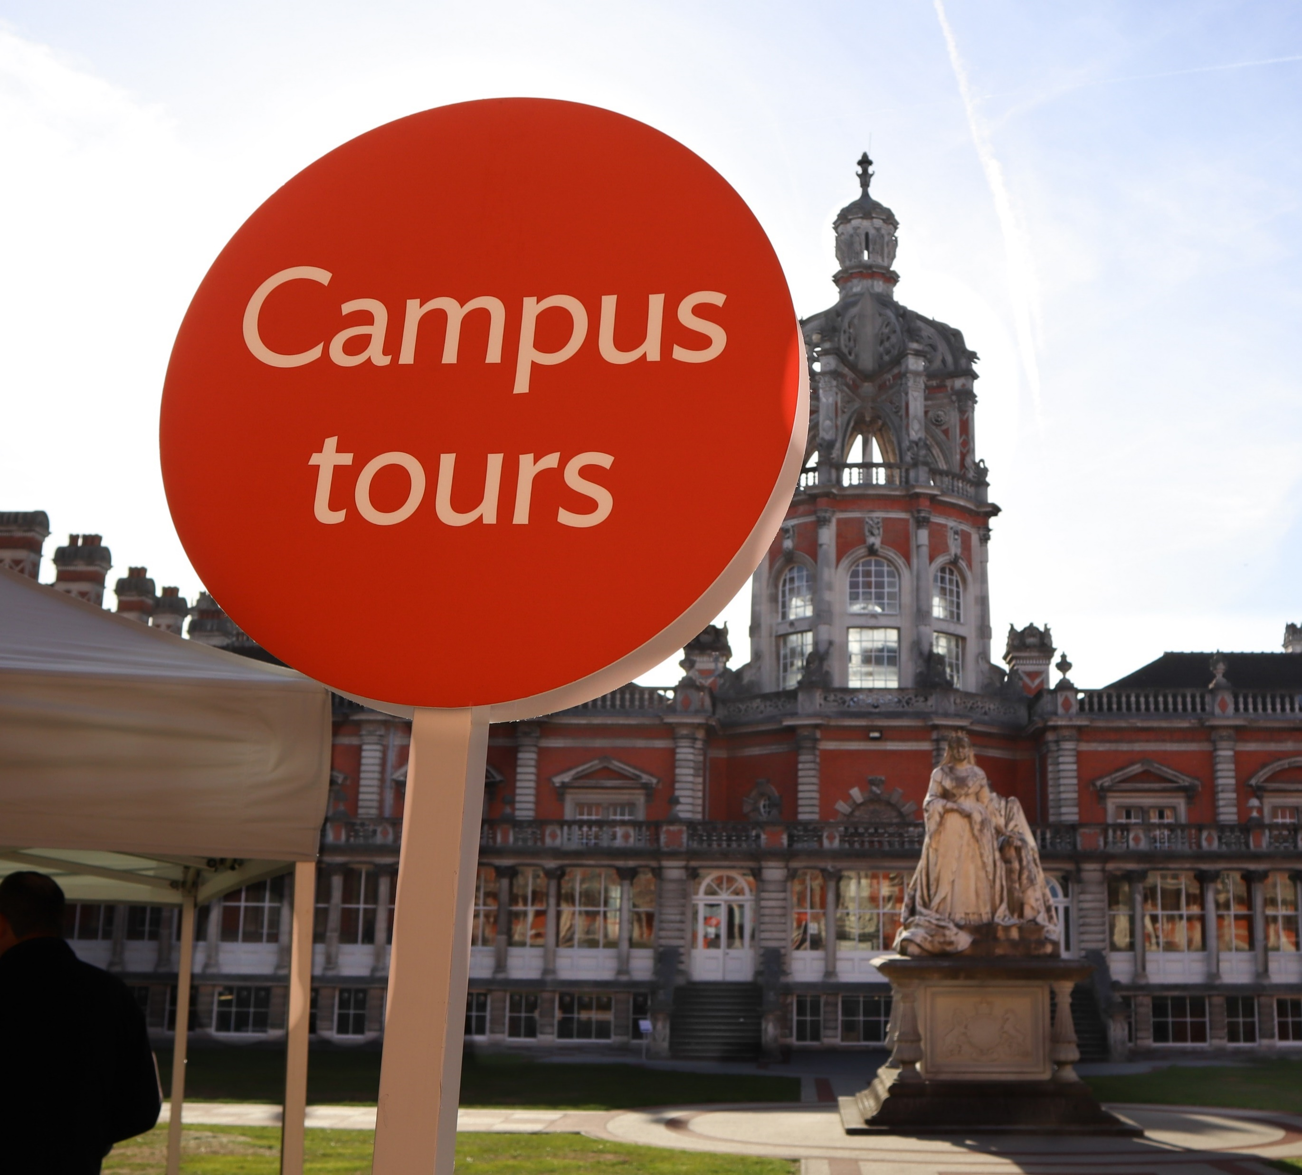
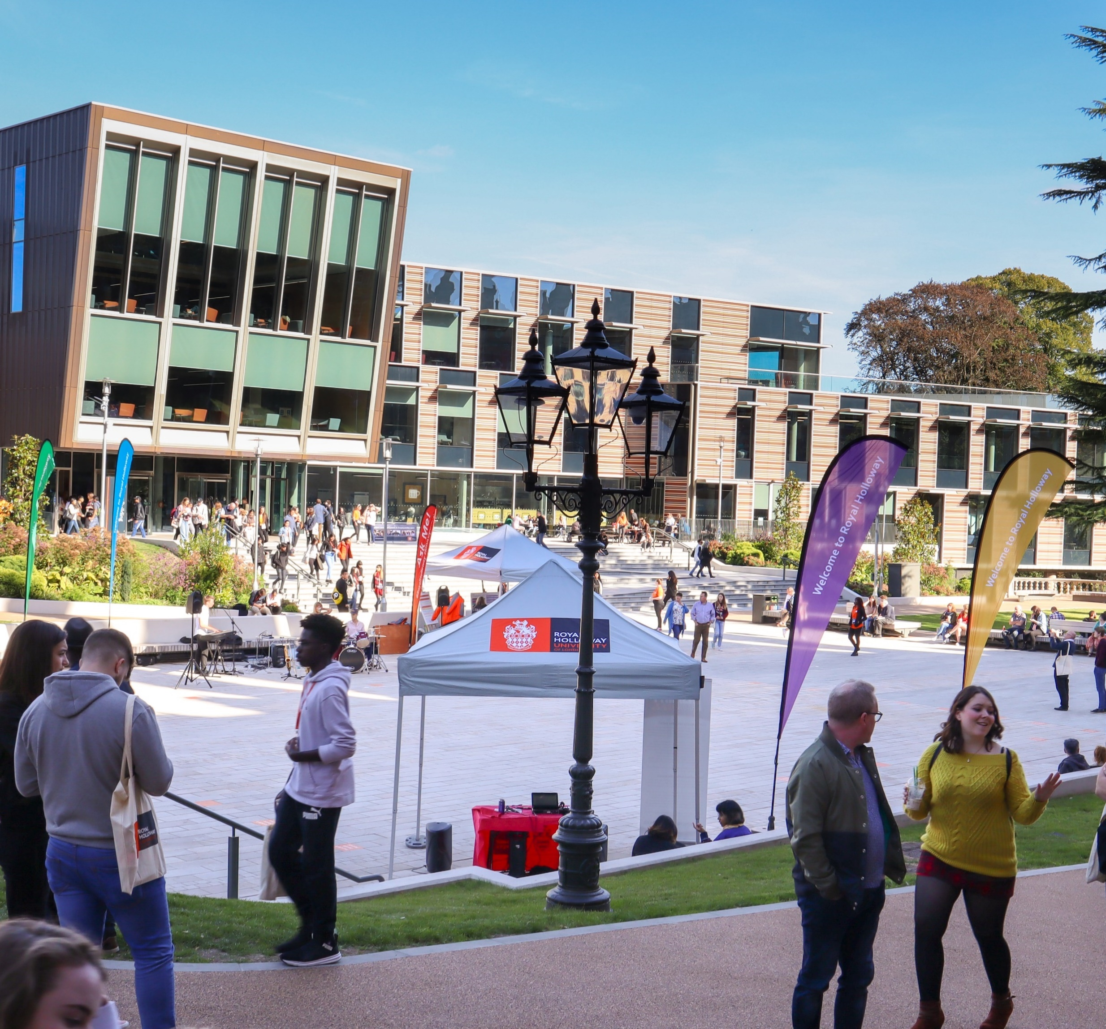
Visit
Royal Holloway
Our Open Days and Online Open Days are a perfect opportunity to discover more about Royal Holloway, University of London. Get a tour of our campus in Egham, chat to current students and hear directly from lecturers about the courses you are interested in.
Find out more and book your place
royalholloway.ac.uk/opendays

Slide 4
Discover Solent University
Open days are the best way to experience Solent and find out all about the opportunities on offer.
Book your place today:
Saturday 10 September – All faculties, on campus
Saturday 8 October – Careers in Maritime, on campus
Saturday 15 October – All faculties, on campus
Saturday 5 November – All faculties, virtual
Saturday 26 November – Careers in Maritime, virtual
Saturday 3 December – All faculties, on campus
https://www.solent.ac.uk/open-days

