Slide 3
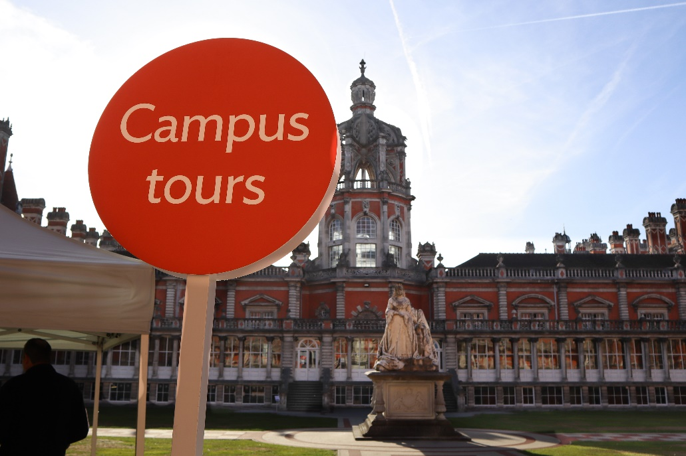
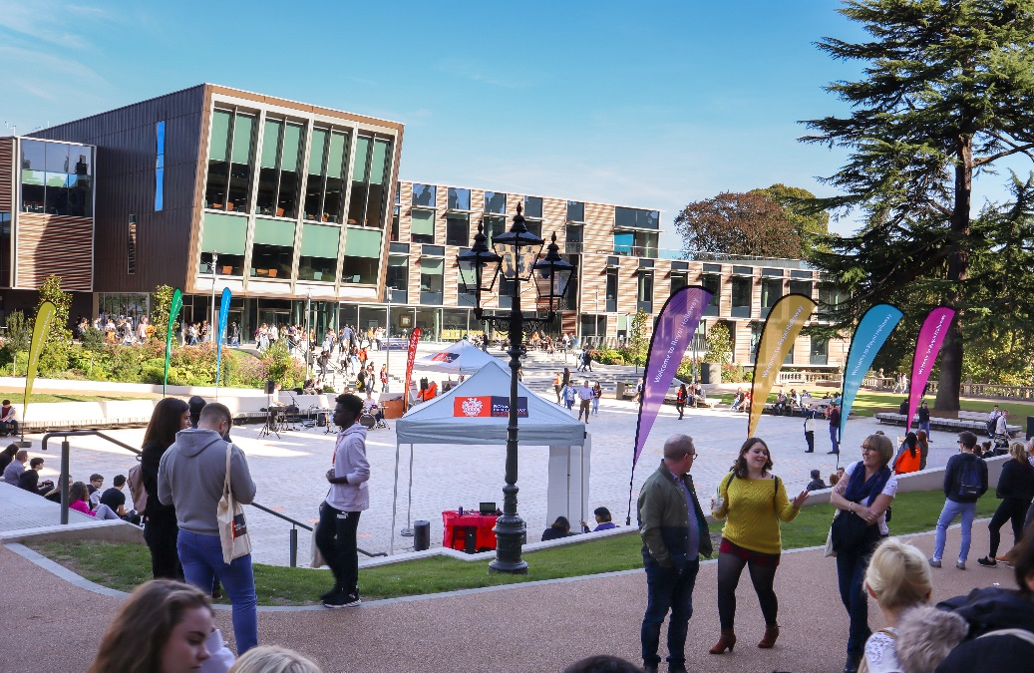
Visit
Royal Holloway
Our Open Days and Online Open Days are a perfect opportunity to discover more about Royal Holloway, University of London. Get a tour of our campus in Egham, chat to current students and hear directly from lecturers about the courses you are interested in.
Find out more and book your place
royalholloway.ac.uk/opendays

Slide 5
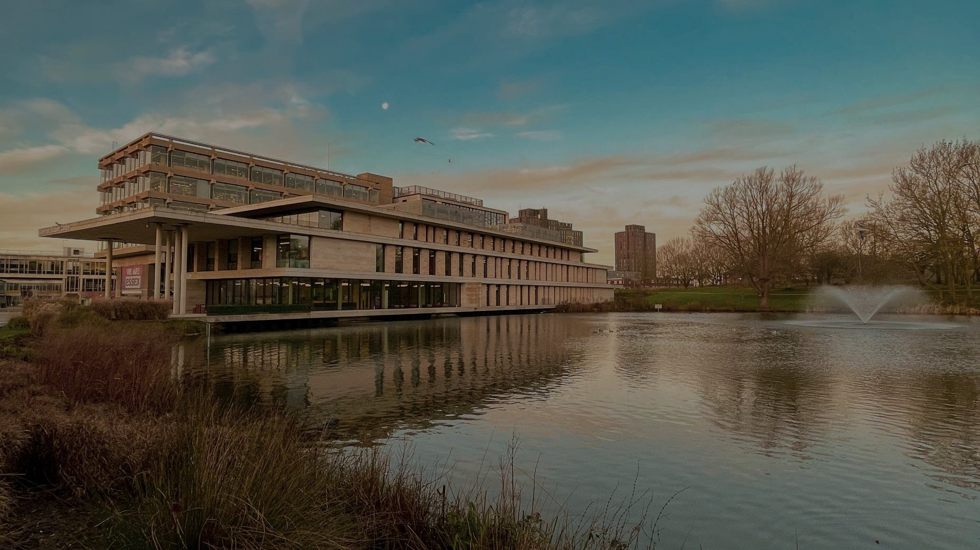
Essex Open Days A chance for you to see where you might be calling home.
Colchester Campus
Saturday 16 September
Saturday 28 October
Southend Campus
Saturday 14 October
essex.ac.uk/visit-us/open-days

Slide 8
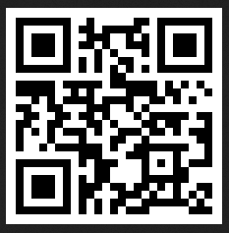
Scan the QR code to find out more about:
Our courses and student experience
Opportunities to visit our campuses in Exeter and Cornwall
Download resources and materials to help you with your application
@DiscoverUniExe
www.exeter.ac.uk/discoveruniversity

Slide 9
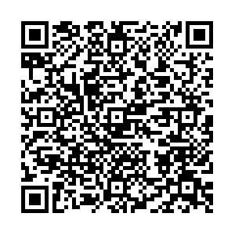
Current News Webinar Series
25 September – 5 October
Unsure what subject you’d like to study at university?
This webinar series will:
Provide a taster of university teaching
Share our latest academic research
Include interactive Q&A sessions
Register now!
Featuring:
Engineering, Psychology, Medicine, Modern Languages and More

