Slide 6
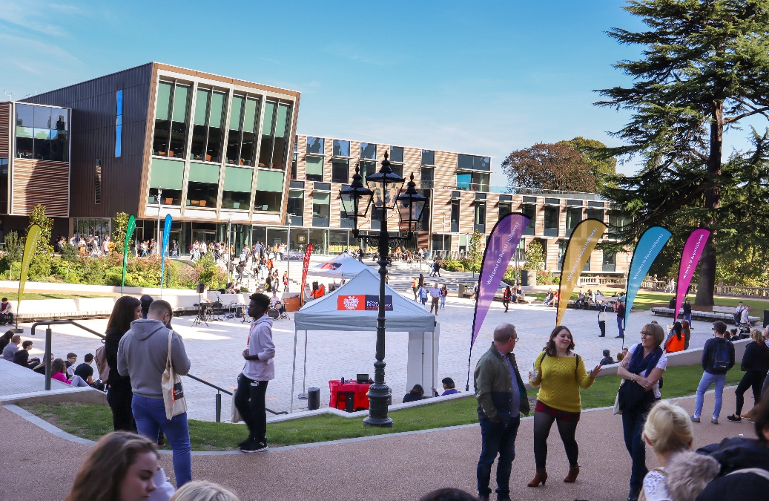
Visit
Royal Holloway
Our Open Days and Online Open Days are a perfect opportunity to discover more about Royal Holloway, University of London. Get a tour of our campus in Egham, chat to current students and hear directly from lecturers about the courses you are interested in.
Find out more and book your place
royalholloway.ac.uk/opendays

Slide 8
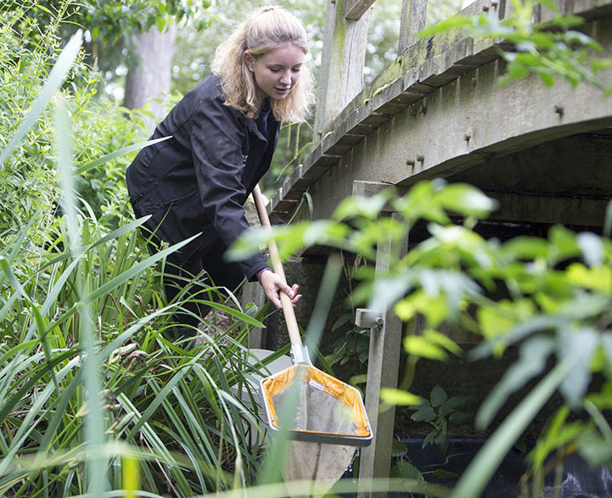
Animal & Geography Taster days at NTU Experience what it’s like to study an Animal or Geography based subject at the award-winning NTU
Animal & Wildlife Studies -
19th June
Geography & Environmental Studies - 21st June
These interactive events are lead by our academics
Scan the QR code to sign up

Slide 9
Experience Humanities & Social Sciences at NTU
Secondary Education -
8th June
History - 15th June
English Language & Linguistics - 28th June
These interactive taster days are lead by our academics
Scan the QR code to sign up

Slide 10
Experience Design & Digital Arts at NTU
Join us on 7th June to experience:
Photography
Graphic design
Games design
Virtual production
Animation & many more
This interactive taster day will be lead by our academics
Scan the QR code to sign up

Slide 11
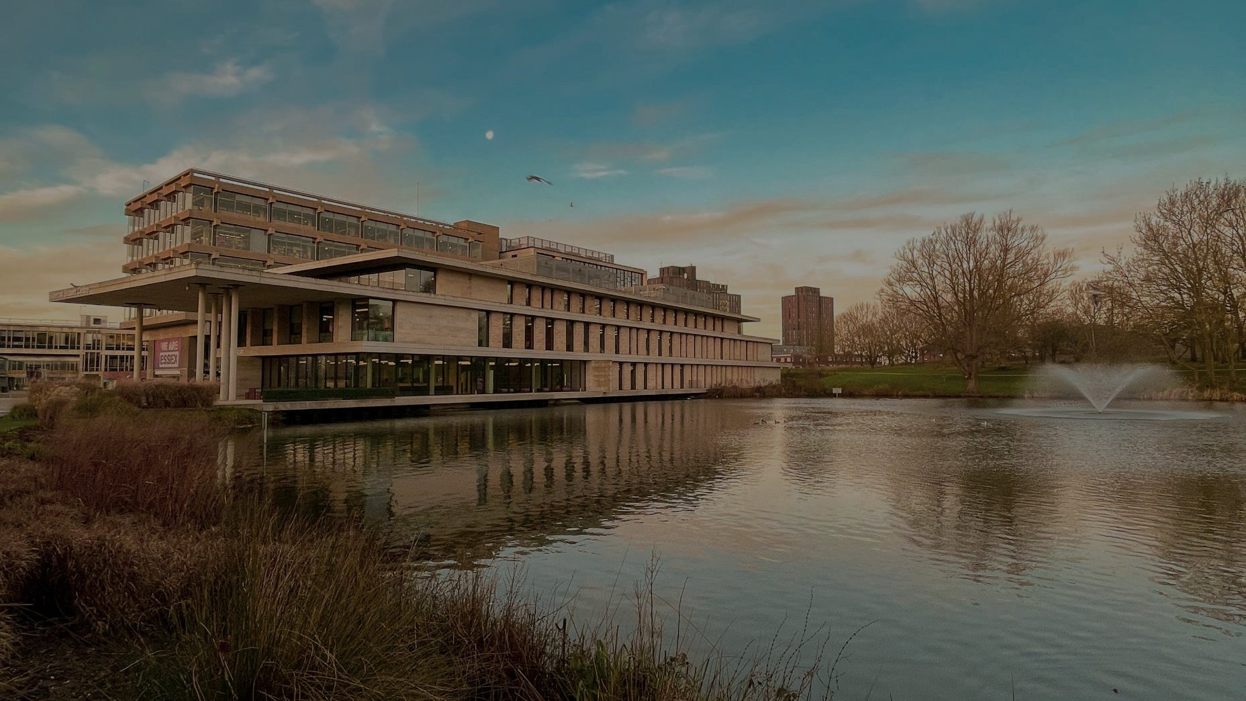
Essex Open Days A chance for you to see where you might be calling home.
Colchester Campus
Saturday 17 June
Saturday 16 September
Saturday 28 October
Southend Campus
Saturday 14 October
essex.ac.uk/visit-us/open-days

