Slide 1


Slide 2


Slide 3



Meet the
Webinars
Tuesday 30th April 2024 - Thursday 2nd May 2024
UK University Search are excited to be collaborating with the Russell Group once again to bring you our popular, informative and inspiring webinars that cover a range of key topics.
Taking place from the 30th April to the 2nd May, we have five free 90-minute sessions
each featuring five or six expert panelists.
In each session the Q&A function will be managed by member universities from the Russell Group who will be able to answer specific questions and provide further information.
Sign up or find out more by scanning the QR code below.
Please also register if you would like to be emailed access to the recordings.

Slide 4

Undergraduate
Open Days
Saturday 20 April – General,
On Campus
Saturday 27 April – General,
Virtual
Saturday 11 May – Careers at Sea,
Virtual
https://www.solent.ac.uk/open-days

Slide 5
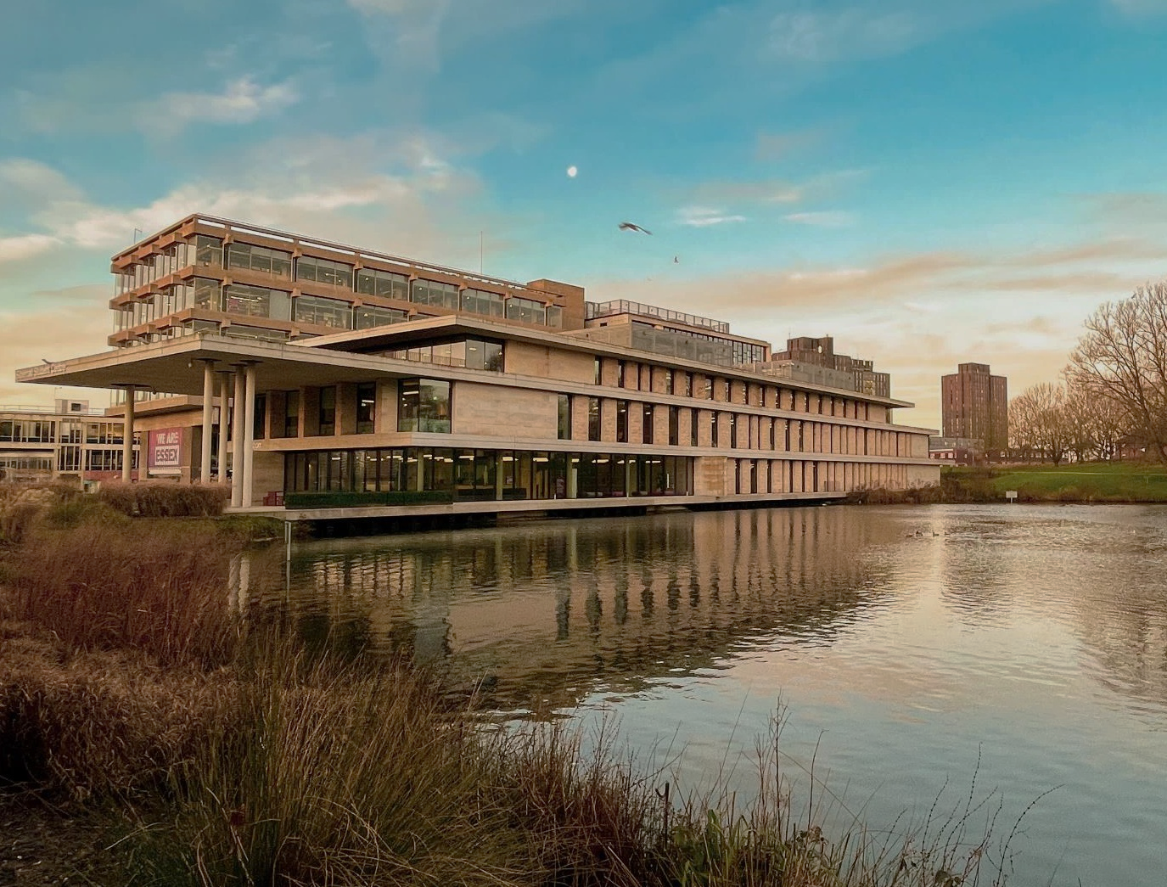


Essex Open Days
A chance for you to see where you might be calling home
Colchester Campus
Saturday 15 June
Saturday 21 September
Saturday 26 October
Southend Campus
Saturday 12 October
Book now
essex.ac.uk/visit-us/open-days

Slide 6


Slide 7


Slide 8
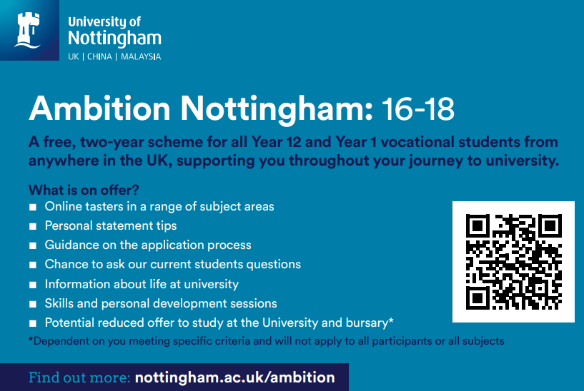


Slide 9
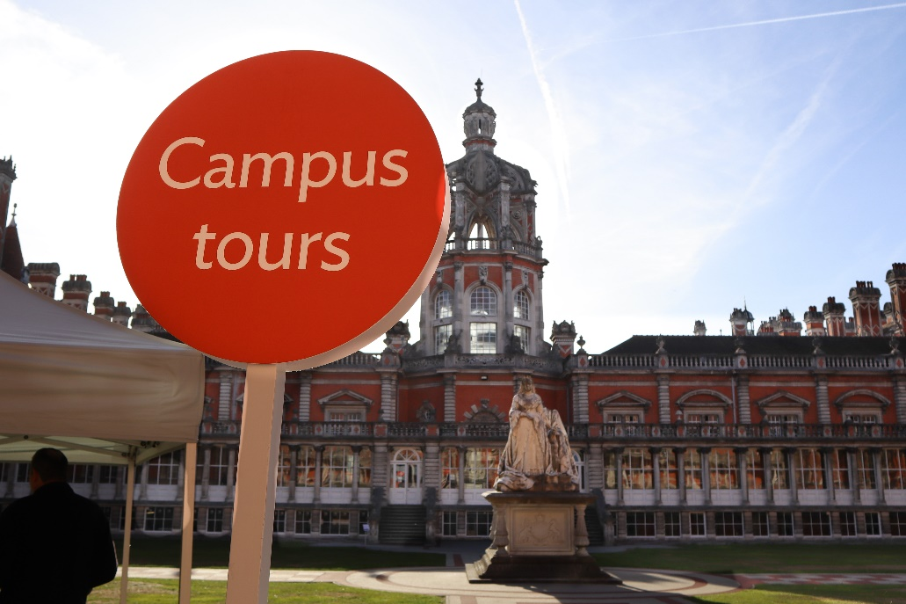
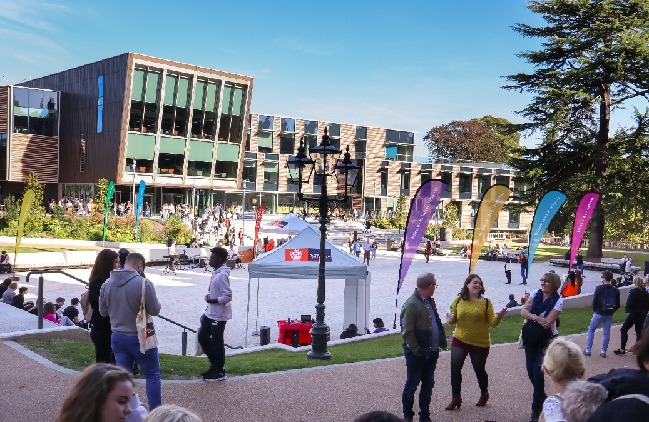
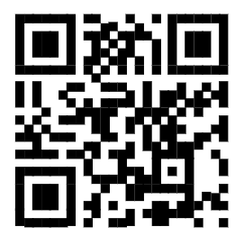

Visit
Royal Holloway
Our Open Days and Online Open Days are a perfect opportunity to discover more about Royal Holloway, University of London. Get a tour of our campus in Egham, chat to current students and hear directly from lecturers about the courses you are interested in.
Find out more and book your place
royalholloway.ac.uk/opendays

Slide 10


