Slide 2
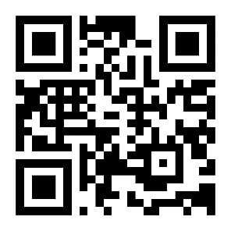
GO BEYOND
THE LECTURE THEATRE
Visit us to explore our campuses
at our next Open Day.
SCAN TO BOOK
YOUR PLACE
www.southwales.ac.uk/opendays
@de_cymru @UniSouthWales

Slide 3
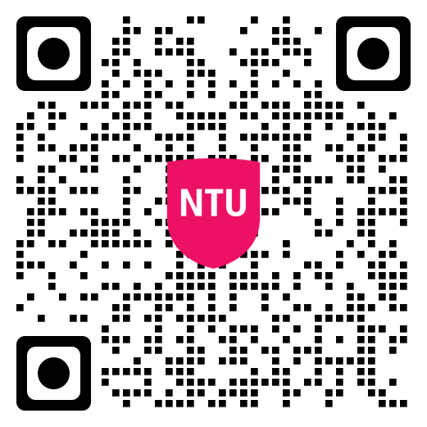
Engineering Taster day at NTU Experience what it’s like to study Engineering at the award-winning NTU
Join us on 9th October to experience a range of disciplines:
Mechanical
Electric/electronical
Sports
Aeronautical
Scan the QR code to sign up

Slide 7
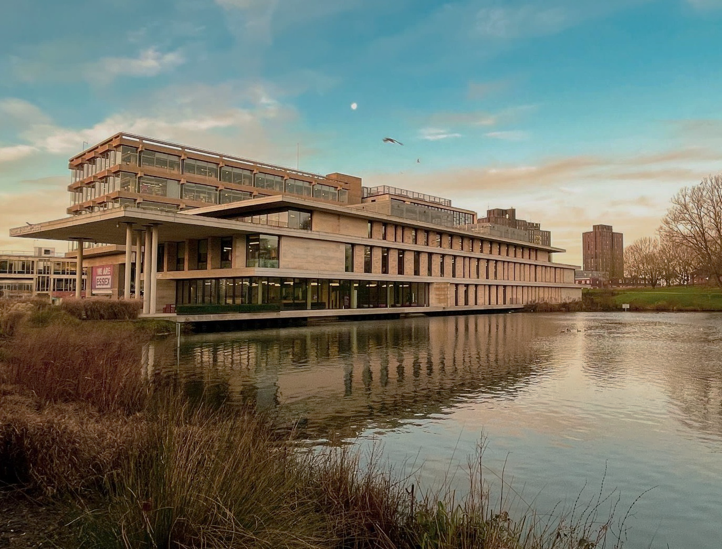
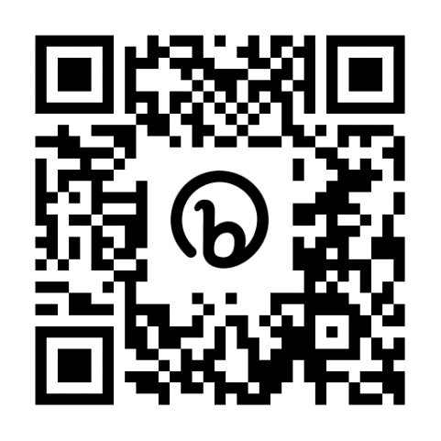
Essex Open Days A chance for you to see where you might be calling home
Colchester Campus
Saturday 21 September
Saturday 26 October
Southend Campus
Saturday 12 October
Book now
essex.ac.uk/visit-us/open-days

Slide 9
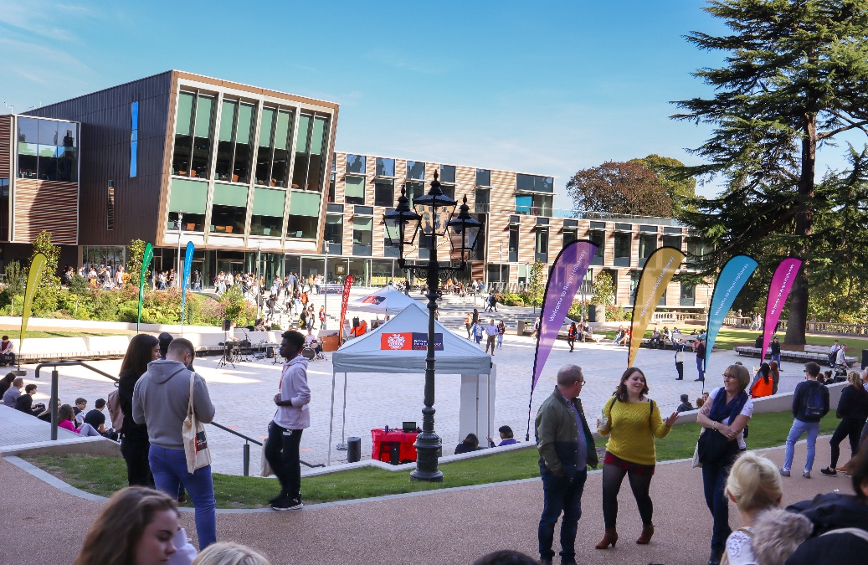
Visit
Royal Holloway
Our Open Days and Online Open Days are a perfect opportunity to discover more about Royal Holloway, University of London. Get a tour of our campus in Egham, chat to current students and hear directly from lecturers about the courses you are interested in.
Find out more and book your place
royalholloway.ac.uk/opendays

Slide 10
The University of Exeter has added a range of T levels to its accepted qualifications list.
Visit our course pages using the QR code below to find out more.
@DiscoverUniExe
www.exeter.ac.uk/discoveruniversity

