Slide 3
Visit Winchester!
Our Open Days and Campus Tours are a great opportunity to see our beautiful campus, take a tour of our stunning accommodation, and meet staff and students from the course you are looking to study.
Find out more at winchester.ac.uk/study/visit-us

Slide 5
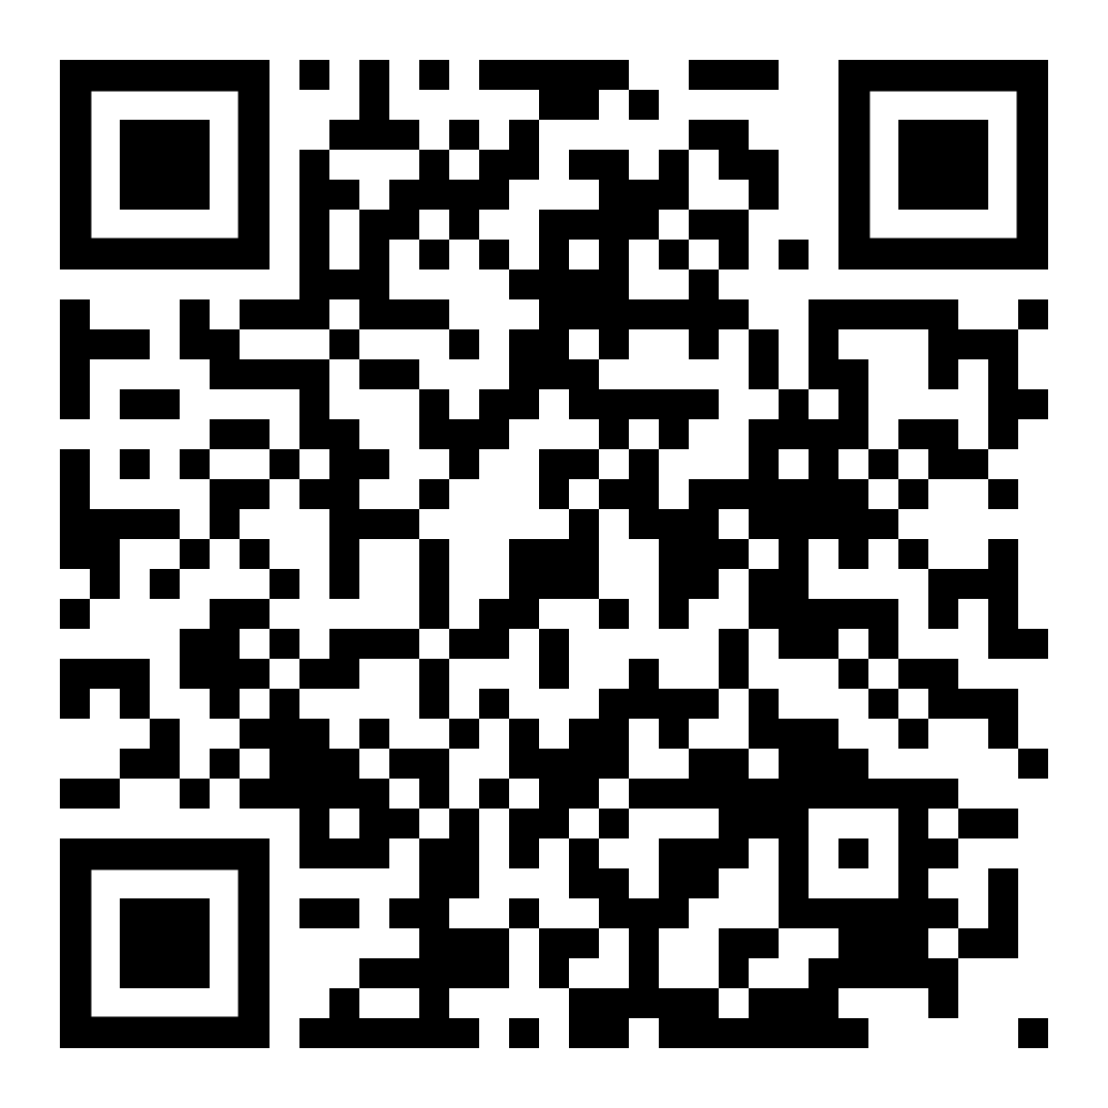
Discover Swansea University at one of our
On-Campus Open Days:
Saturday 15th February 2025
Saturday 22nd March 2025
Register now!

Slide 9
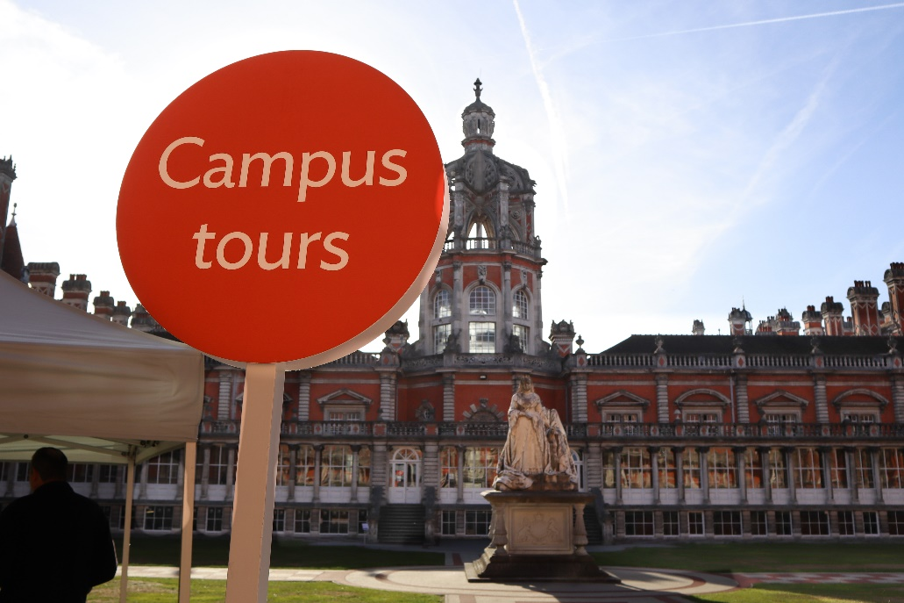
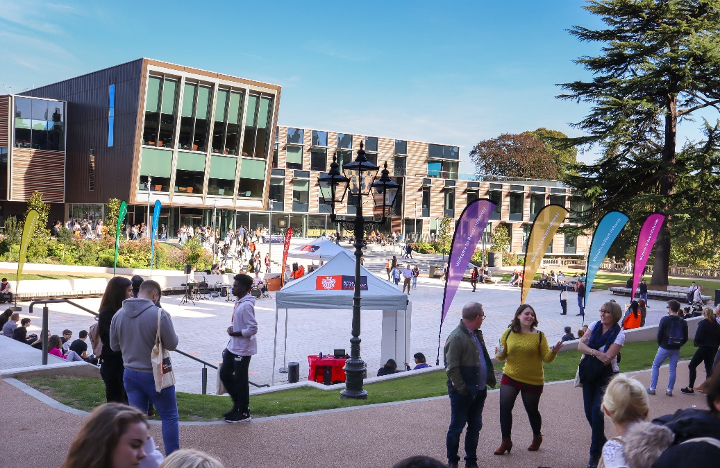
Visit
Royal Holloway
Our Open Days and Online Open Days are a perfect opportunity to discover more about Royal Holloway, University of London. Get a tour of our campus in Egham, chat to current students and hear directly from lecturers about the courses you are interested in.
Find out more and book your place
royalholloway.ac.uk/opendays

Slide 10
The University of Exeter has added a range of T levels to its accepted qualifications list.
Visit our course pages using the QR code below to find out more.
@DiscoverUniExe
www.exeter.ac.uk/discoveruniversity

