Slide 3
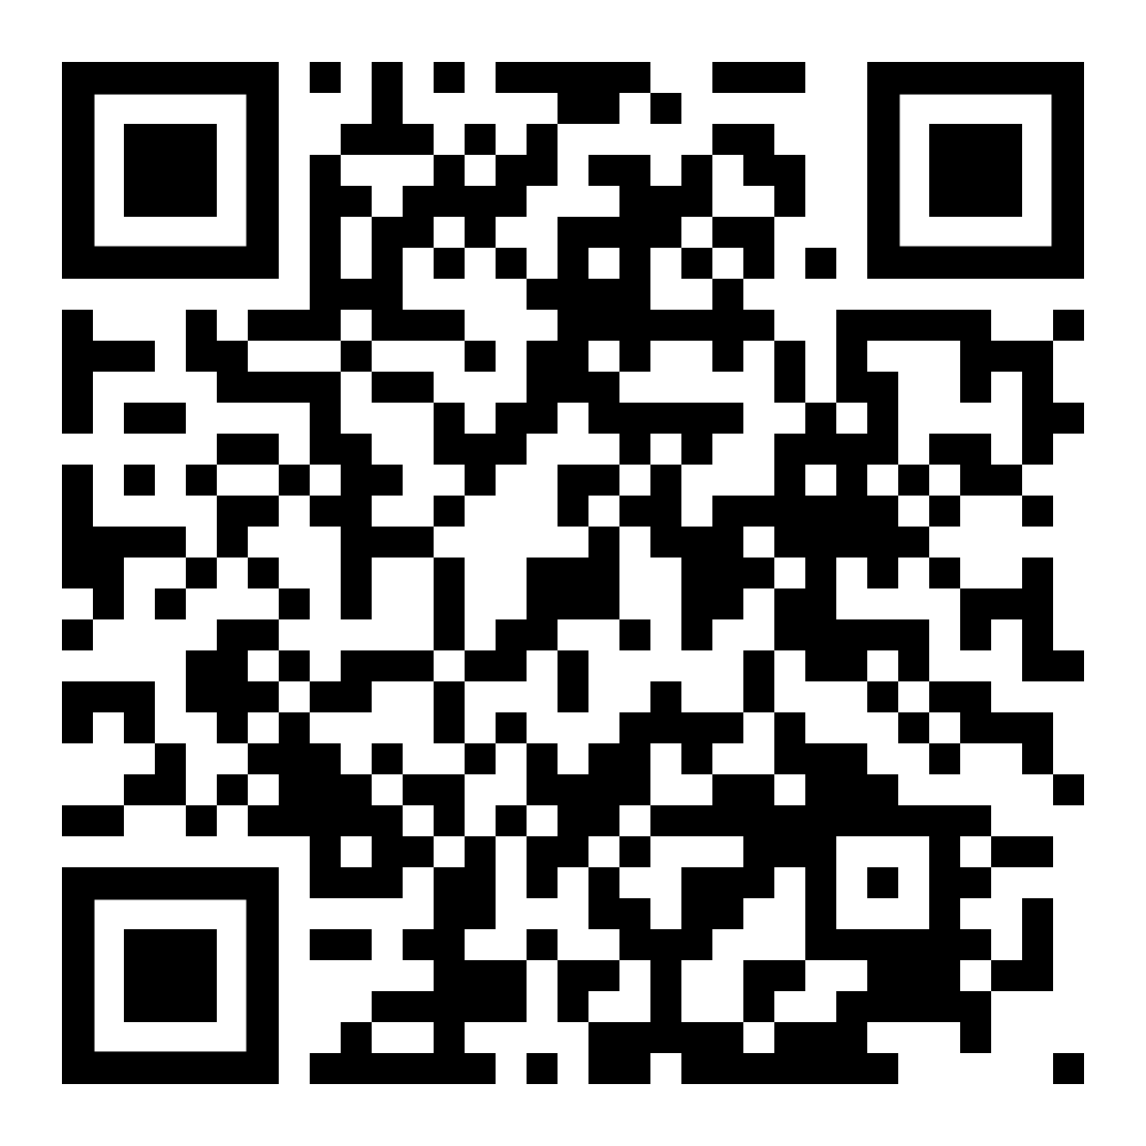
Discover Swansea University at one of our
On-Campus Open Days:
Saturday 15th February 2025
Saturday 22nd March 2025
Register now!

Slide 4
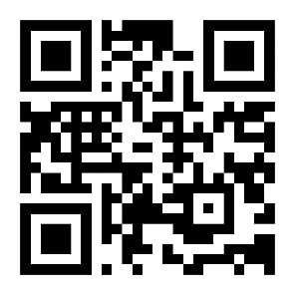
GO BEYOND
THE LECTURE THEATRE
Visit us to explore our campuses
at our next Open Day.
SCAN TO BOOK
YOUR PLACE
www.southwales.ac.uk/opendays
@de_cymru @UniSouthWales

Slide 8
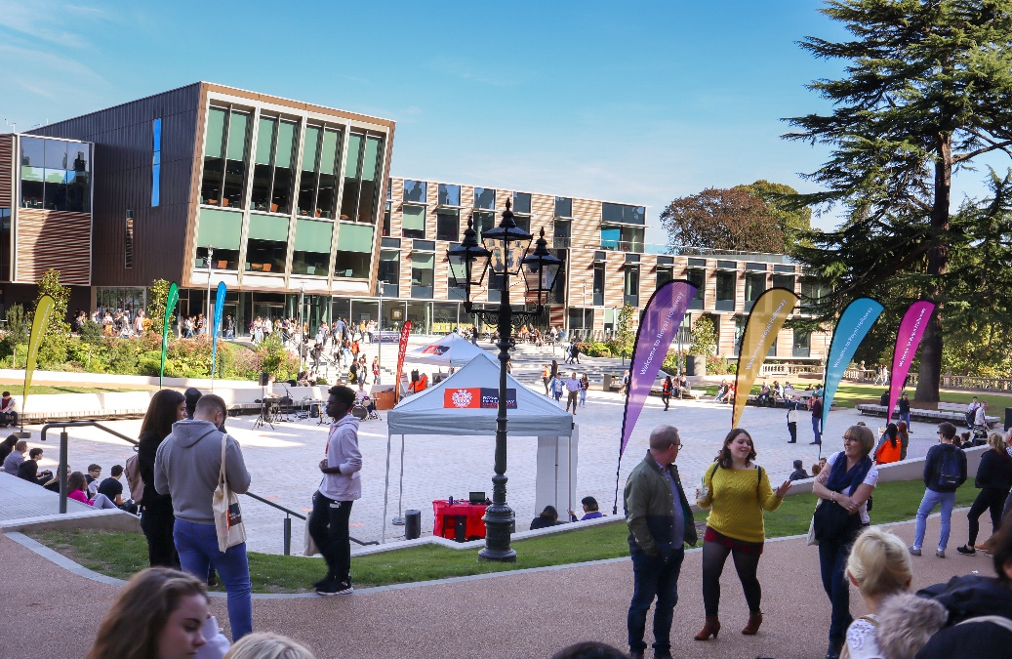
Visit
Royal Holloway
Our Open Days and Online Open Days are a perfect opportunity to discover more about Royal Holloway, University of London. Get a tour of our campus in Egham, chat to current students and hear directly from lecturers about the courses you are interested in.
Find out more and book your place
royalholloway.ac.uk/opendays

Slide 9
The University of Exeter has added a range of T levels to its accepted qualifications list.
Visit our course pages using the QR code below to find out more.
@DiscoverUniExe
www.exeter.ac.uk/discoveruniversity

