Slide 1


Slide 2






PLACES AVAILABLE
FOR THIS SEPTEMBER
Call us for an instant offer:
03455 76 06 06
FIND OUT MORE
ABOUT CLEARING
www.southwales.ac.uk
@de_cymru
@UniSouthWales

Slide 3


Slide 4


Slide 5


Slide 6

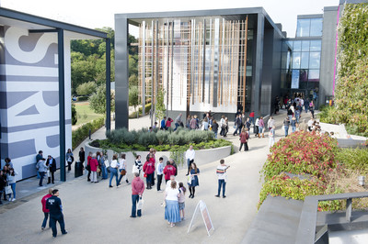

Visit Winchester!
Our Open Days and Campus Tours are a great opportunity to see our beautiful campus, take a tour of our stunning accommodation, and meet staff and students from the course you are looking to study.
Find out more at winchester.ac.uk/study/visit-us

Slide 7


Slide 8


Slide 9


Slide 10


Slide 11
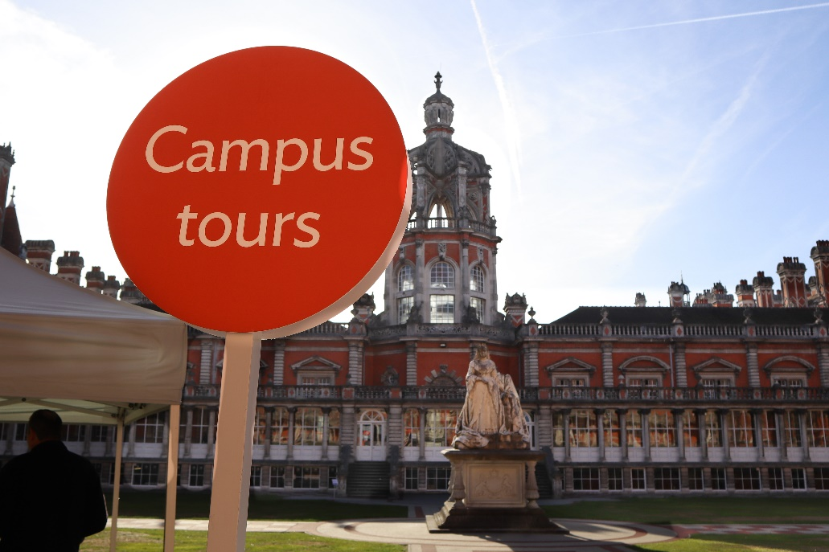
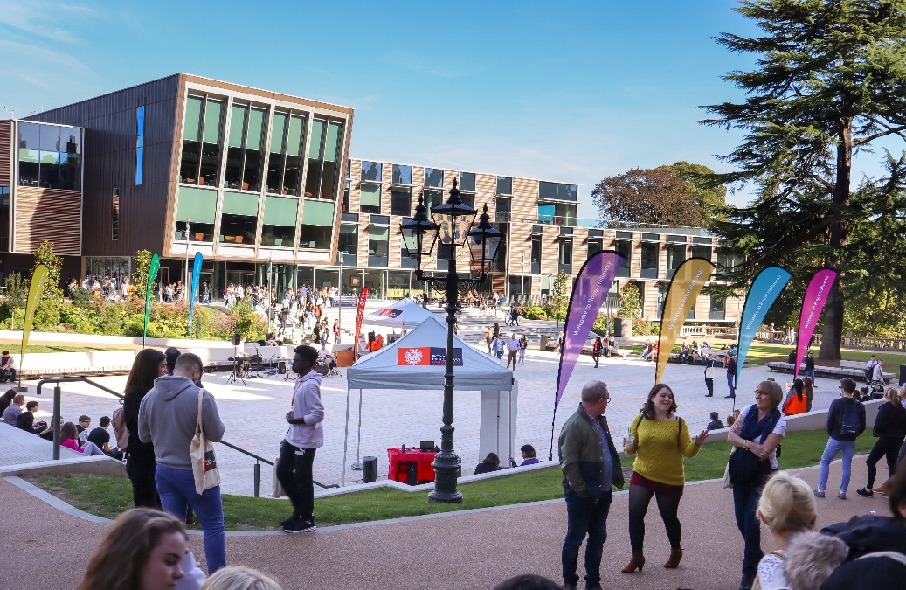
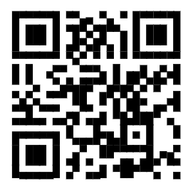

Visit
Royal Holloway
Our Open Days and Online Open Days are a perfect opportunity to discover more about Royal Holloway, University of London. Get a tour of our campus in Egham, chat to current students and hear directly from lecturers about the courses you are interested in.
Find out more and book your place
royalholloway.ac.uk/opendays

