Slide 6
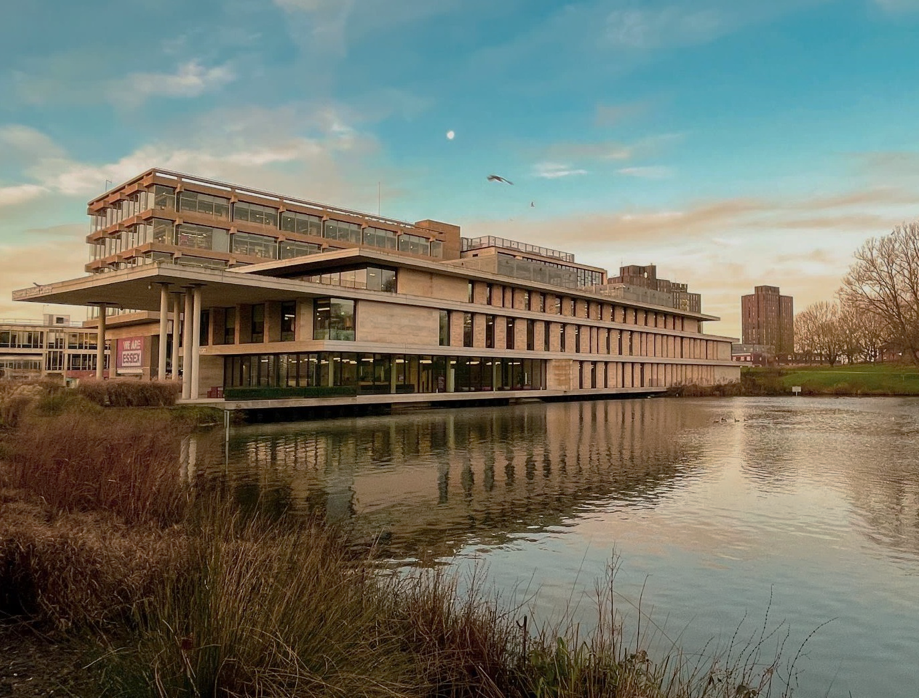
Essex Open Days A chance for you to see where you might be calling home
Colchester Campus
Saturday 15 June
Saturday 21 September
Saturday 26 October
Southend Campus
Saturday 12 October
Book now
essex.ac.uk/visit-us/open-days

Slide 9
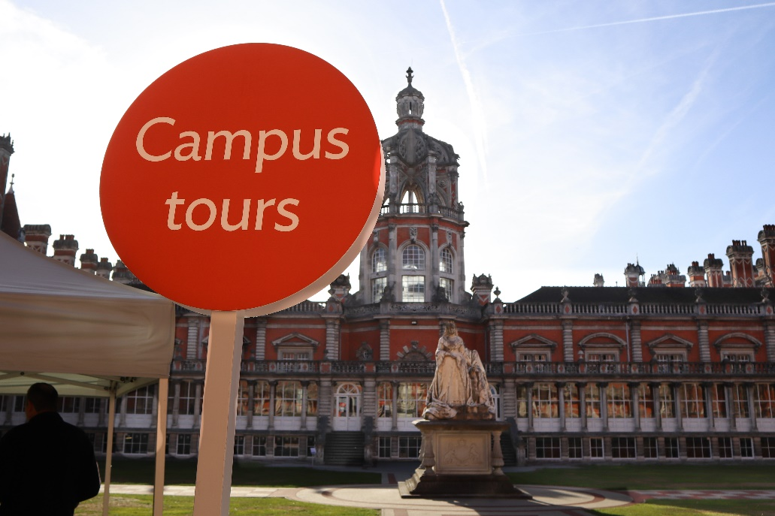
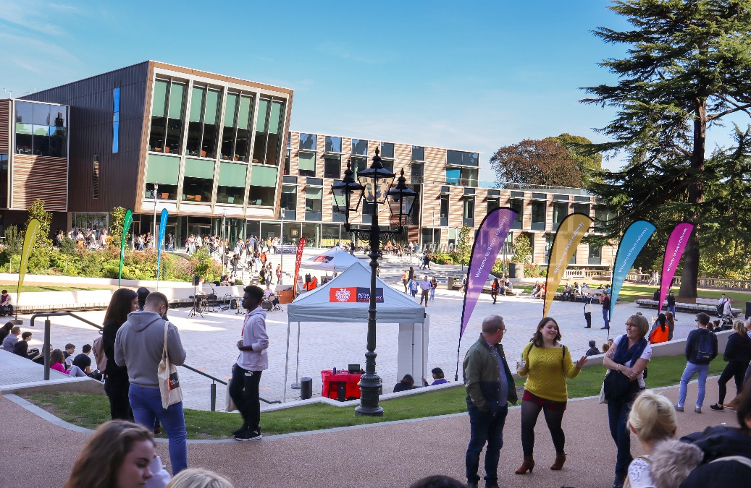
Visit
Royal Holloway
Our Open Days and Online Open Days are a perfect opportunity to discover more about Royal Holloway, University of London. Get a tour of our campus in Egham, chat to current students and hear directly from lecturers about the courses you are interested in.
Find out more and book your place
royalholloway.ac.uk/opendays

