Slide 1

New Guides and Podcasts
UniTasterDays.com/Students

Slide 9
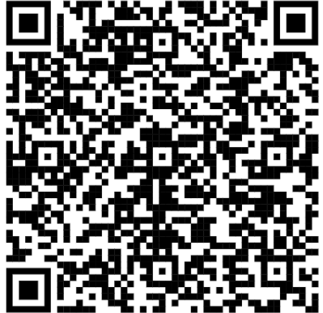
Masterclass Webinars
16th – 19th November 2026
Register Now

Slide 10
Join us for our upcoming Open Days!

Slide 12
FREE SUBJECT TASTER DAYS
Great experience for Personal Statements
Take part in subject taster sessions, hear from experts, talk to current students and explore our campuses.
Travel funding available.
4 November Performing Arts Masterclass Day
10 November Education Taster Day
11 November Geography & Biosciences Taster Day
11 November Accounting & Finance Taster Day
11 November Cyber & Computing Taster Day
18 November Psychology Taster Day
25 November Marketing Taster Day
27 November Health & Social Care Taster Day
BOOK www.glos.ac.uk/outreach

Slide 16

Book your Open Day
or Campus Tour now.
brunel.ac.uk/study/open-days

Slide 17
INSERT QR CODE

Slide 22
Visit Winchester!
Our Open Days and Campus Tours are a great opportunity to see our beautiful campus, take a tour of our stunning accommodation, and meet staff and students from the course you are looking to study.
Find out more at winchester.ac.uk/study/visit-us

