Slide 1



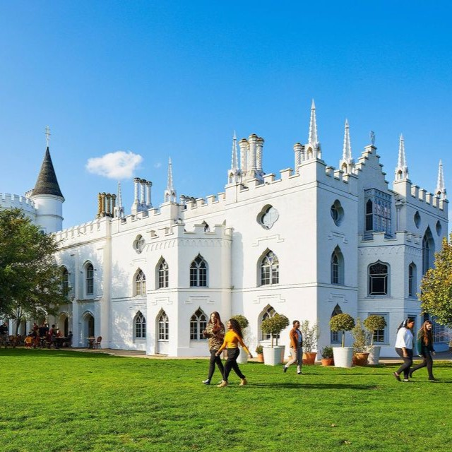

New Guides and Podcasts
UniTasterDays.com/Students

Slide 3


Slide 4


Slide 5


Slide 6
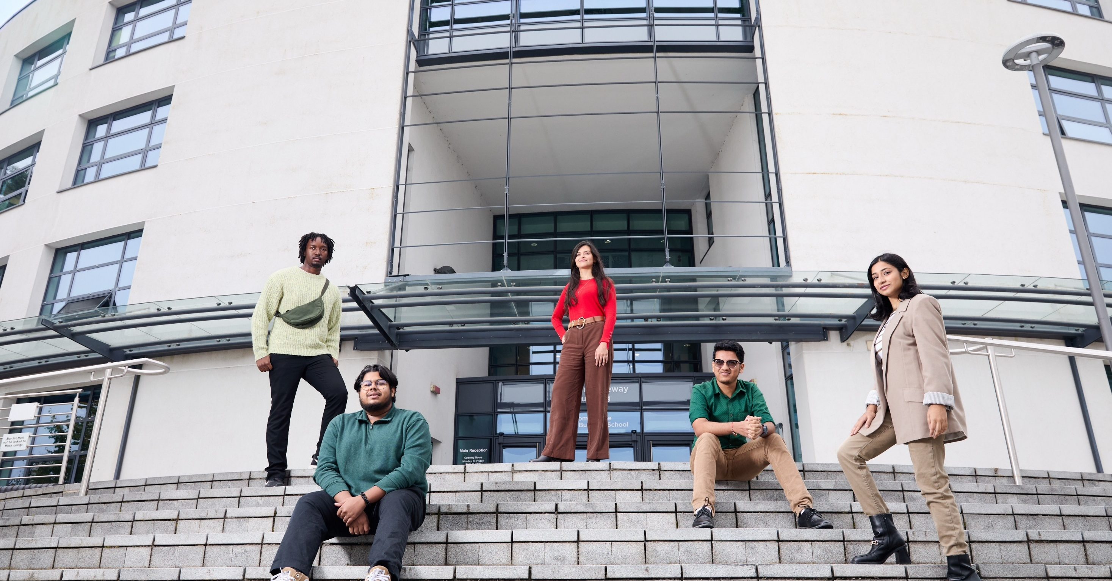



Book your Open Day
or Campus Tour now.
brunel.ac.uk/study/open-days

Slide 7
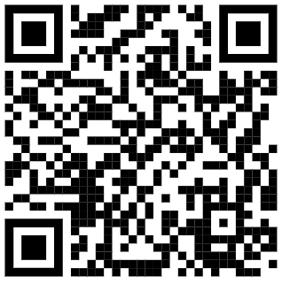
INSERT QR CODE

Slide 8
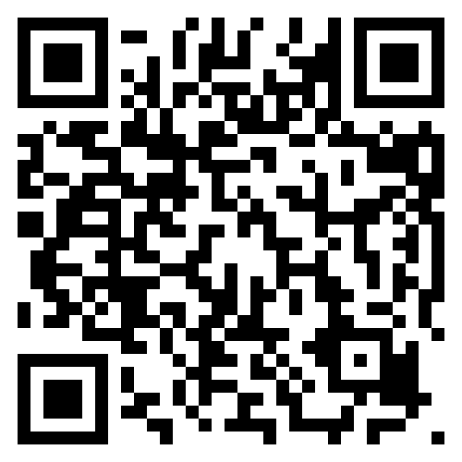
Open Days
  Saturday 4th July 2026
  Saturday 3rd October 2026
  Saturday 28th November 2026
Book here:
www.aston.ac.uk/open-days

Slide 9


Slide 10


Slide 11


Slide 12


Slide 13
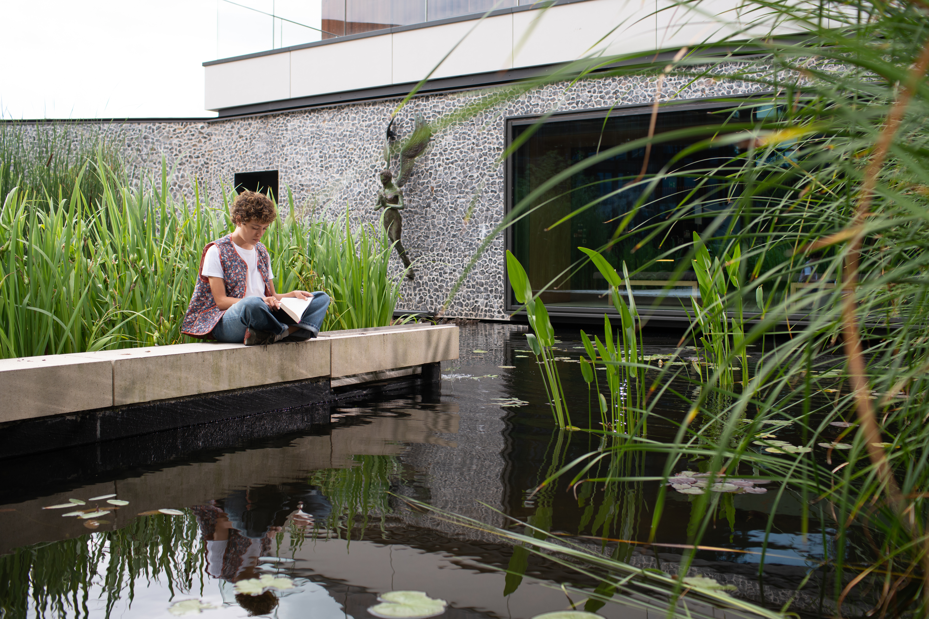
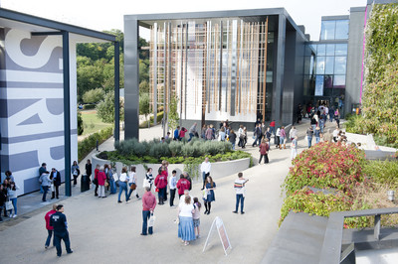
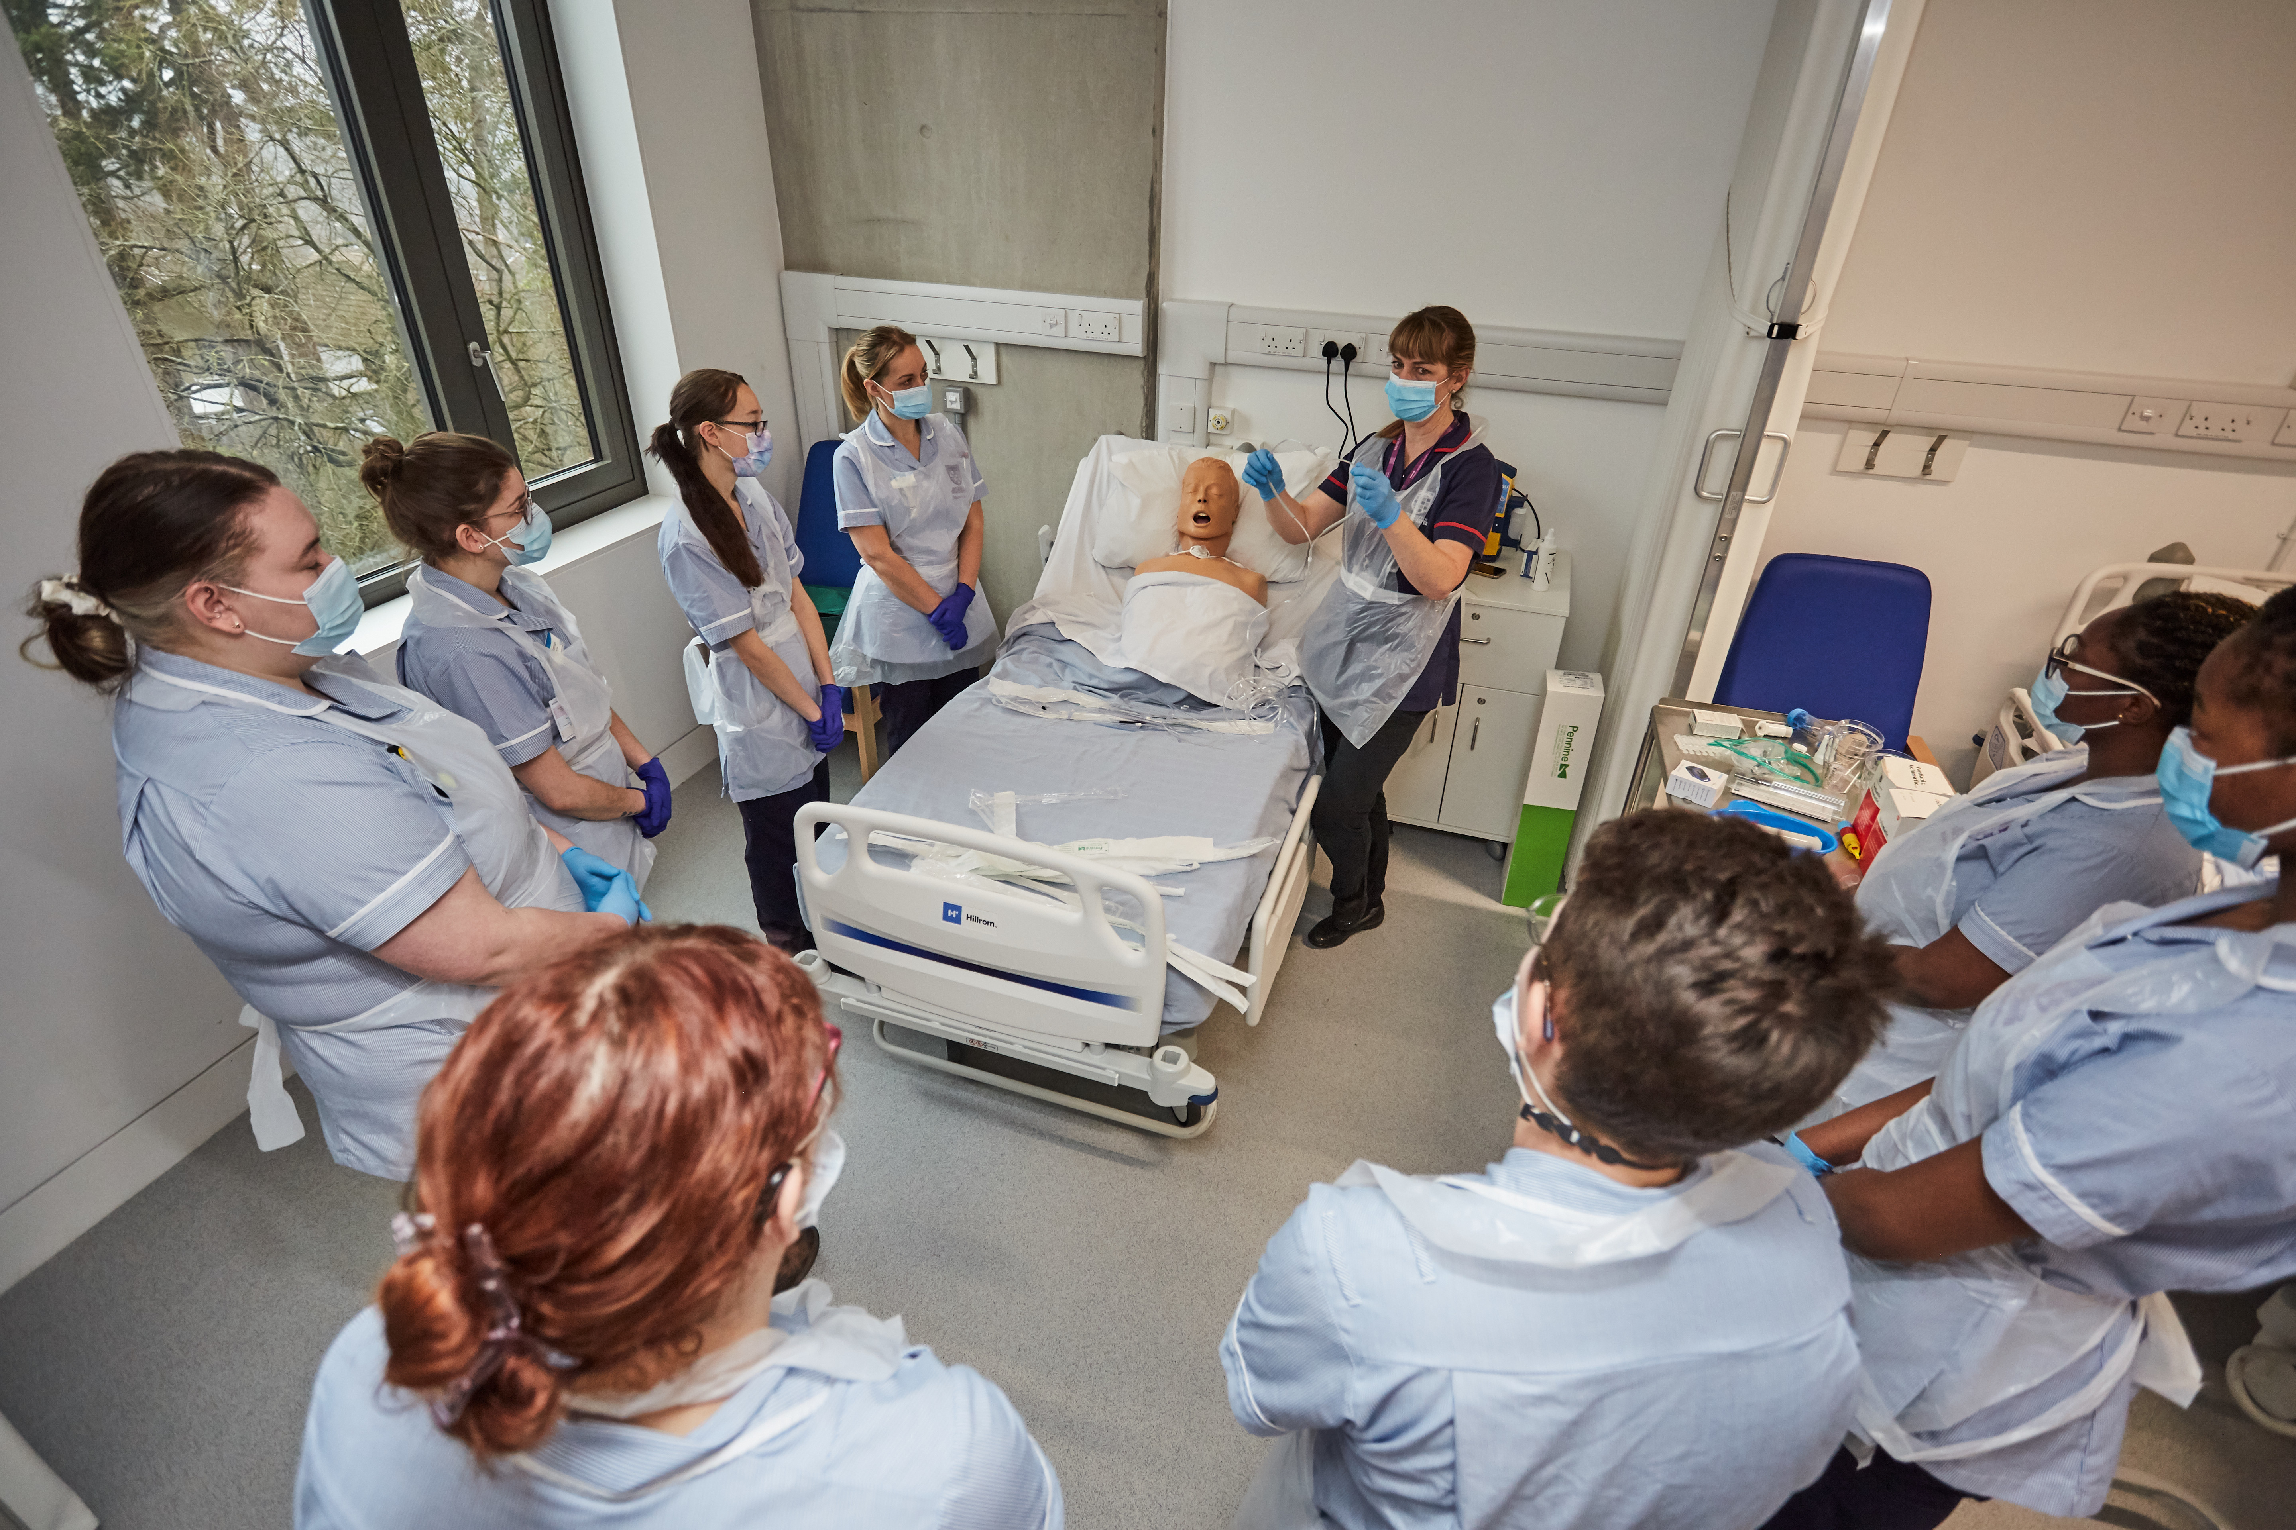
Visit Winchester!
Our Open Days and Campus Tours are a great opportunity to see our beautiful campus, take a tour of our stunning accommodation, and meet staff and students from the course you are looking to study.
Find out more at winchester.ac.uk/study/visit-us

Slide 14


Slide 15


Slide 16


