Slide 1


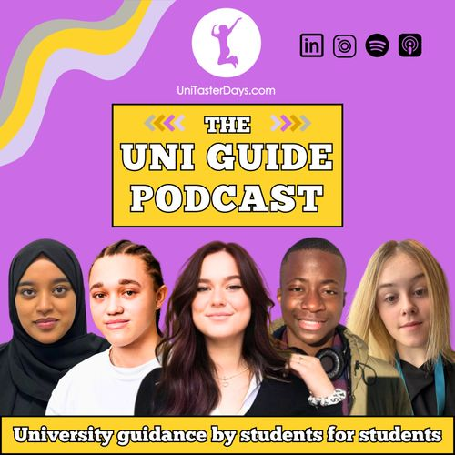
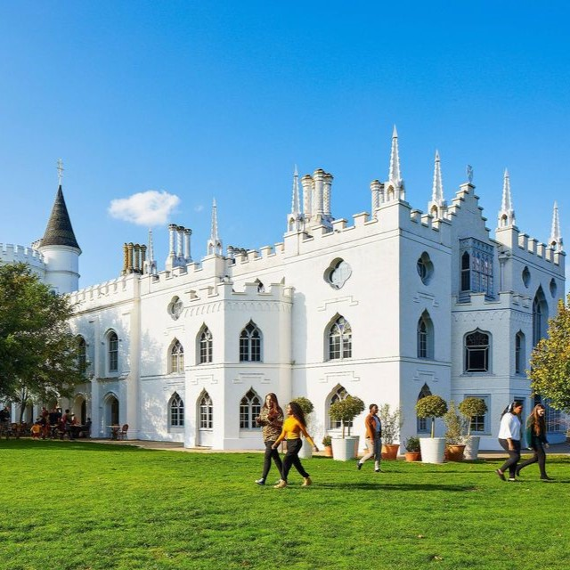

New Guides and Podcasts
UniTasterDays.com/Students

Slide 2
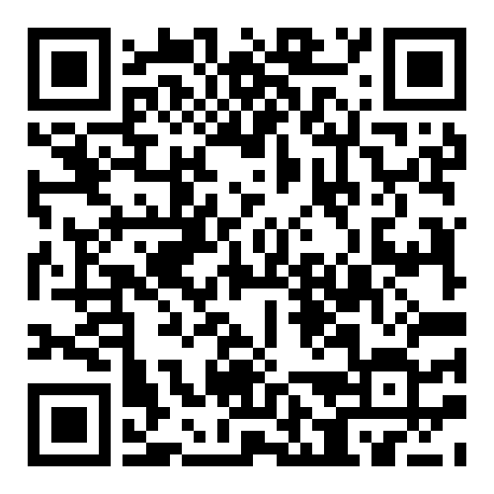
Join us for our upcoming Open Days!

Slide 3
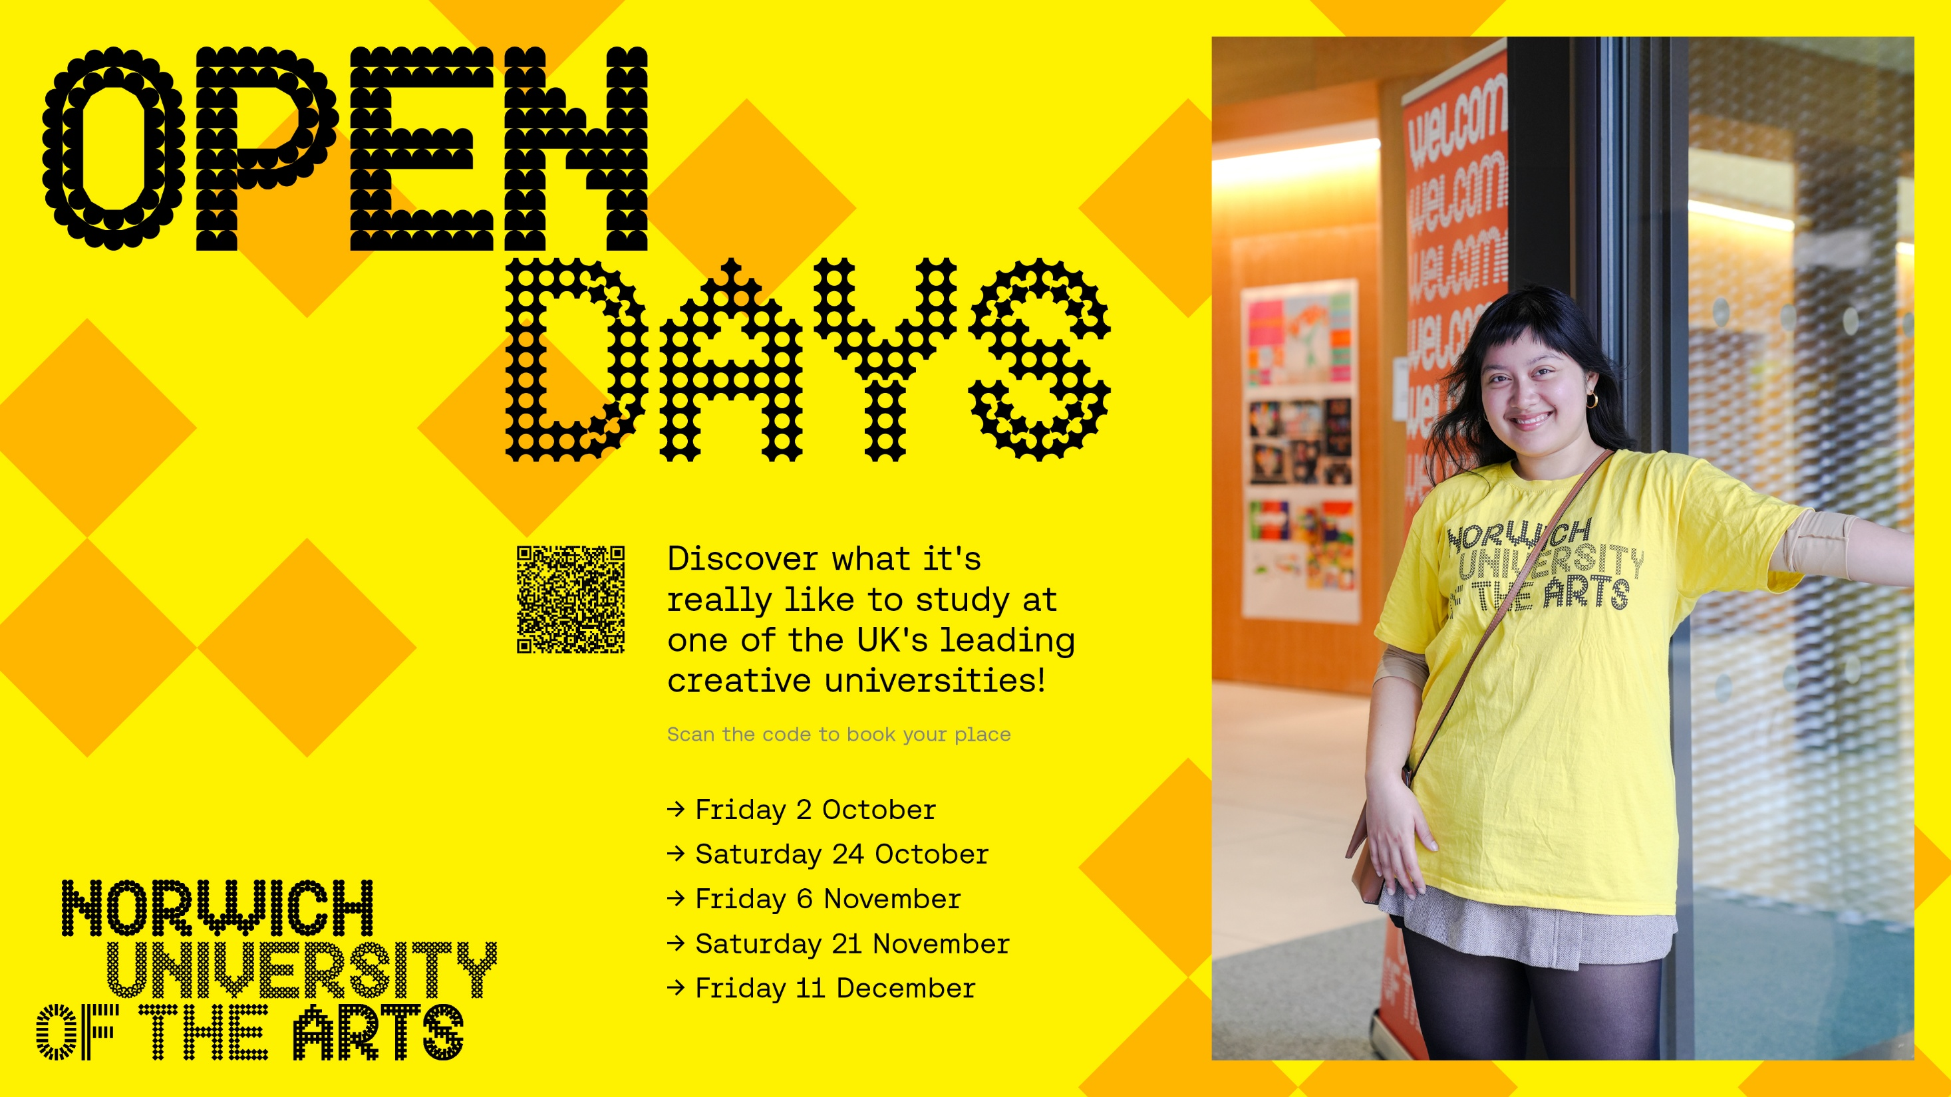

Slide 4
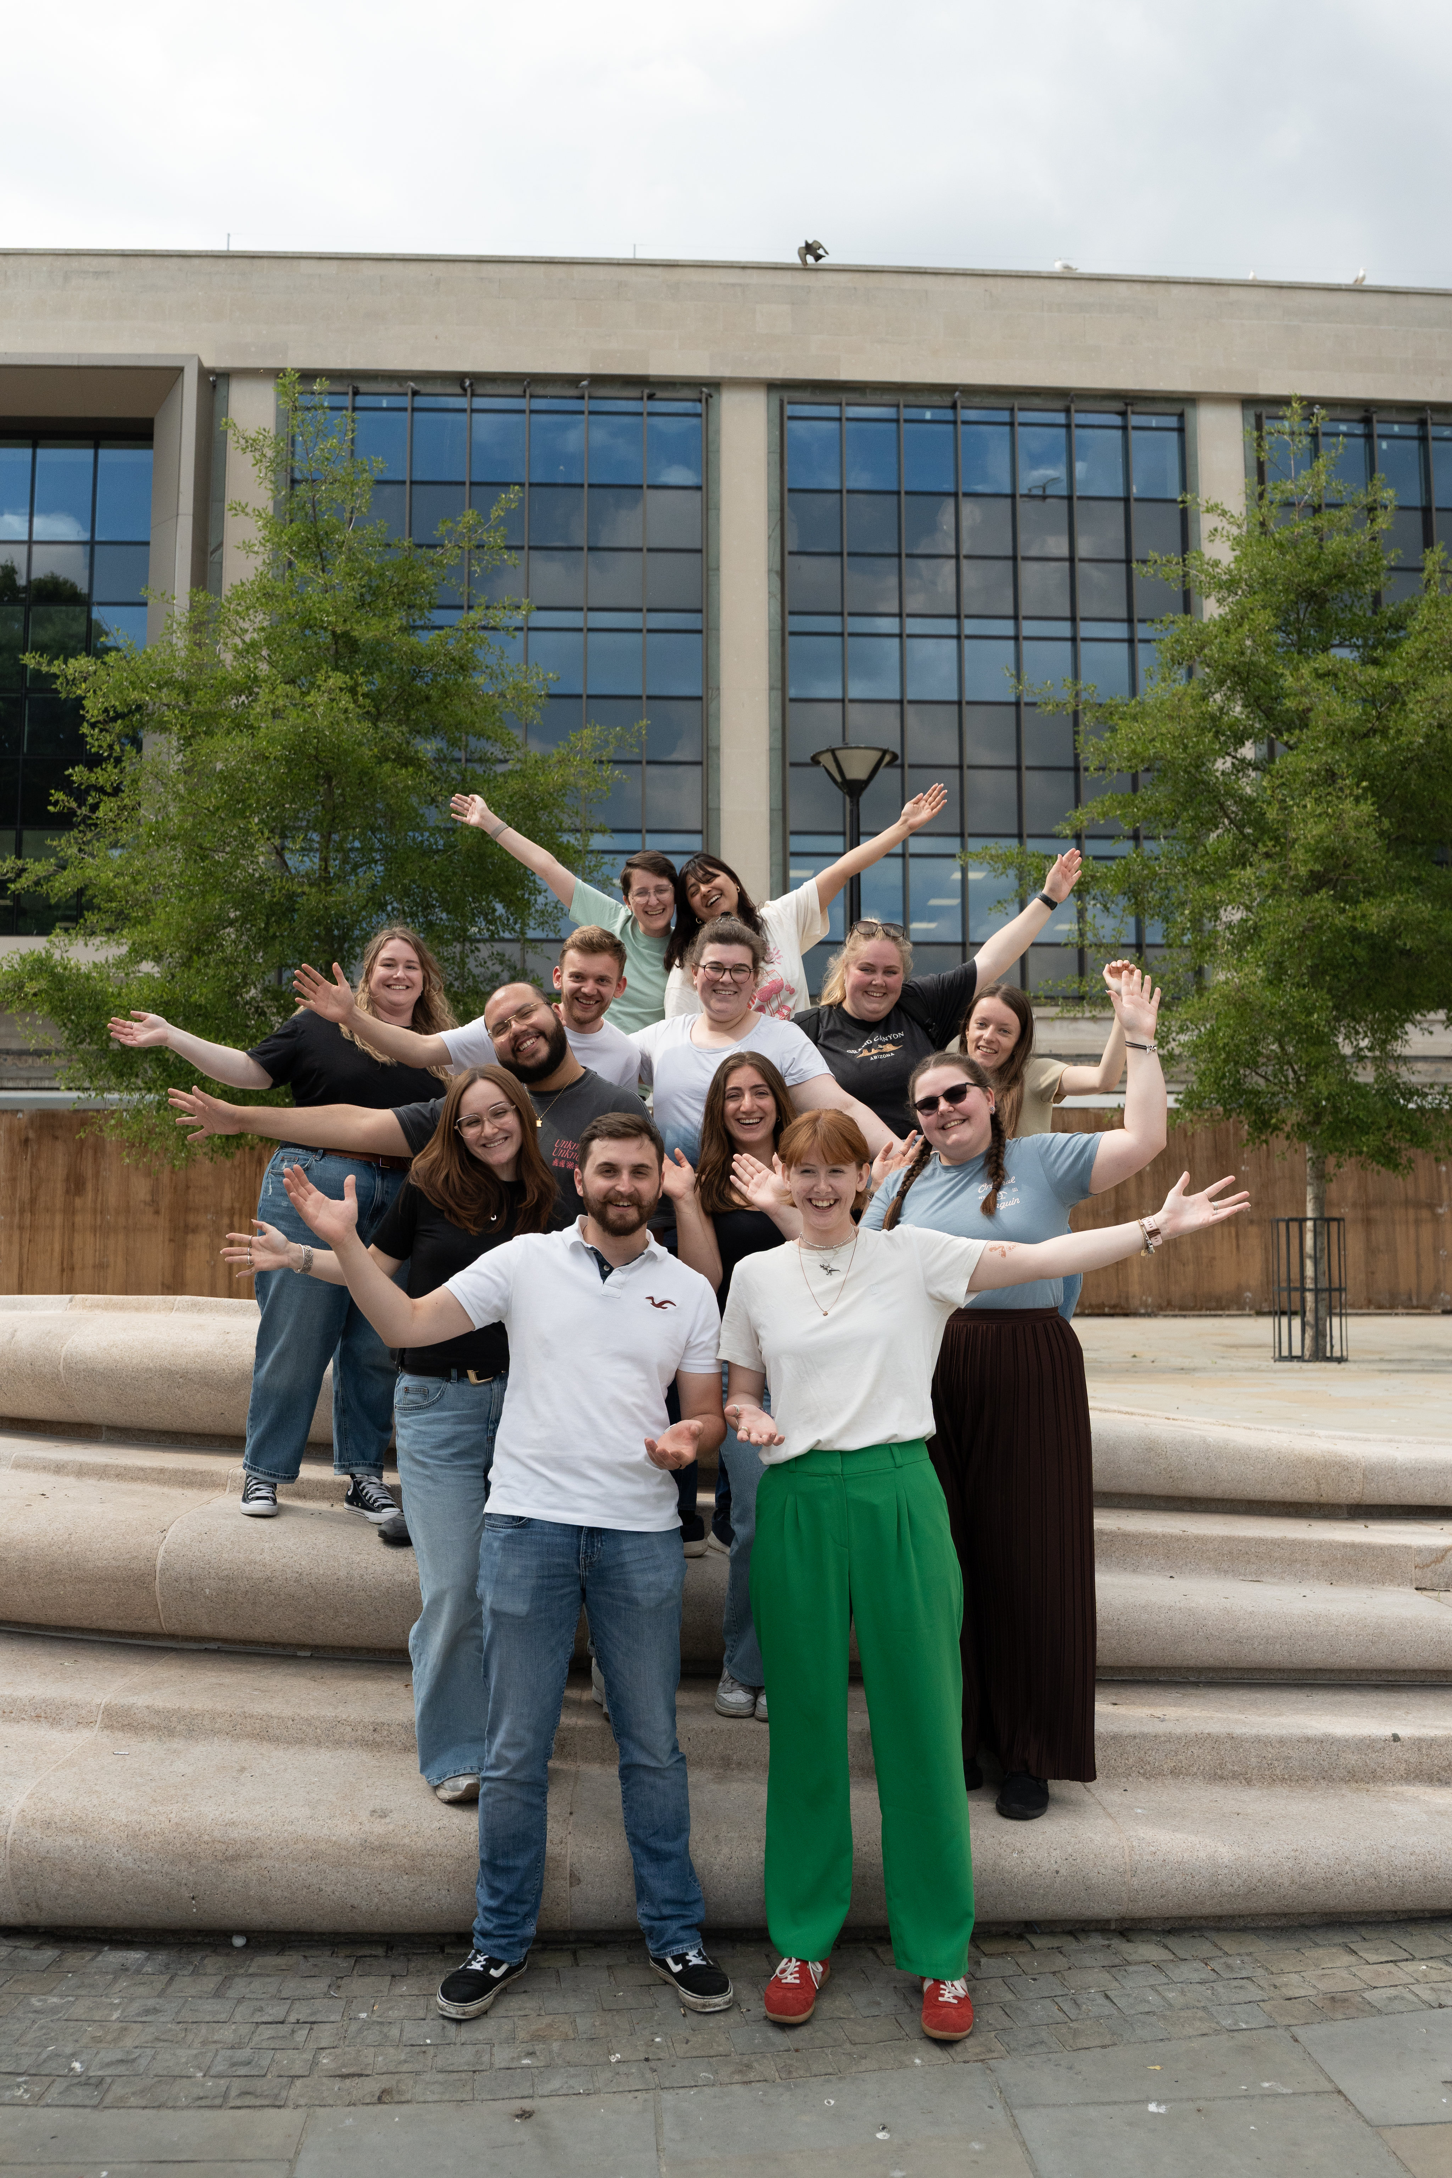
FREE SUBJECT TASTER DAYS
Great experience for Personal Statements
Take part in subject taster sessions, hear from experts, talk to current students and explore our campuses.
Travel funding available.
30 September Criminology Taster Day
7 October Sports Taster Day
9 October Music & Media Taster Day
21 October Architecture Taster Day
21 October Law Taster Day
4 November Creative Connections Festival
4 November Performing Arts Masterclass Day
10 November Education Taster Day
11 November Geography & Biosciences Taster Day
11 November Accounting & Finance Taster Day
BOOK www.glos.ac.uk/outreach

Slide 5



Slide 7


Slide 8
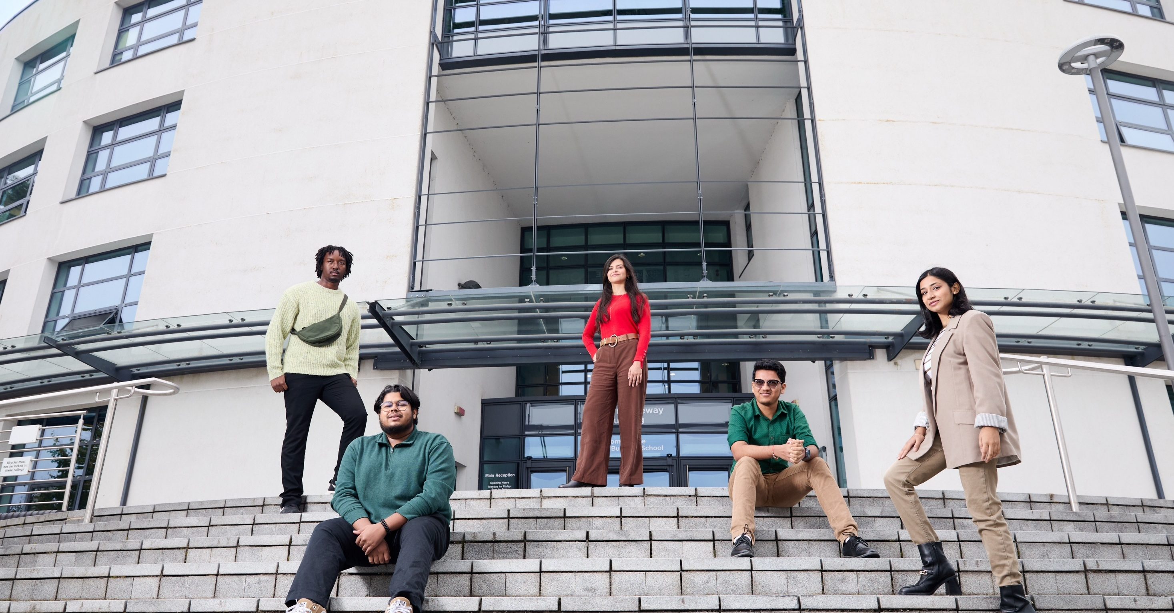


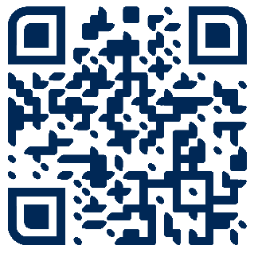
Book your Open Day
or Campus Tour now.
brunel.ac.uk/study/open-days

Slide 9
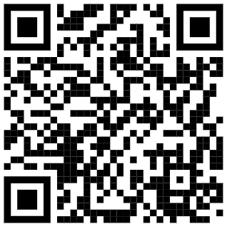
INSERT QR CODE

Slide 10


Slide 11


Slide 12


Slide 13


Slide 14
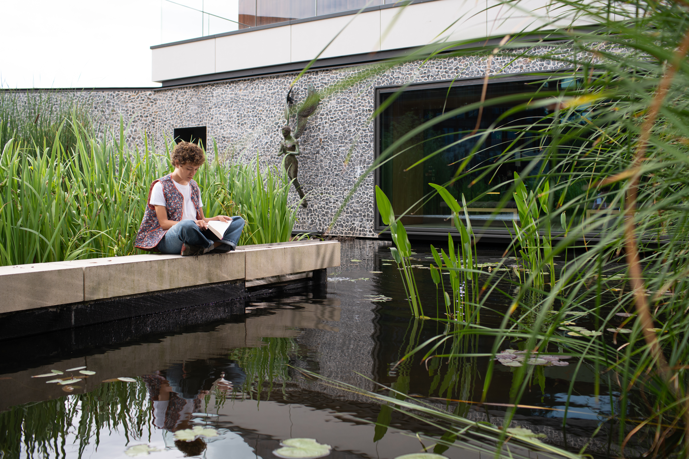
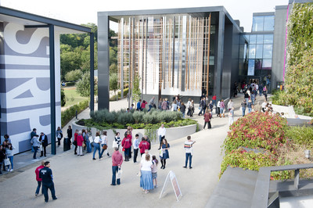
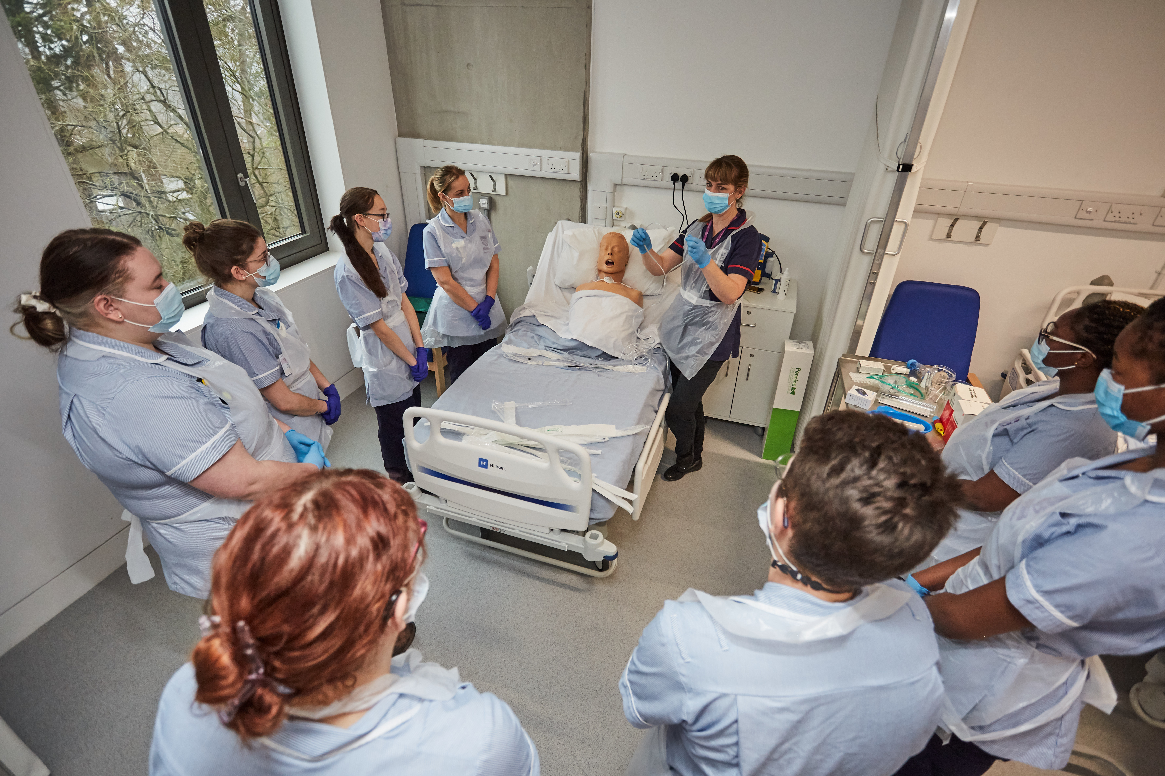
Visit Winchester!
Our Open Days and Campus Tours are a great opportunity to see our beautiful campus, take a tour of our stunning accommodation, and meet staff and students from the course you are looking to study.
Find out more at winchester.ac.uk/study/visit-us

Slide 15


Slide 16


Slide 17


Slide 18
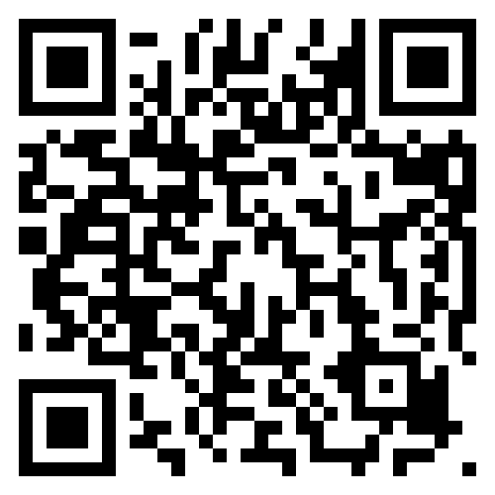
Open Days
  Saturday 3rd October 2026
  Saturday 28th November 2026
Book here:
www.aston.ac.uk/open-days

Slide 19
