Slide 1
New Guides and Podcasts
UniTasterDays.com/Students

Slide 6
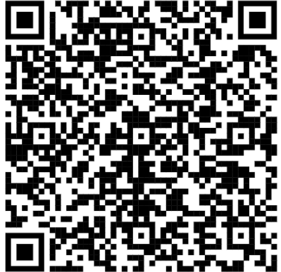
Masterclass Webinars
16th – 19th November 2026
Register Now

Slide 7
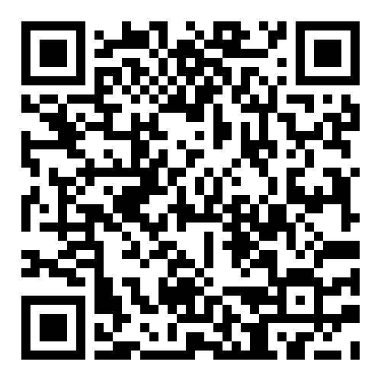
Join us for our upcoming Open Days!

Slide 9
FREE SUBJECT TASTER DAYS
Great experience for Personal Statements
Take part in subject taster sessions, hear from experts, talk to current students and explore our campuses.
Travel funding available.
9 October Music & Media Taster Day
21 October Architecture Taster Day
21 October Law Taster Day
4 November Performing Arts Masterclass Day
10 November Education Taster Day
11 November Geography & Biosciences Taster Day
11 November Accounting & Finance Taster Day
11 November Cyber & Computing Taster Day
18 November Psychology Taster Day
25 November Marketing Taster Day
27 November Health & Social Care Taster Day
BOOK www.glos.ac.uk/outreach

Slide 11


Slide 14

Book your Open Day
or Campus Tour now.
brunel.ac.uk/study/open-days

Slide 15
INSERT QR CODE

Slide 20
Visit Winchester!
Our Open Days and Campus Tours are a great opportunity to see our beautiful campus, take a tour of our stunning accommodation, and meet staff and students from the course you are looking to study.
Find out more at winchester.ac.uk/study/visit-us

Slide 23
Open Days
  Saturday 3rd October 2026
  Saturday 28th November 2026
Book here:
www.aston.ac.uk/open-days

