Slide 1



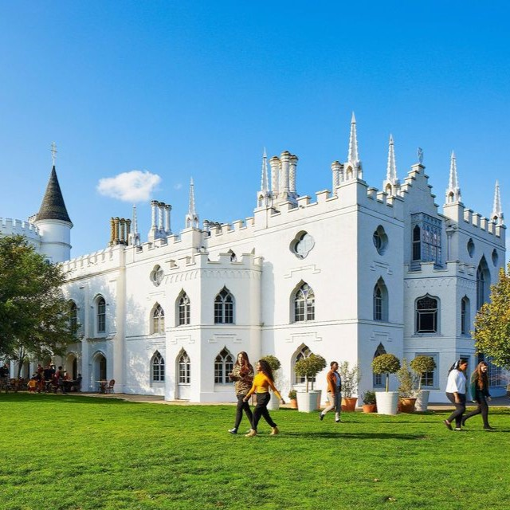

New Guides and Podcasts
UniTasterDays.com/Students

Slide 2


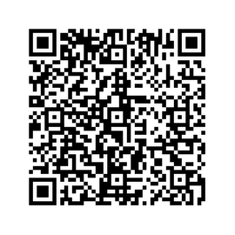
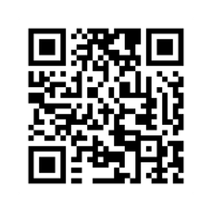
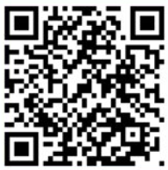

Stay in touch with us...
Your Open Day visit awaits
See it - feel it - find your place
Drop us an email
Your future begins at Summer School
Study@swansea.ac.uk
Your Summer, upgraded - get ahead and stand out

Slide 3


Slide 4


Slide 5
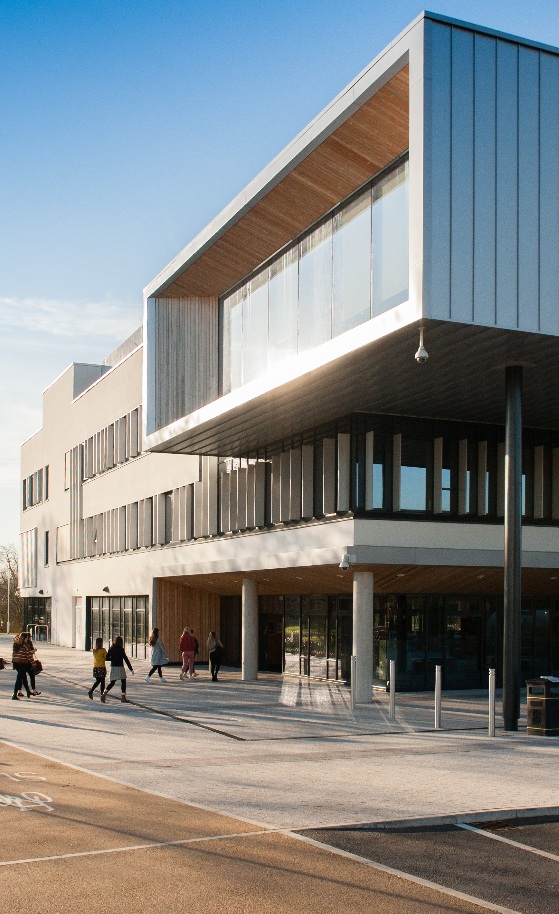

Connect Higher
Friday 12th June 10am – 2:30pm
Suitable for Years 12s (or equivalent)
Oxstalls Campus, Gloucester & Park Campus, Cheltenham
This event is all about supporting students to connect with higher education. The open day style experience means students choose from a range of sessions that best support their interests and progression needs.
Campus Tours with Student Ambassadors
Student Life Talks & Live Q&A
Subject Tasters and Workshops with Academic Staff
University Information Sessions
  University Essentials
  Personal Statement Top Tips
  Affording University Life
  Choosing your University and Course
*CPD and Networking opportunity for staff accompanying students
Book via the website or by emailing outreach@glos.ac.uk

Slide 6


Slide 7


Slide 8


Slide 9
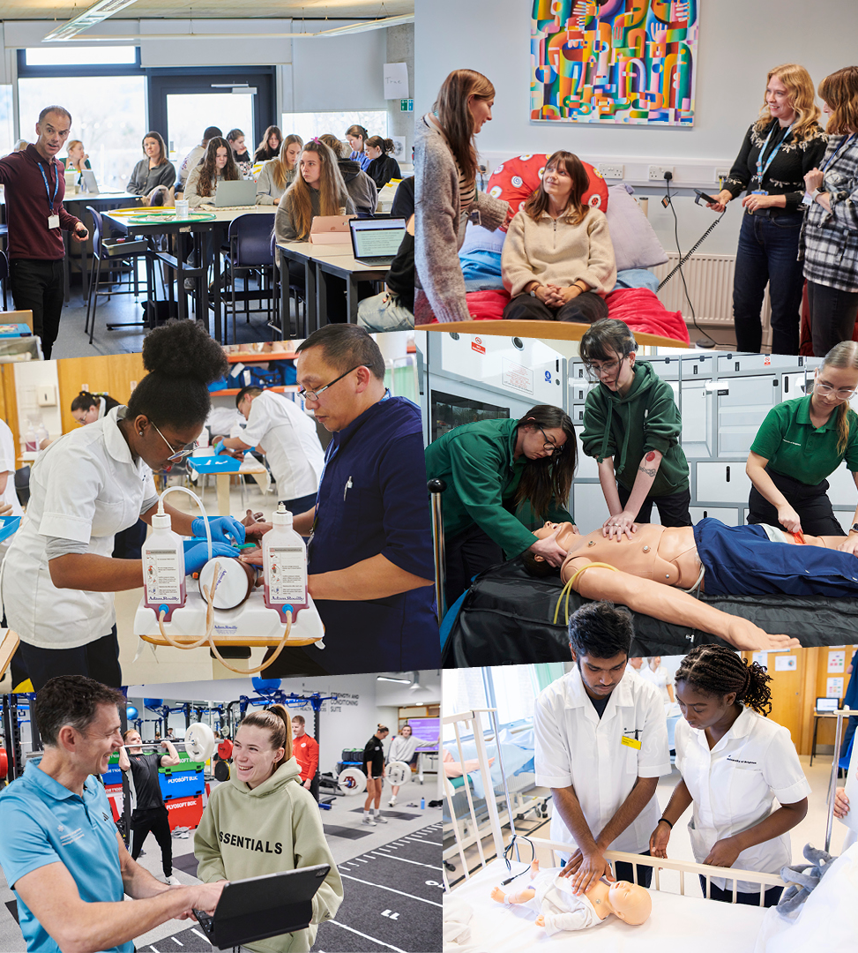

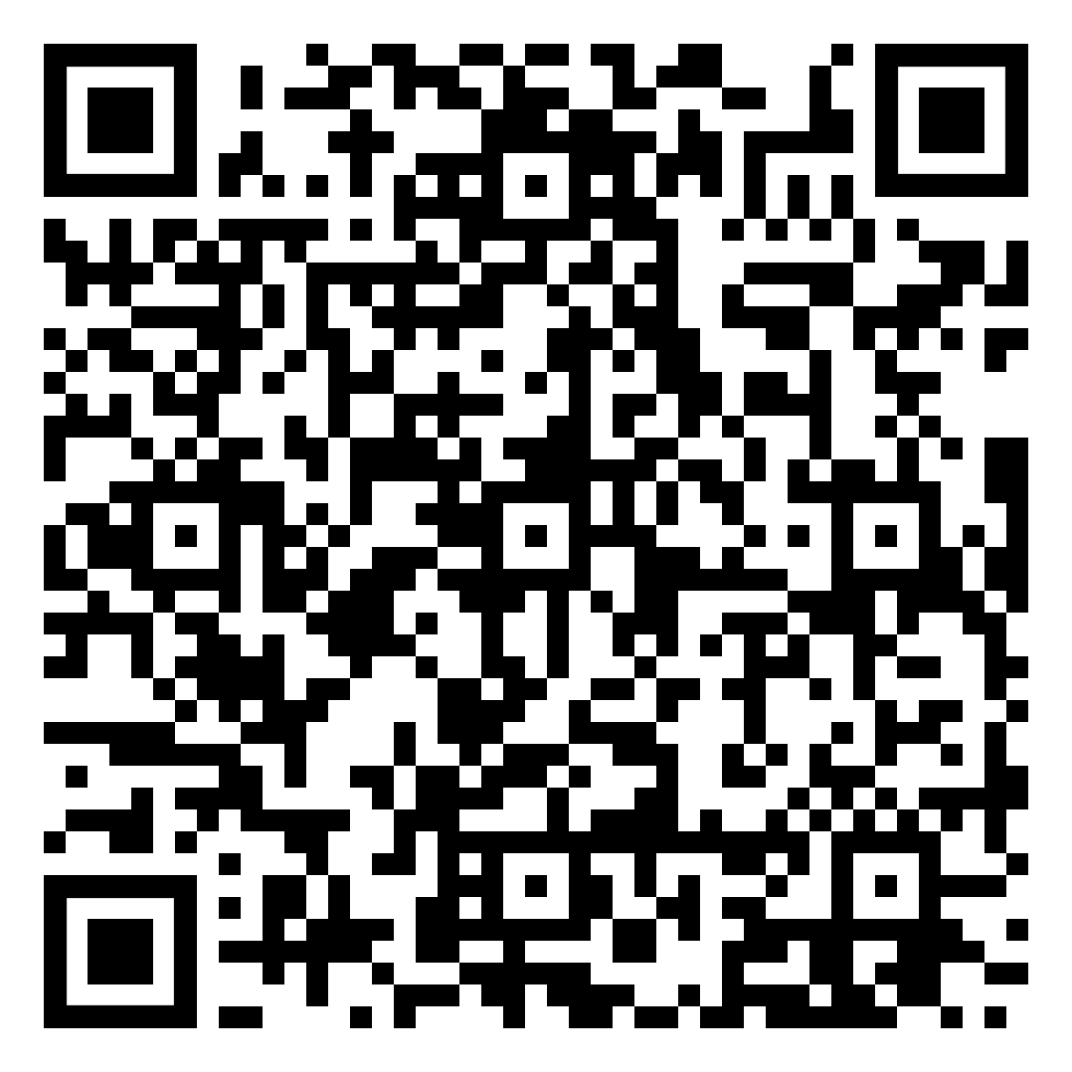

Online subject taster events at the University of Brighton
Want to see what university subjects are really like? Book your place on an online taster session and explore exciting topics with our academics.
+ Psychology
+ Pharmacy
+ Media
+ Podiatry and Physiotherapy
+ Product Design/Design Engineering
+ Space Law
+ Geography and the environment
+ Politics and Philosophy
+ Midwifery
+ Business and Marketing
+ Architecture

Slide 10
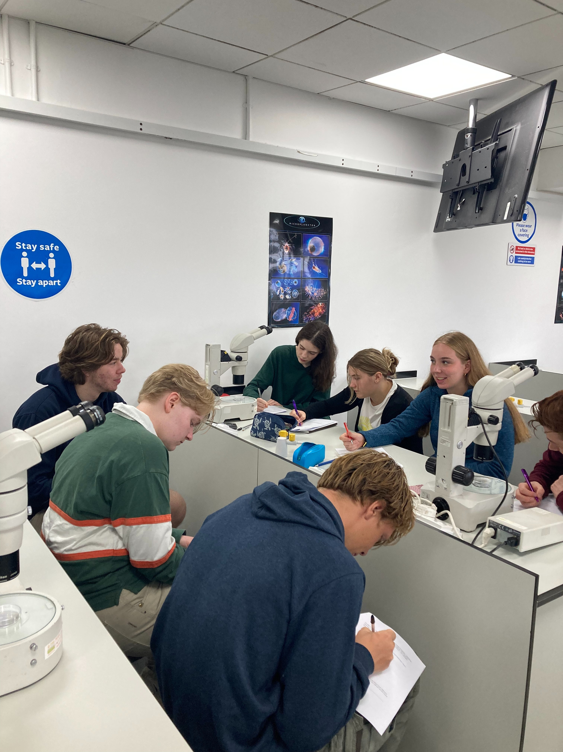
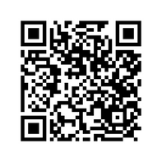



Apply for Industrial Cadets Silver
Insight into University Experiences
Explore STEM degree subjects at leading universities throughout the UK during our range of summer schools run over 4 or 5 days.
Non-residential courses for Yr 11
Non-residential courses for Yr 12
Residential courses for Yr12/S5-6
EDT (The Engineering Development Trust)
The EDT UK
@industrialcadets
@TheEDTUK
For more information on Industrial Cadets Silver Insight into University experiences, please visit our website here or scan the QR code above.

Slide 11
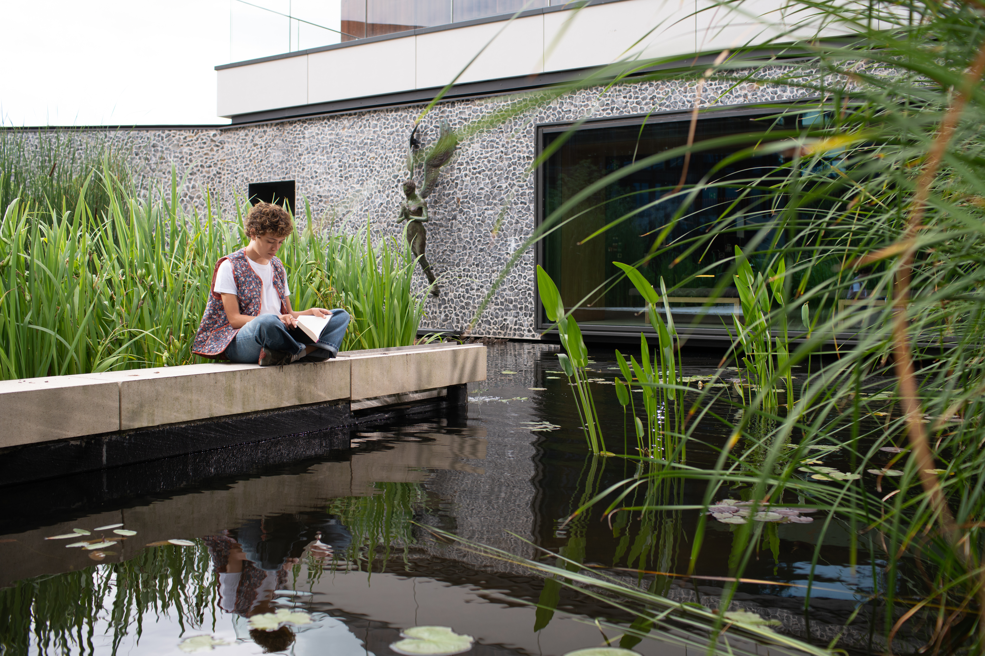
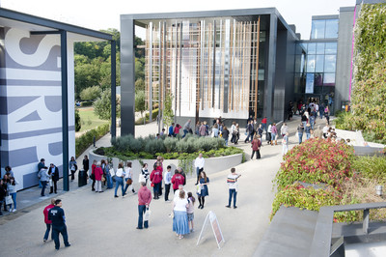
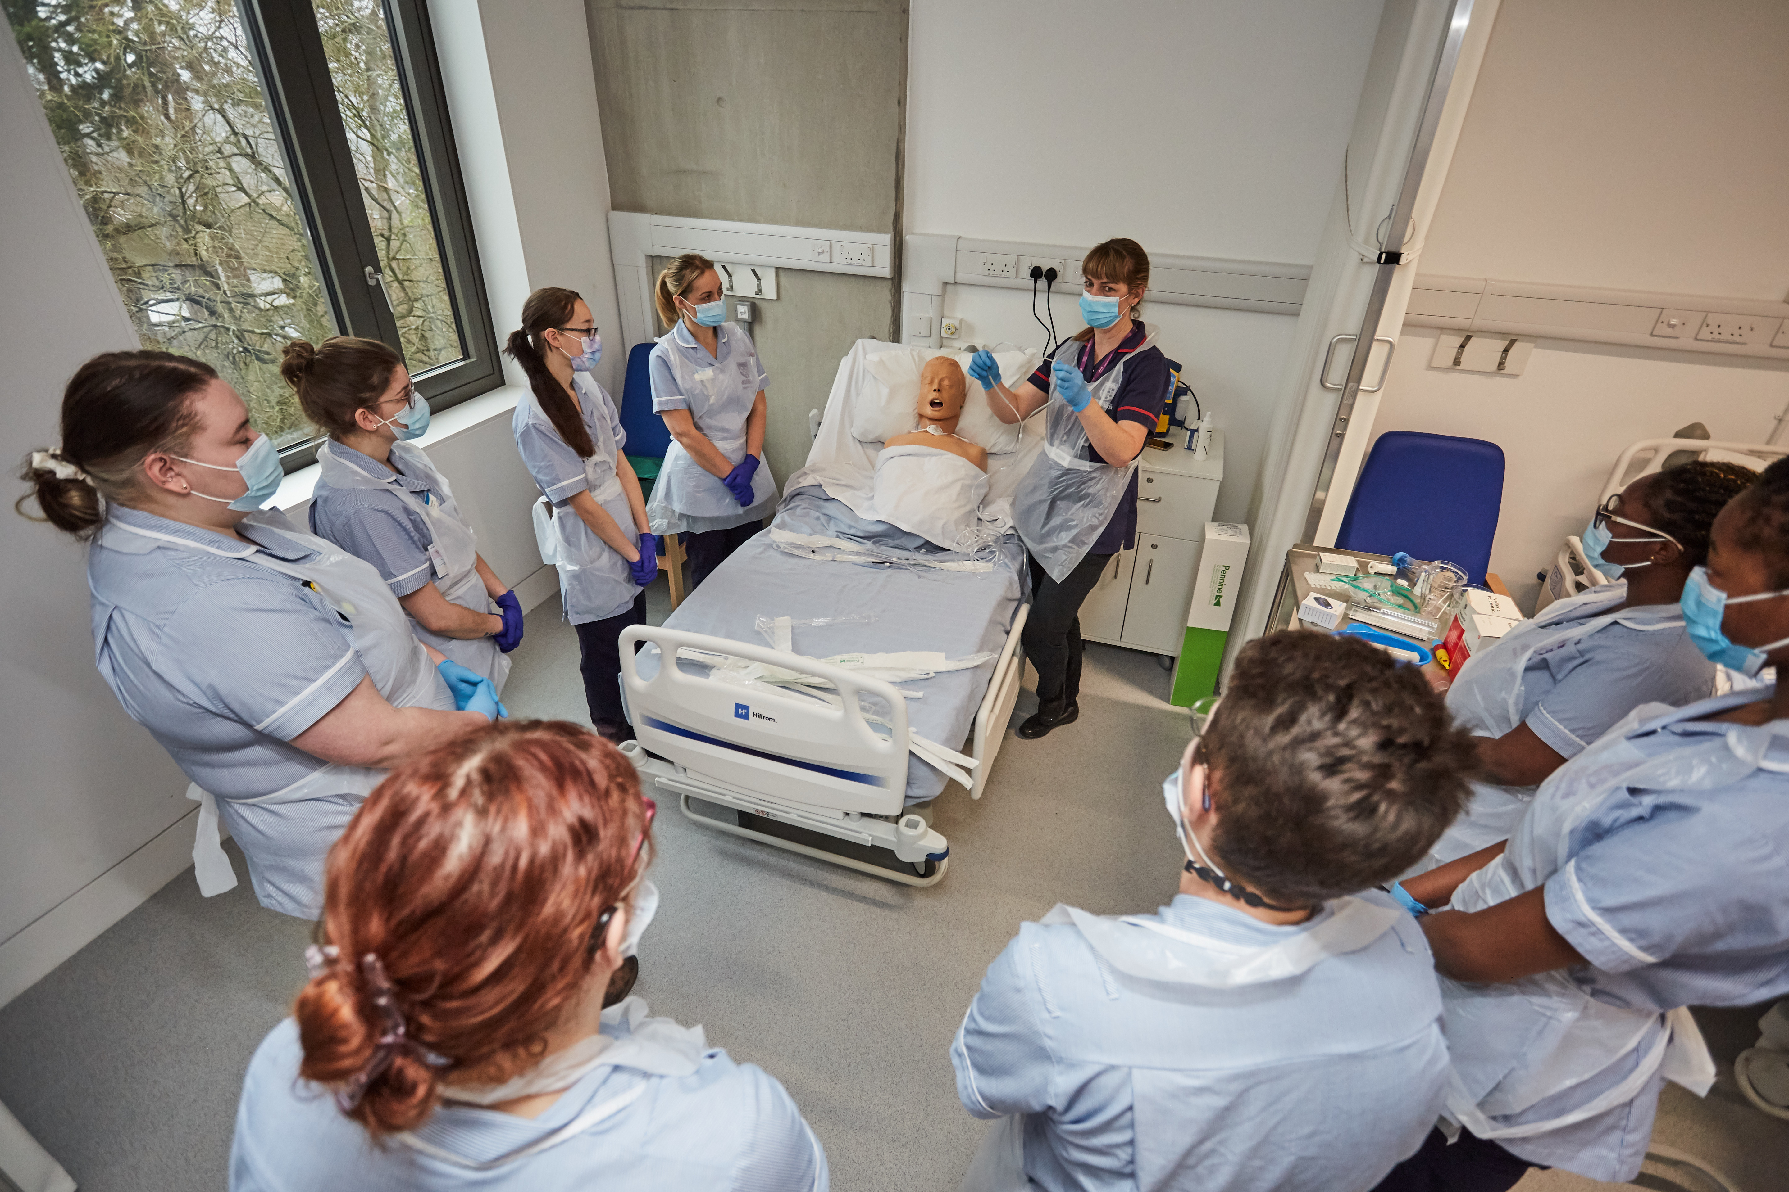
Visit Winchester!
Our Open Days and Campus Tours are a great opportunity to see our beautiful campus, take a tour of our stunning accommodation, and meet staff and students from the course you are looking to study.
Find out more at winchester.ac.uk/study/visit-us

Slide 12


Slide 13


Slide 14


