Slide 1



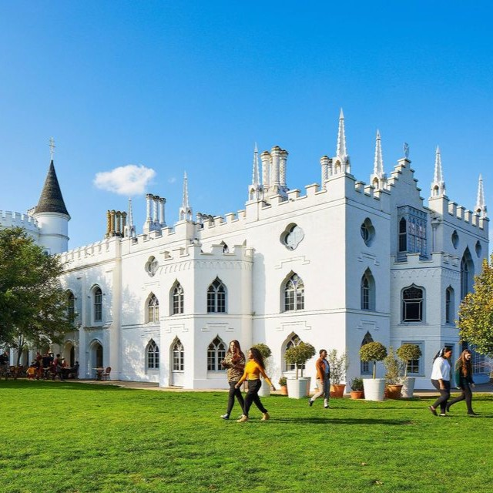

New Guides and Podcasts
UniTasterDays.com/Students

Slide 2
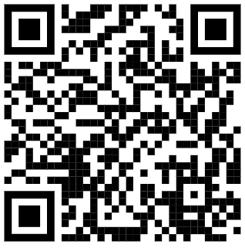
INSERT QR CODE

Slide 3
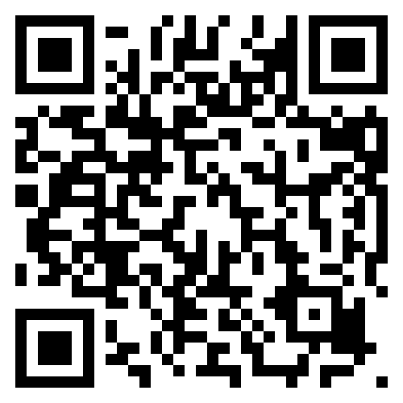
Open Days
  Saturday 4th July 2026
  Saturday 3rd October 2026
  Saturday 28th November 2026
Book here:
www.aston.ac.uk/open-days

Slide 4

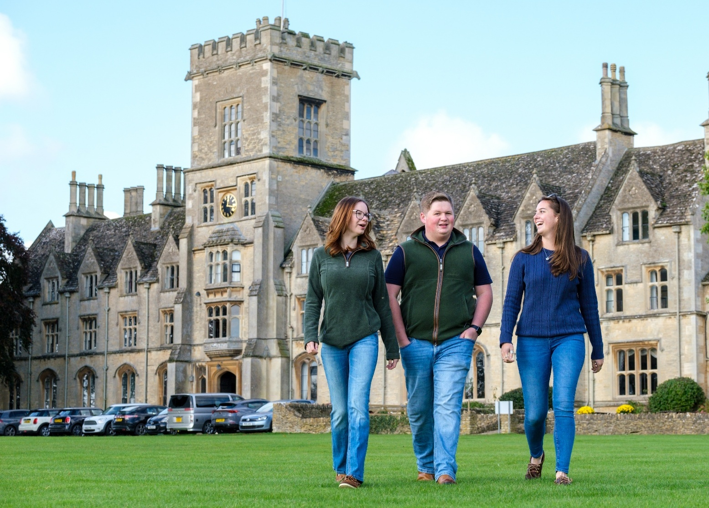
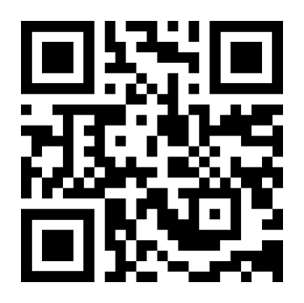
Come and see us!
Undergraduate Open Day – Wednesday 1 July (10:00am – 3:00pm)
Scan to find out more
and book your place!

Slide 5


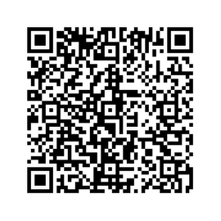
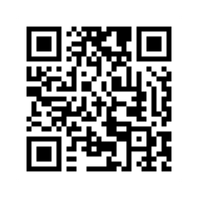
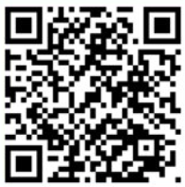

Stay in touch with us...
Your Open Day visit awaits
See it - feel it - find your place
Drop us an email
Your future begins at Summer School
Study@swansea.ac.uk
Your Summer, upgraded - get ahead and stand out

Slide 6


Slide 7


Slide 8


Slide 9


Slide 10


Slide 11
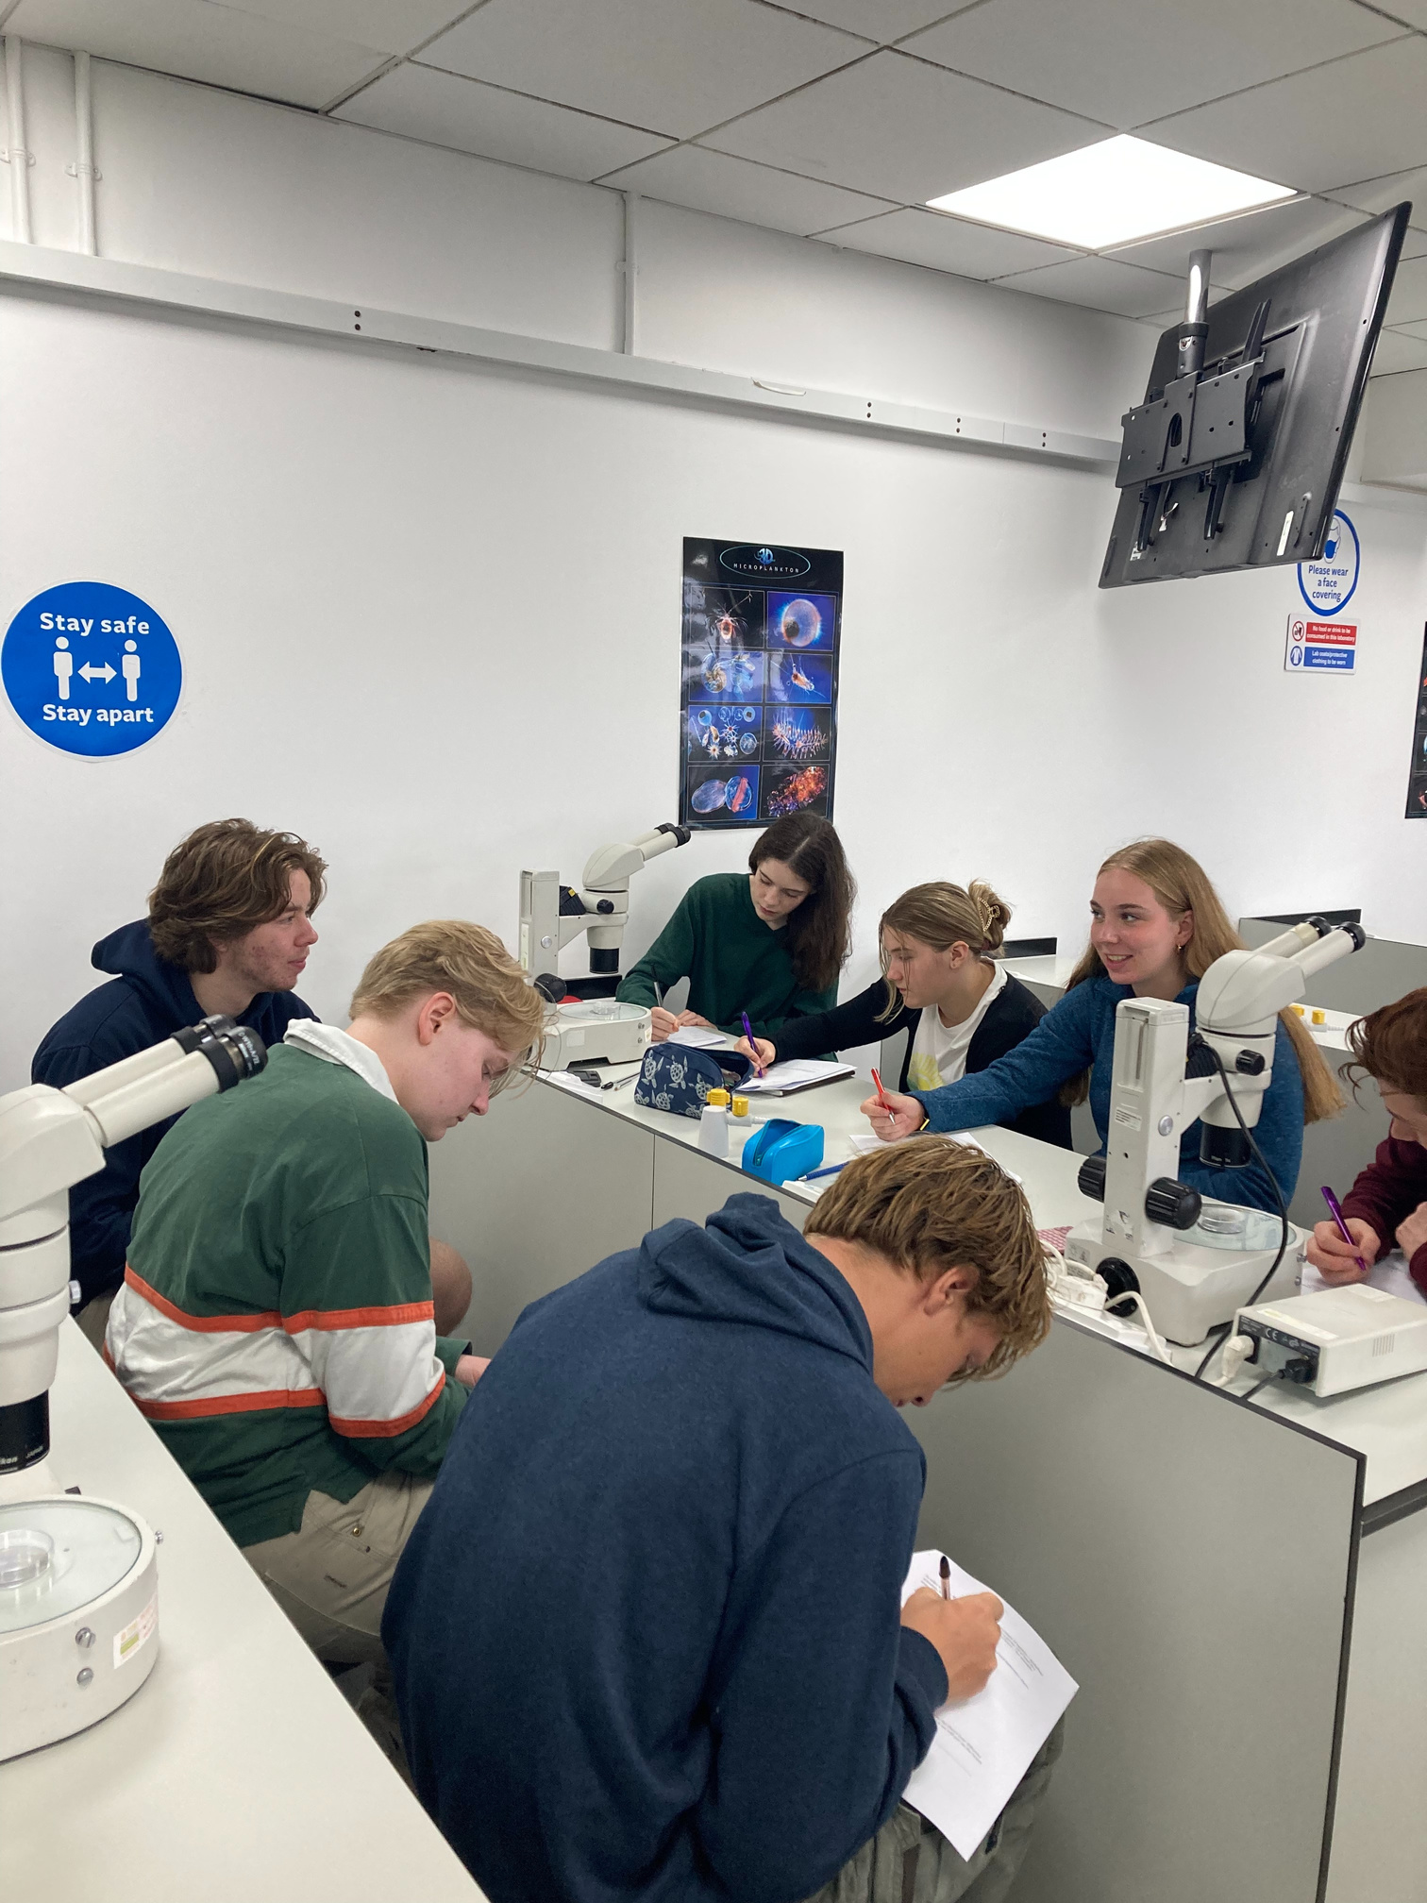
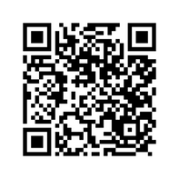



Apply for Industrial Cadets Silver
Insight into University Experiences
Explore STEM degree subjects at leading universities throughout the UK during our range of summer schools run over 4 or 5 days.
Non-residential courses for Yr 11
Non-residential courses for Yr 12
Residential courses for Yr12/S5-6
EDT (The Engineering Development Trust)
The EDT UK
@industrialcadets
@TheEDTUK
For more information on Industrial Cadets Silver Insight into University experiences, please visit our website here or scan the QR code above.

Slide 12
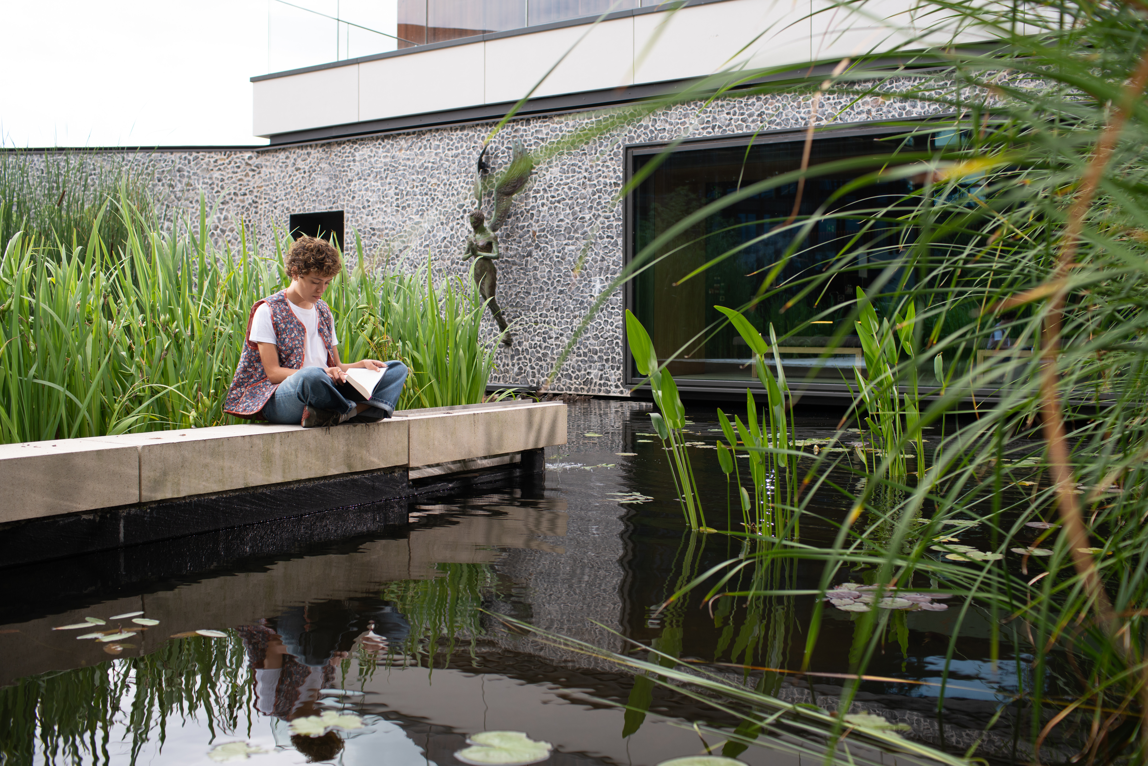
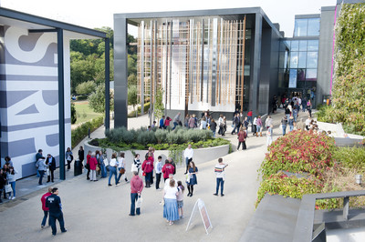
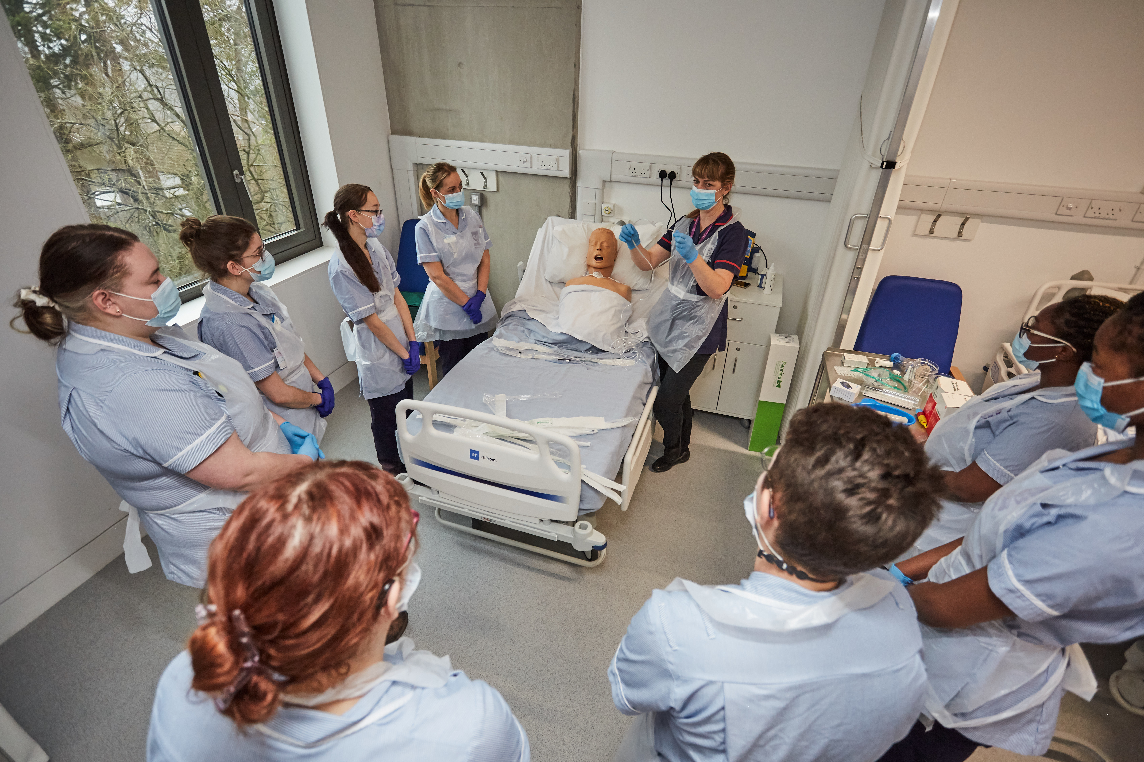
Visit Winchester!
Our Open Days and Campus Tours are a great opportunity to see our beautiful campus, take a tour of our stunning accommodation, and meet staff and students from the course you are looking to study.
Find out more at winchester.ac.uk/study/visit-us

Slide 13


Slide 14


Slide 15


