Slide 1
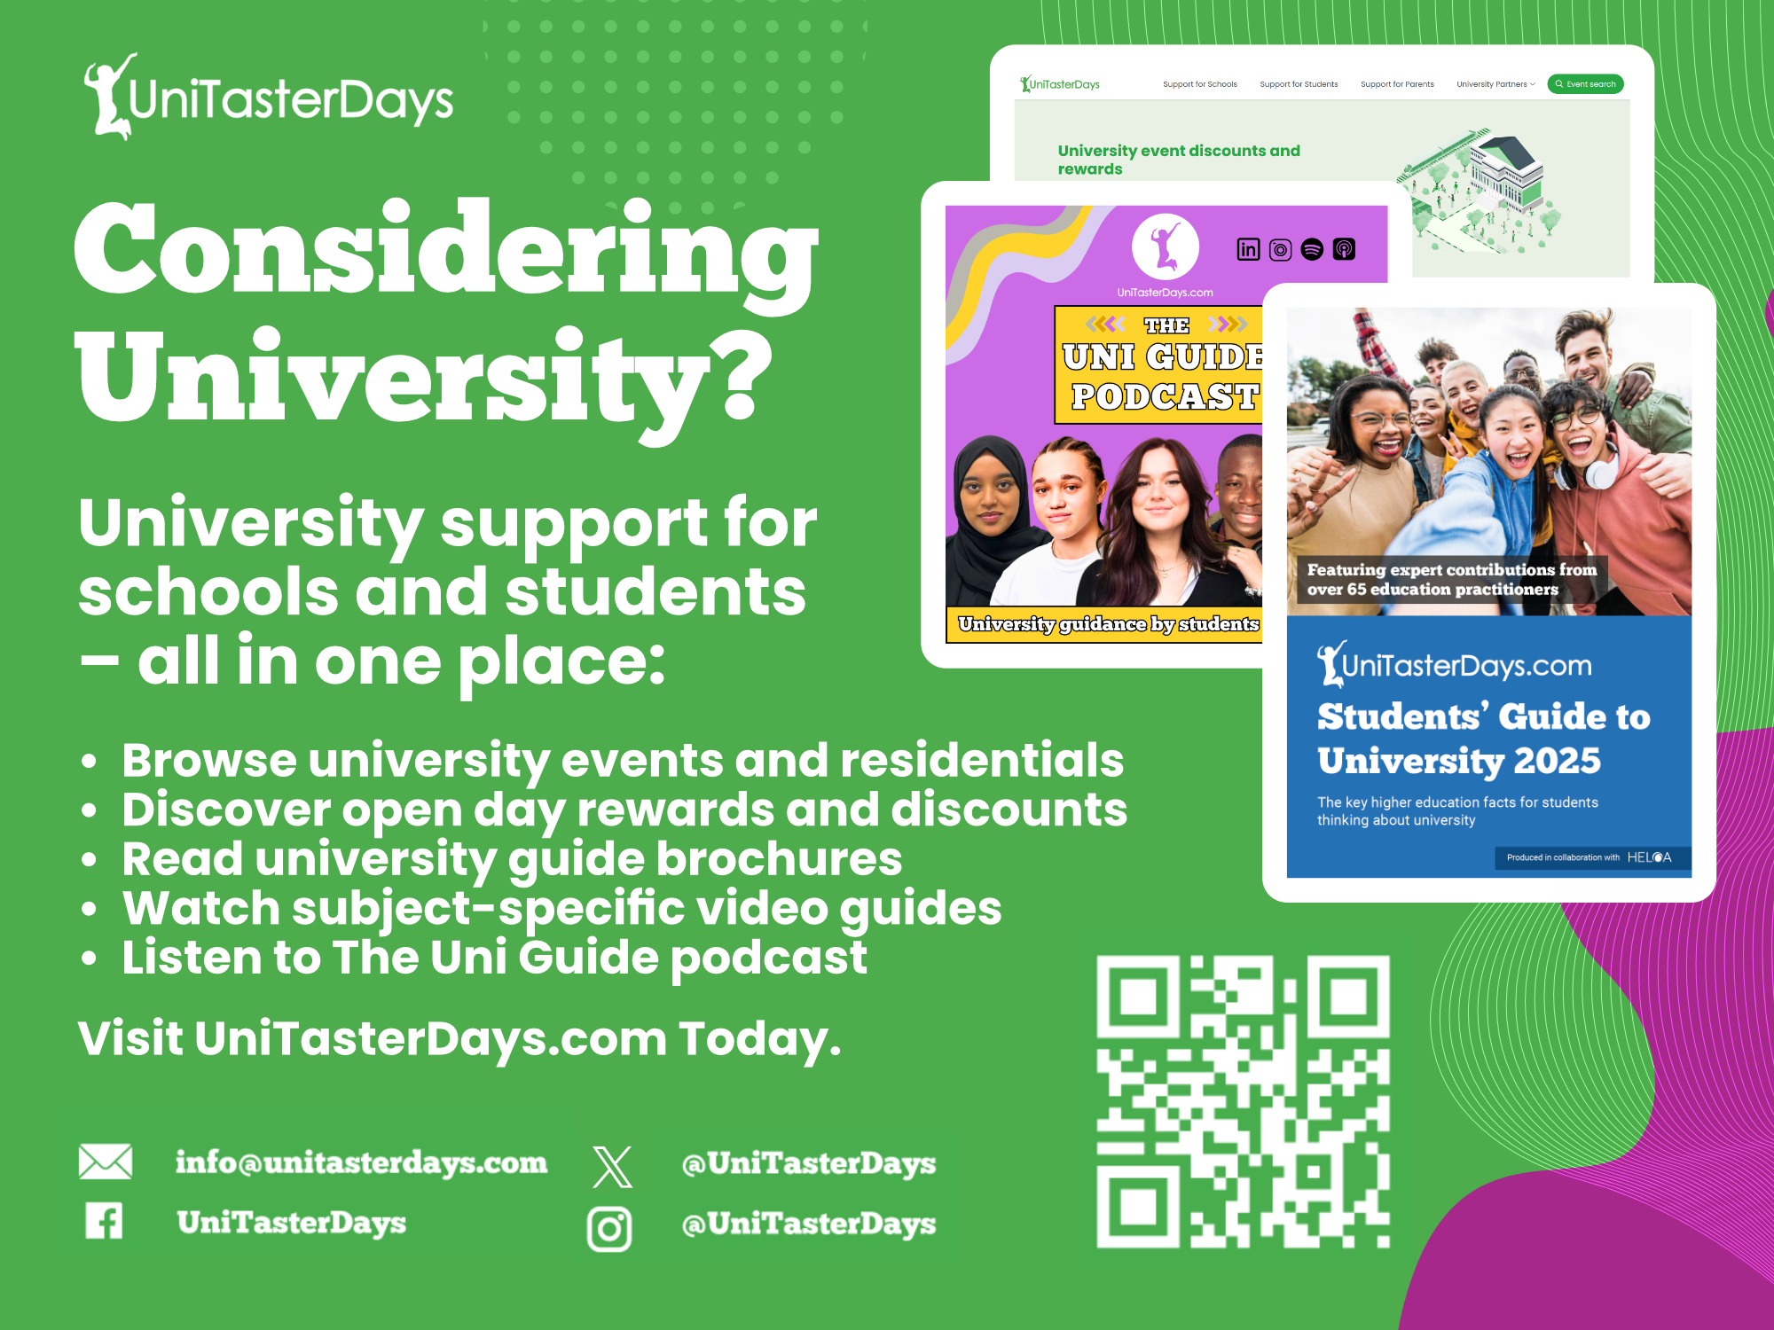


Slide 2
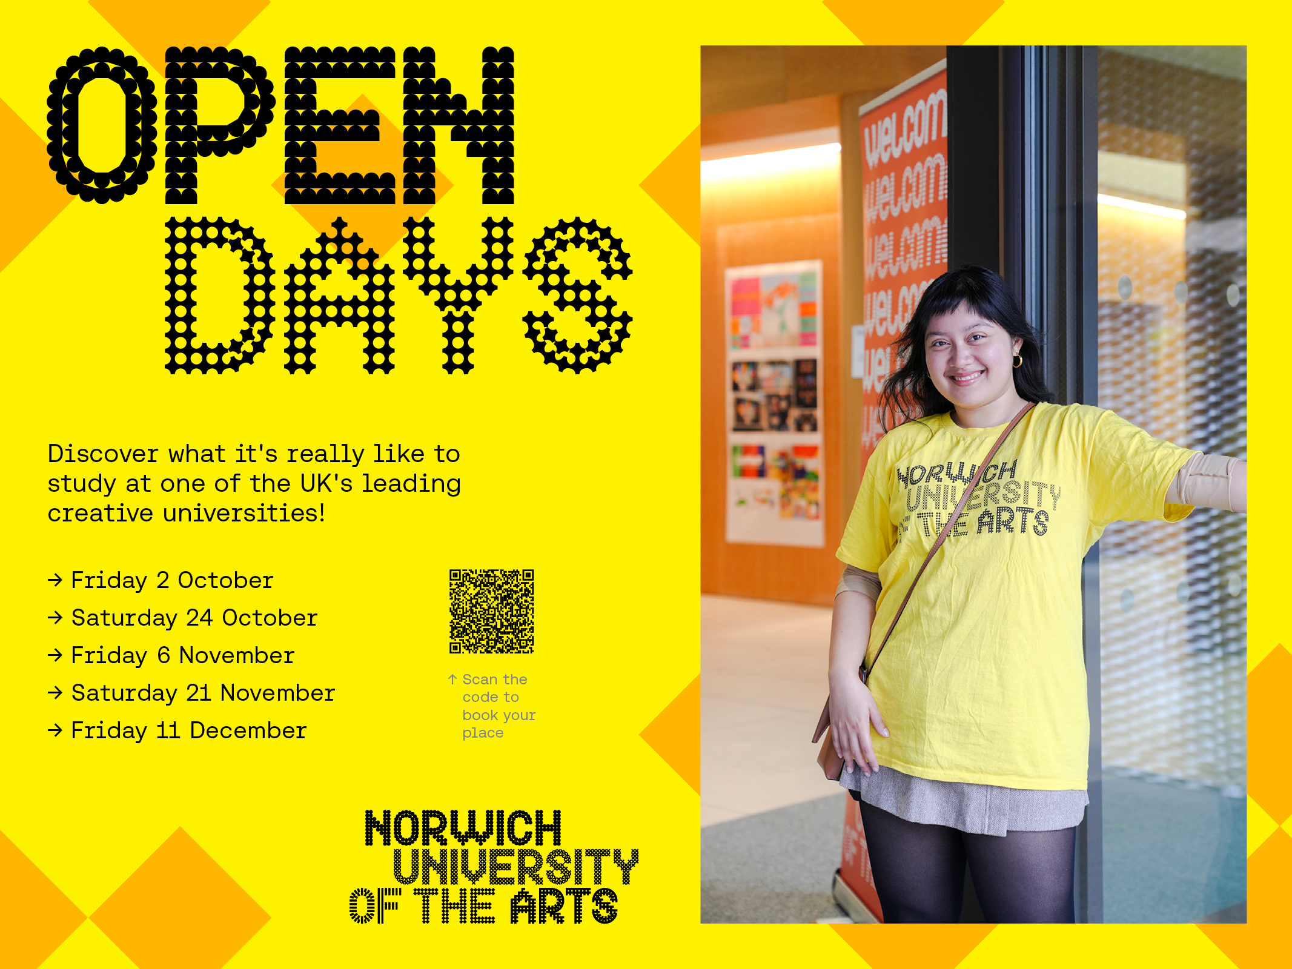

Slide 3
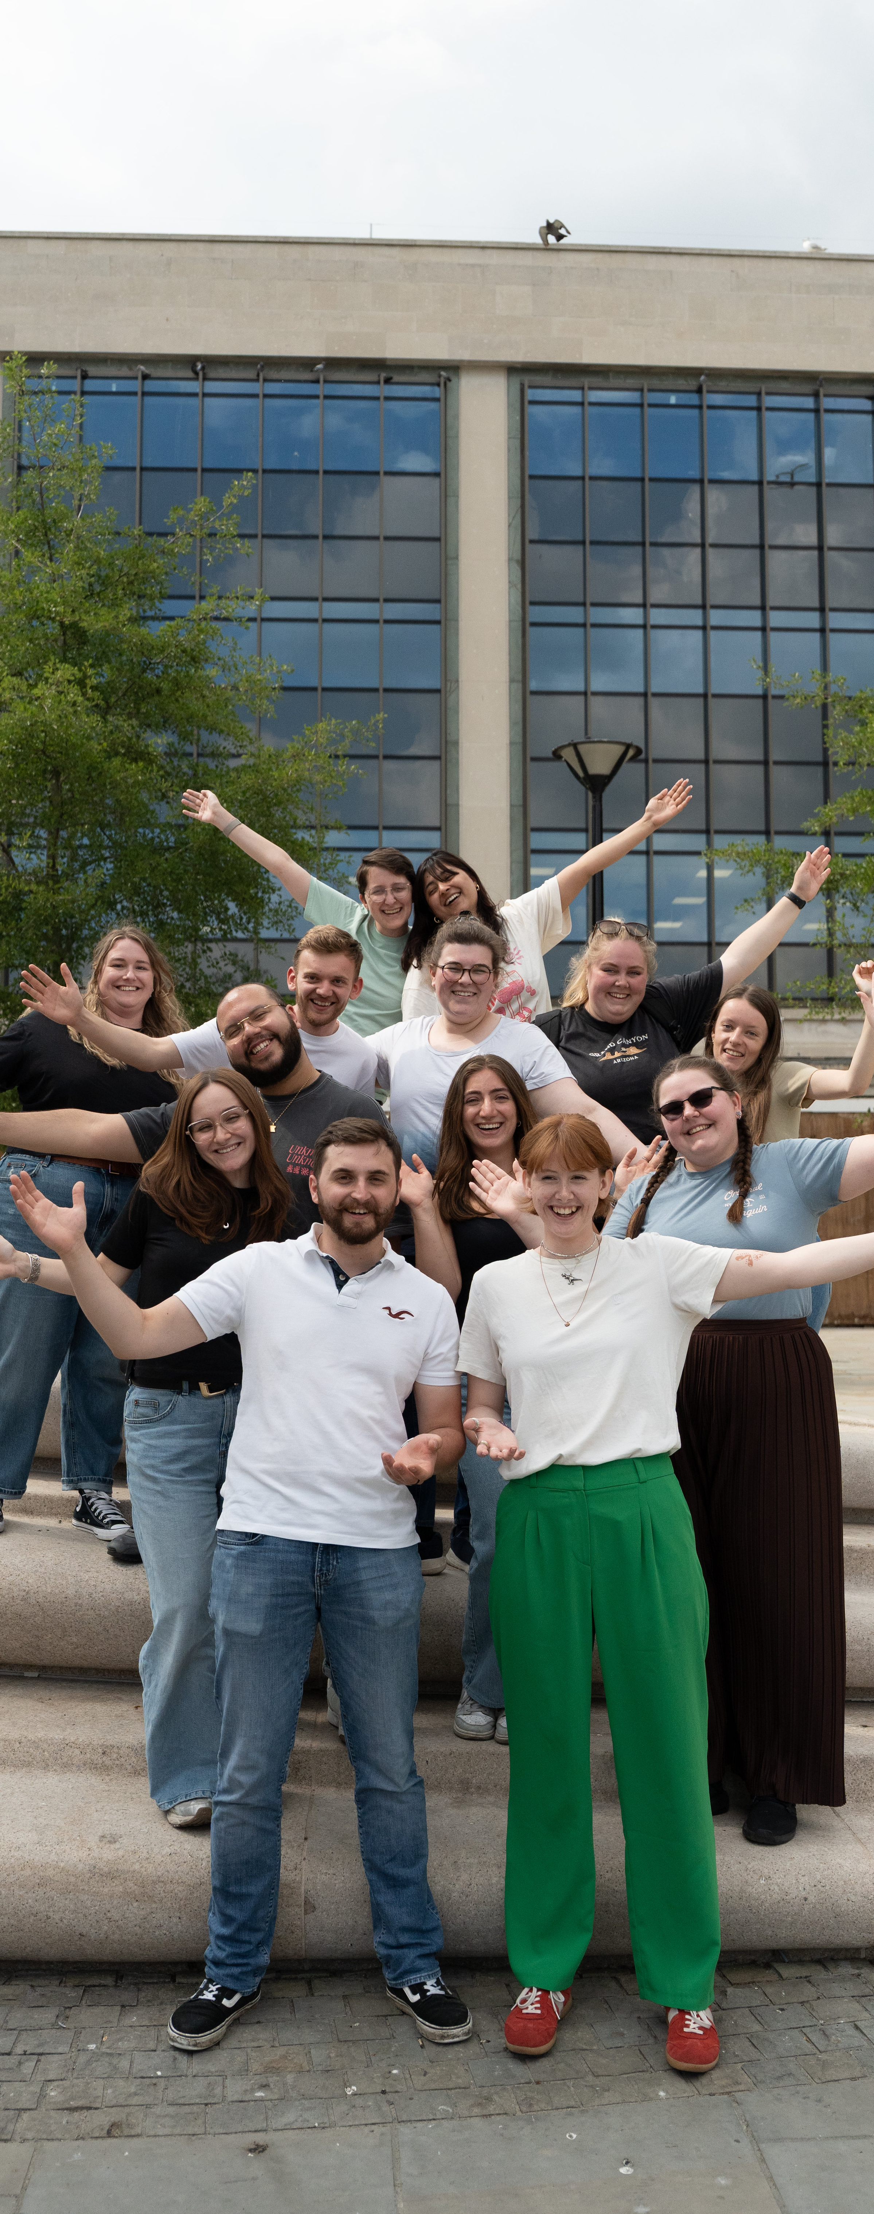
FREE SUBJECT TASTER DAYS
Great experience for Personal Statements
Take part in subject taster sessions, hear from experts, talk to current students and explore our campuses.
Travel funding available.
30 September Criminology Taster Day
7 October Sports Taster Day
9 October Music & Media Taster Day
21 October Architecture Taster Day
21 October Law Taster Day
4 November Creative Connections Festival
4 November Performing Arts Masterclass Day
10 November Education Taster Day
11 November Geography & Biosciences Taster Day
11 November Accounting & Finance Taster Day
BOOK www.glos.ac.uk/outreach

Slide 4



Study Your Way
Flexible Online & Campus Learning
Explore Arden

Slide 5


Slide 6


Slide 7
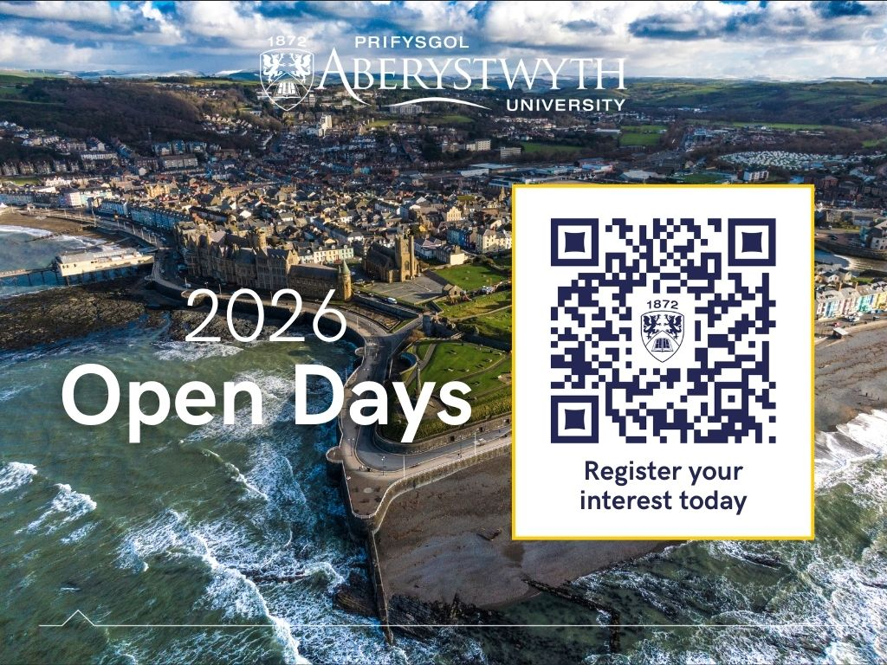

Slide 8


Slide 9

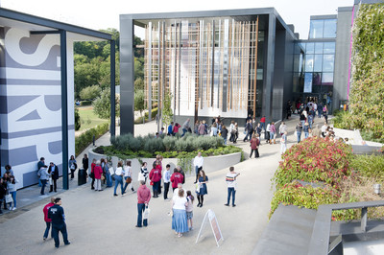

Visit Winchester!
Our Open Days and Campus Tours are a great opportunity to see our beautiful campus, take a tour of our stunning accommodation, and meet staff and students from the course you are looking to study.
Find out more at winchester.ac.uk/study/visit-us

Slide 10


Slide 11


Slide 12


Slide 13
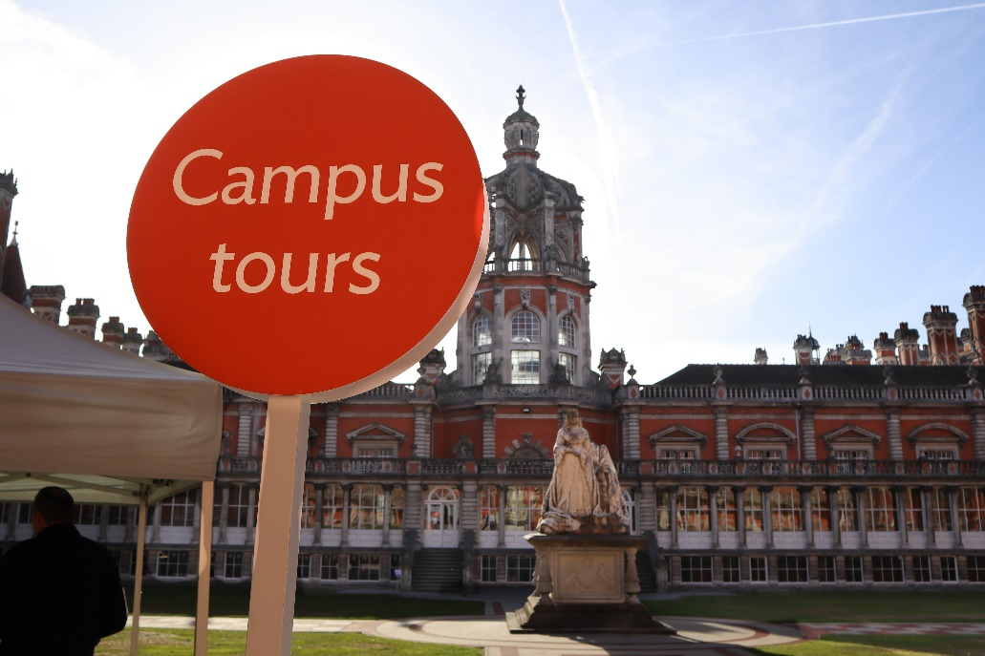
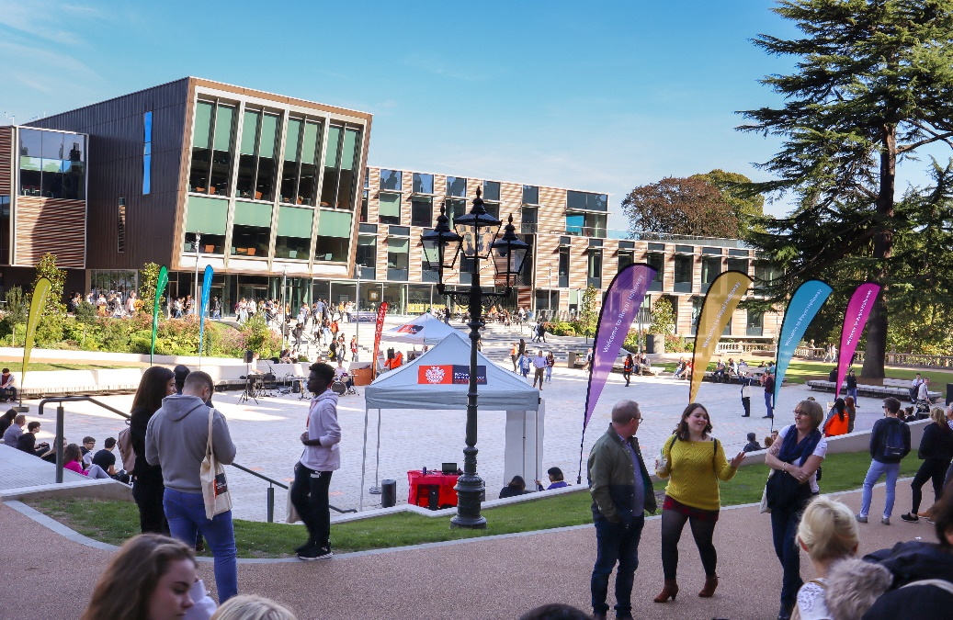
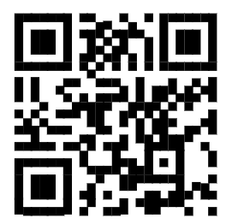

Visit
Royal Holloway
Our Open Days and Online Open Days are a perfect opportunity to discover more about Royal Holloway, University of London. Get a tour of our campus in Egham, chat to current students and hear directly from lecturers about the courses you are interested in.
Find out more and book your place
royalholloway.ac.uk/opendays

Slide 14
