Slide 1
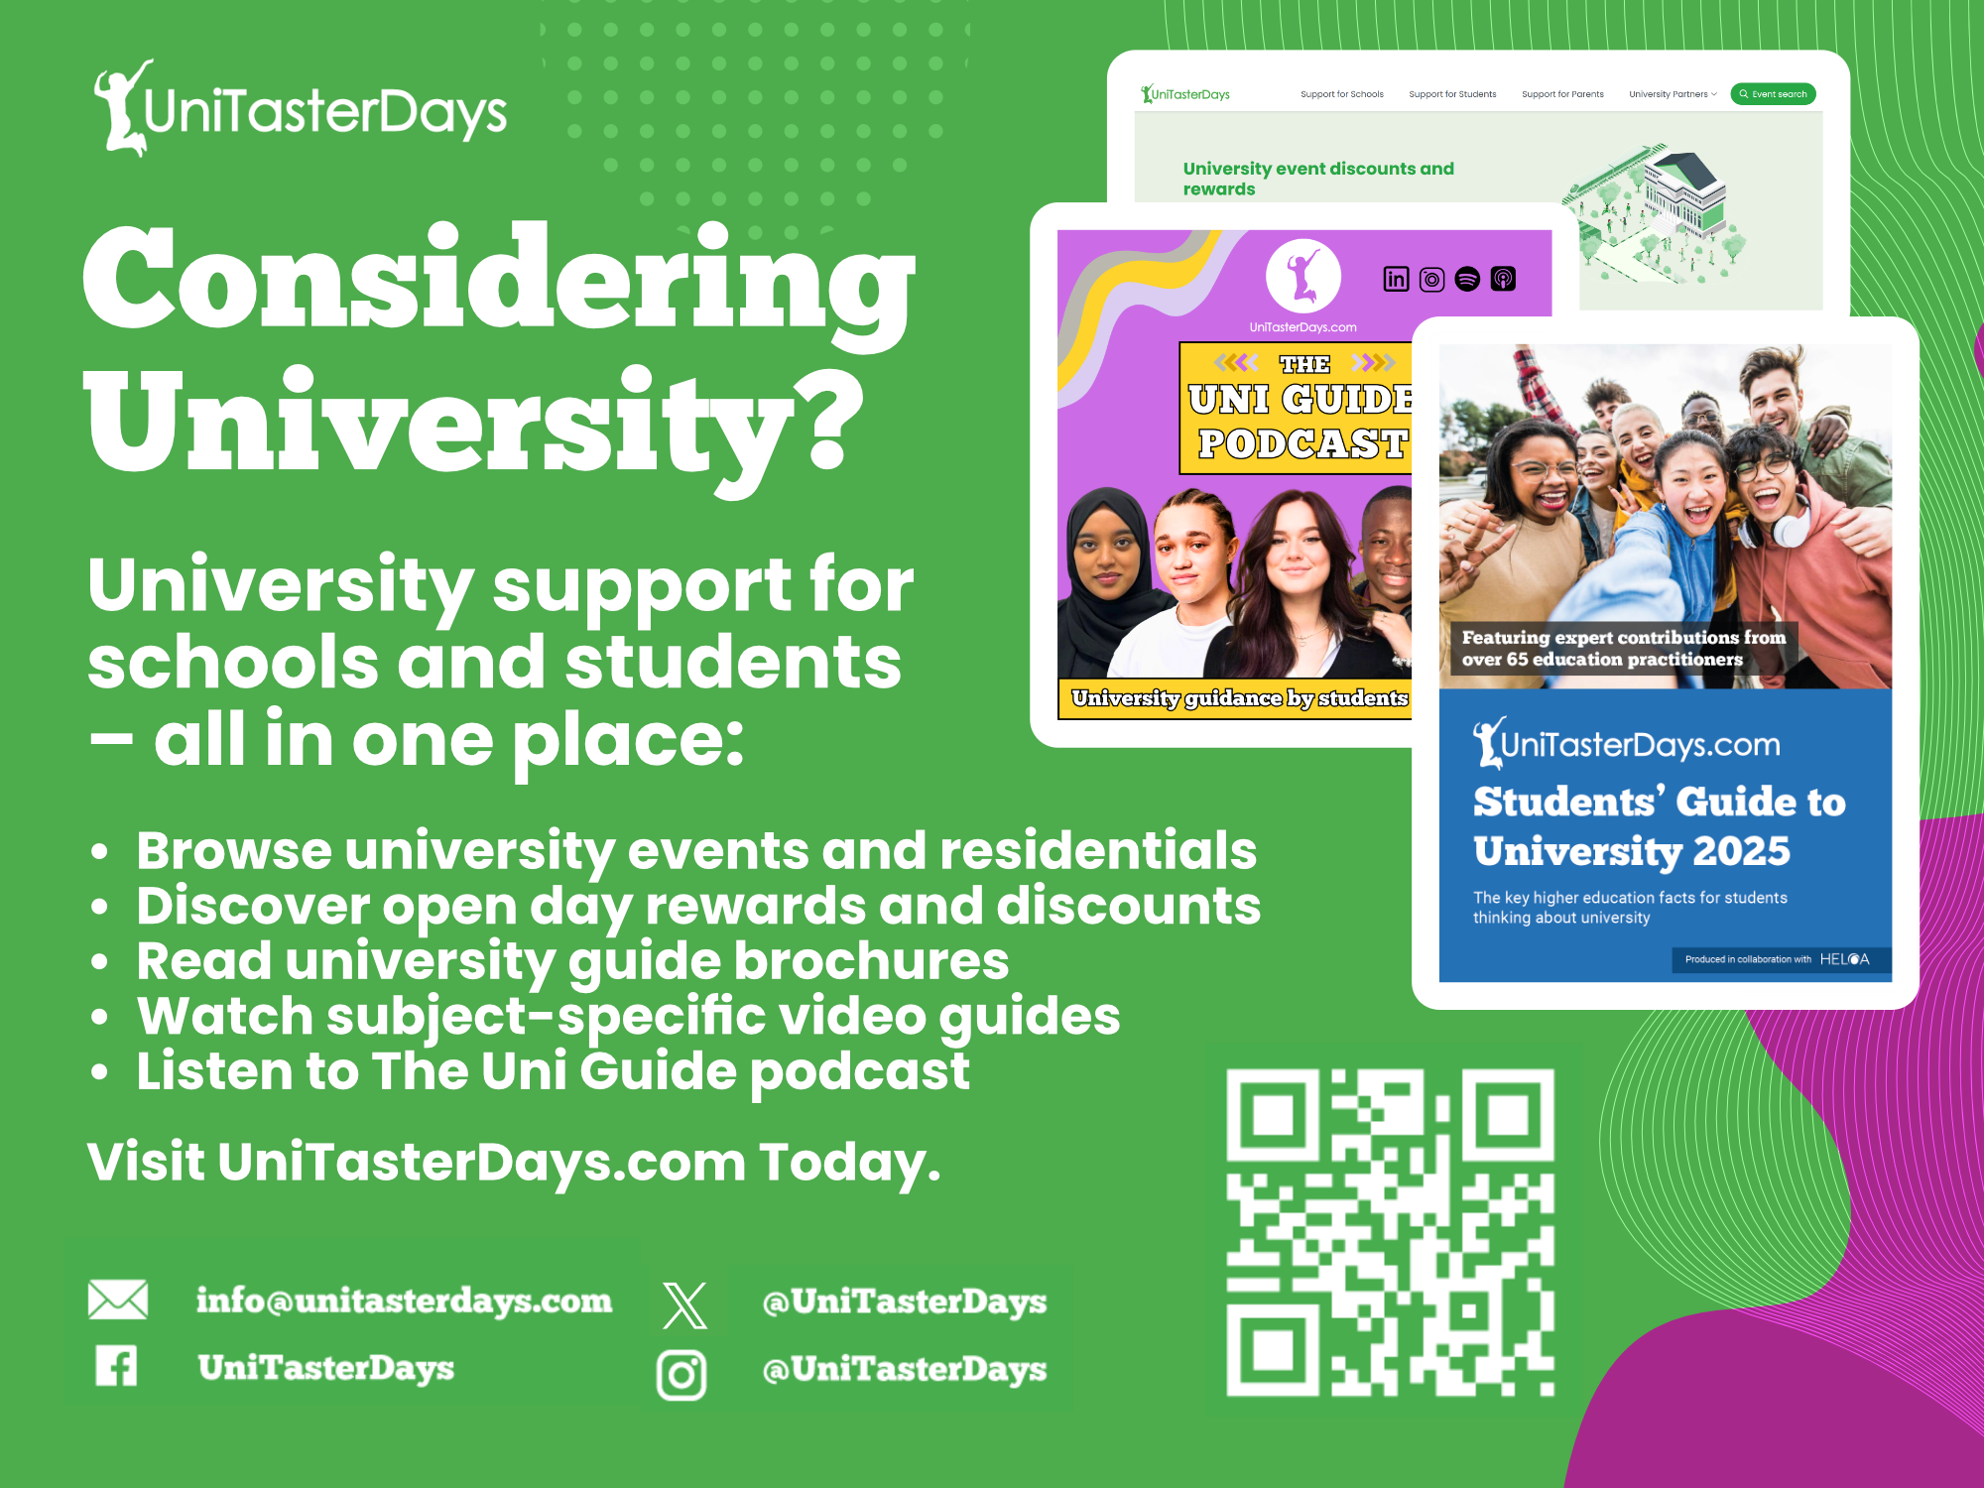


Slide 2
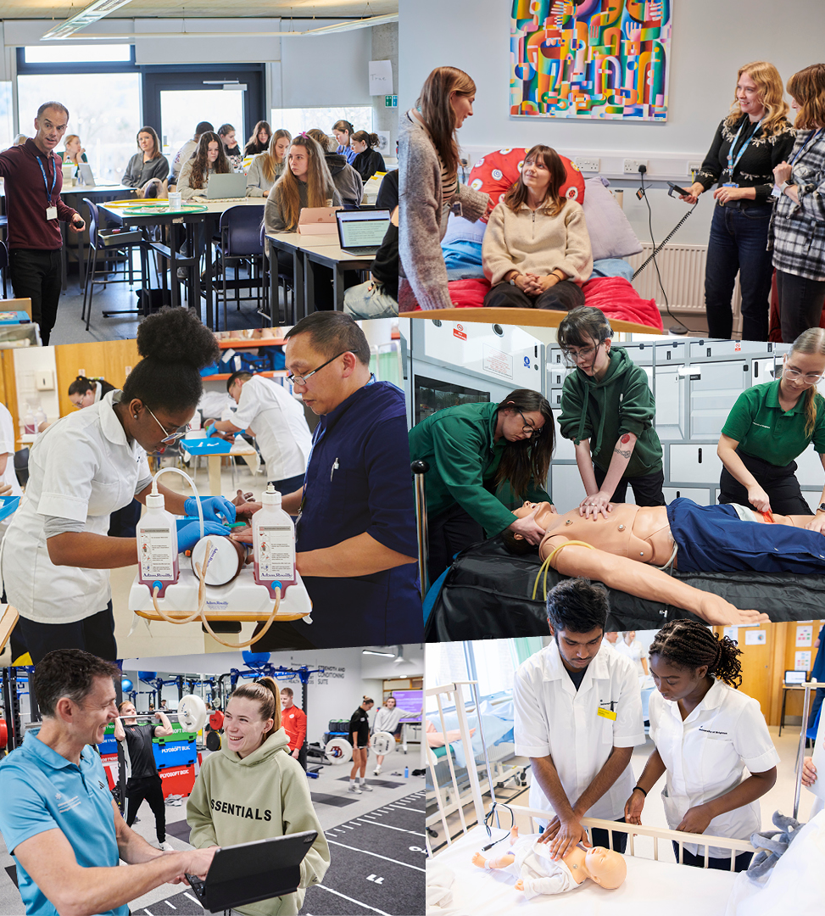

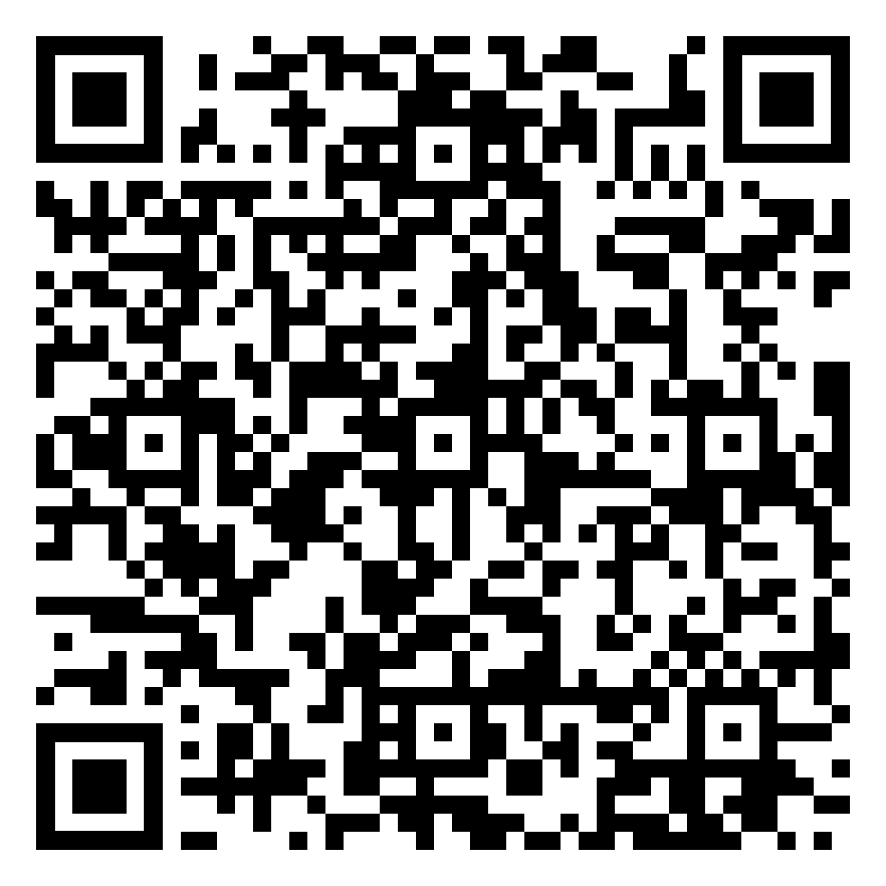

Online subject taster events at the University of Brighton
Want to see what university subjects are really like? Book your place on an online taster session and explore exciting topics with our academics.
+ Psychology
+ Pharmacy
+ Media
+ Podiatry and Physiotherapy
+ Product Design/Design Engineering
+ Space Law
+ Geography and the environment
+ Politics and Philosophy
+ Midwifery
+ Business and Marketing
+ Architecture

Slide 3


Slide 4
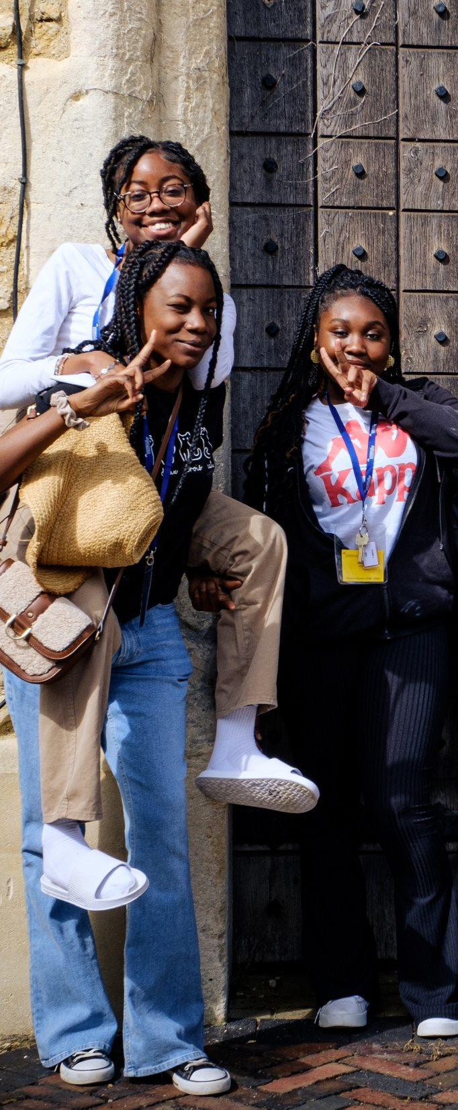
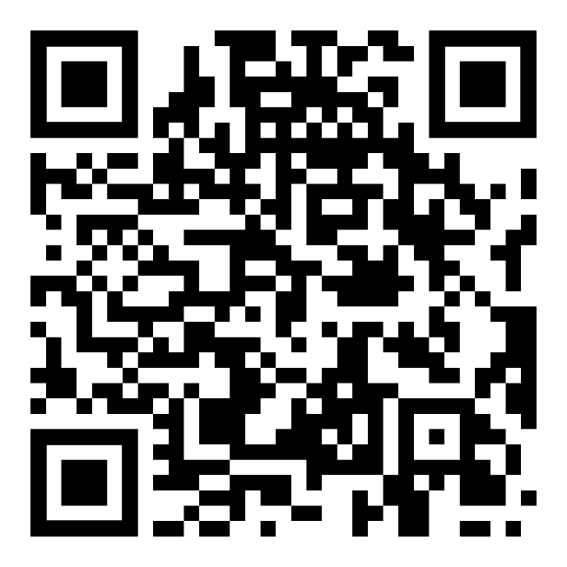
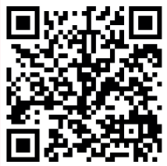
GET A TASTE FOR UNI
with UoG Summer Residentials
YEAR 12: TUESDAY 7 – FRIDAY 10 JULY 2026
YEAR 10: TUESDAY 14 – FRIDAY 17 JULY 2026
Our free summer residentials are the perfect way to experience uni first-hand.
APPLICATIONS NOW OPEN
scan the QR code
glos.ac.uk/residentials26

Slide 5
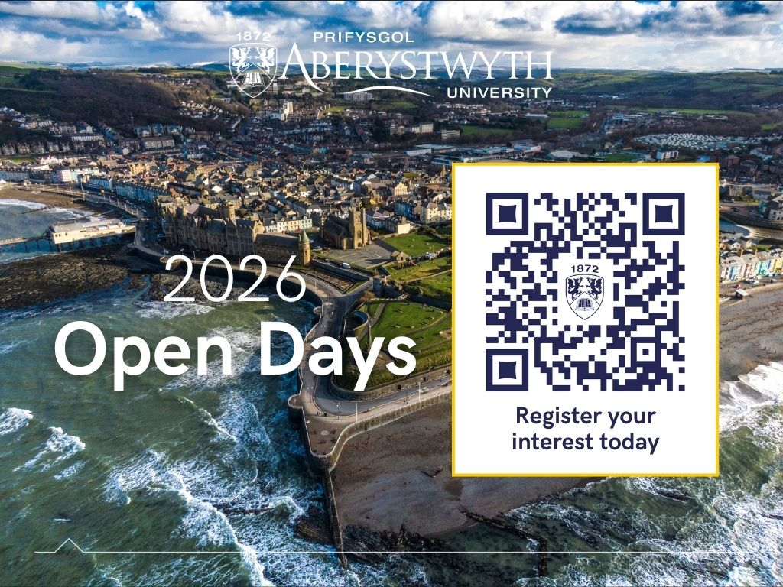

Slide 6

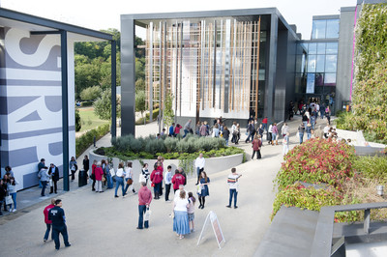

Visit Winchester!
Our Open Days and Campus Tours are a great opportunity to see our beautiful campus, take a tour of our stunning accommodation, and meet staff and students from the course you are looking to study.
Find out more at winchester.ac.uk/study/visit-us

Slide 7


Slide 8


Slide 9


Slide 10


Slide 11
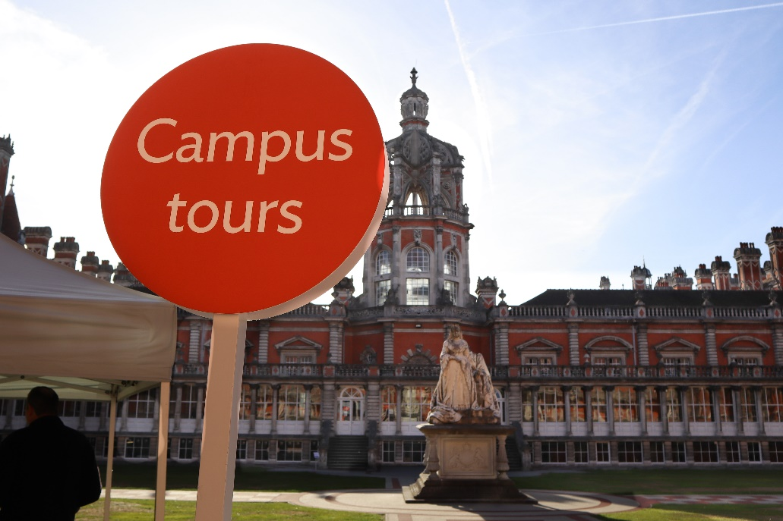
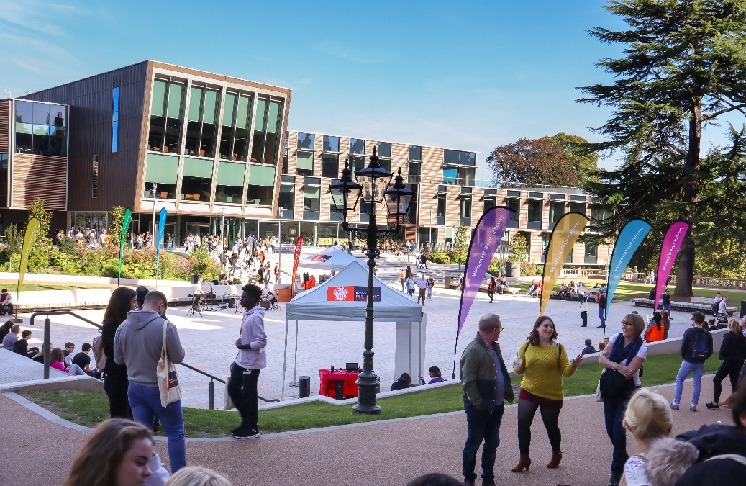
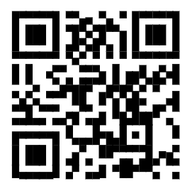

Visit
Royal Holloway
Our Open Days and Online Open Days are a perfect opportunity to discover more about Royal Holloway, University of London. Get a tour of our campus in Egham, chat to current students and hear directly from lecturers about the courses you are interested in.
Find out more and book your place
royalholloway.ac.uk/opendays

