Slide 1



Slide 2


Slide 3

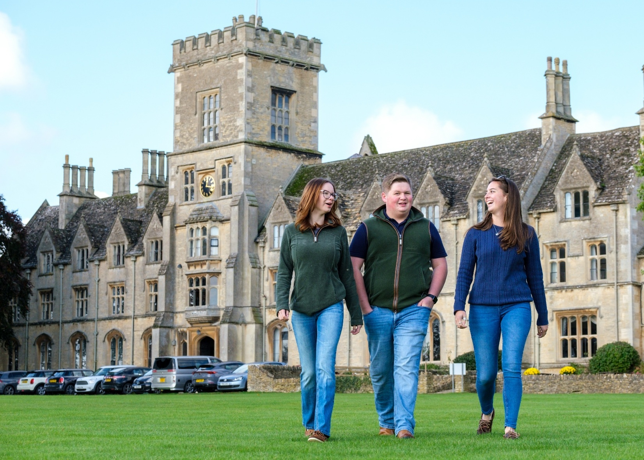

Come and see us!
Undergraduate Open Day – Wednesday 1 July (10:00am – 3:00pm)
Scan to find out more
and book your place!

Slide 4


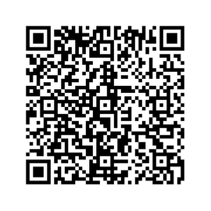



Stay in touch with us...
Your Open Day visit awaits
See it - feel it - find your place
Drop us an email
Your future begins at Summer School
Study@swansea.ac.uk
Your Summer, upgraded - get ahead and stand out

Slide 5


Slide 6


Slide 7


Slide 8

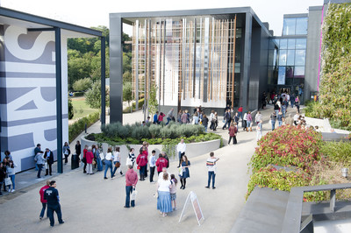

Visit Winchester!
Our Open Days and Campus Tours are a great opportunity to see our beautiful campus, take a tour of our stunning accommodation, and meet staff and students from the course you are looking to study.
Find out more at winchester.ac.uk/study/visit-us

Slide 9


Slide 10


Slide 11


Slide 12
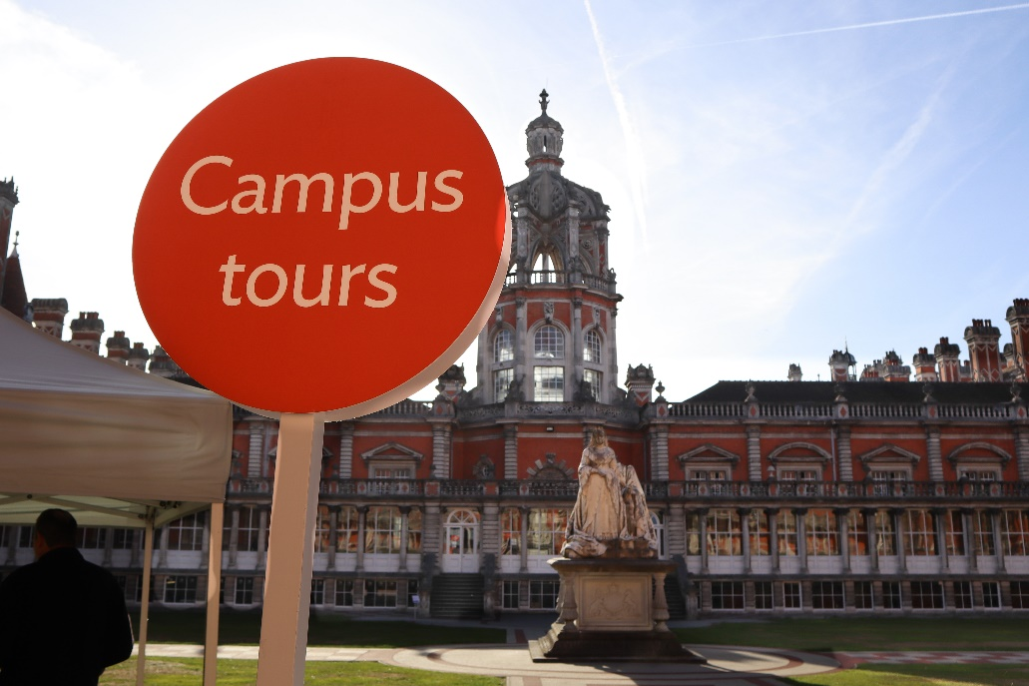
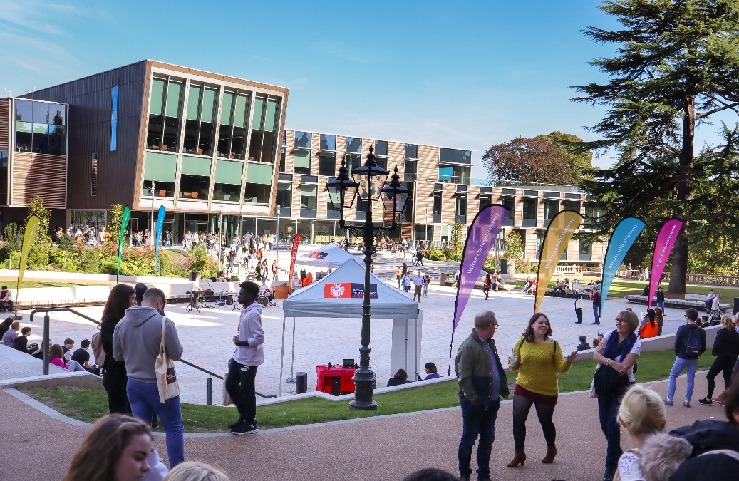
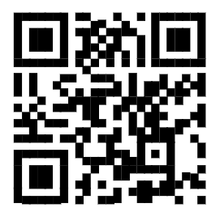

Visit
Royal Holloway
Our Open Days and Online Open Days are a perfect opportunity to discover more about Royal Holloway, University of London. Get a tour of our campus in Egham, chat to current students and hear directly from lecturers about the courses you are interested in.
Find out more and book your place
royalholloway.ac.uk/opendays

