Slide 1
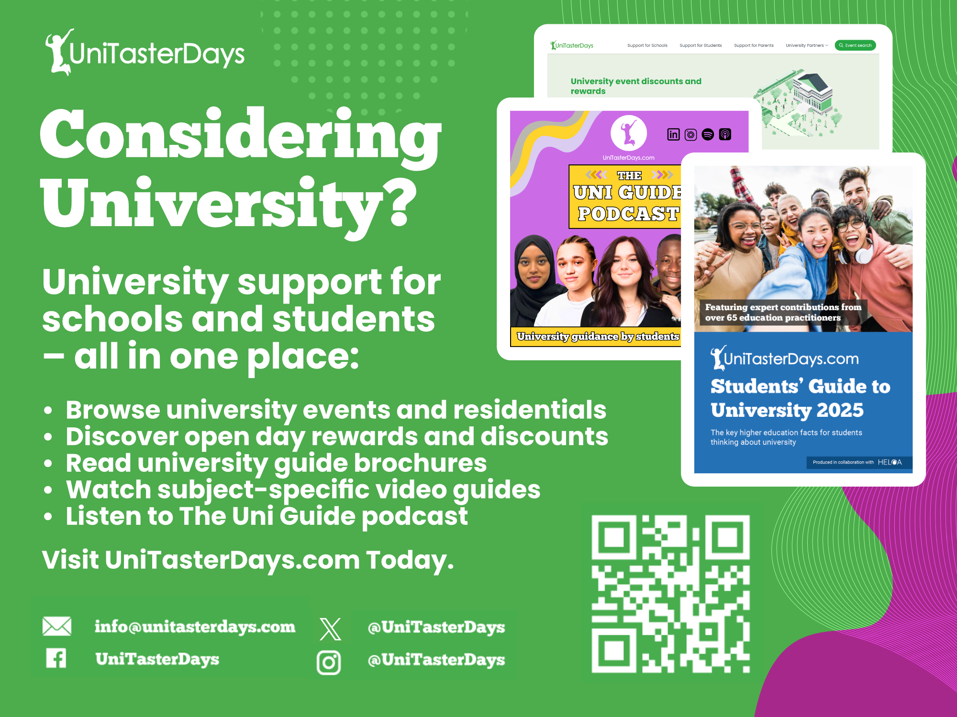

Slide 2


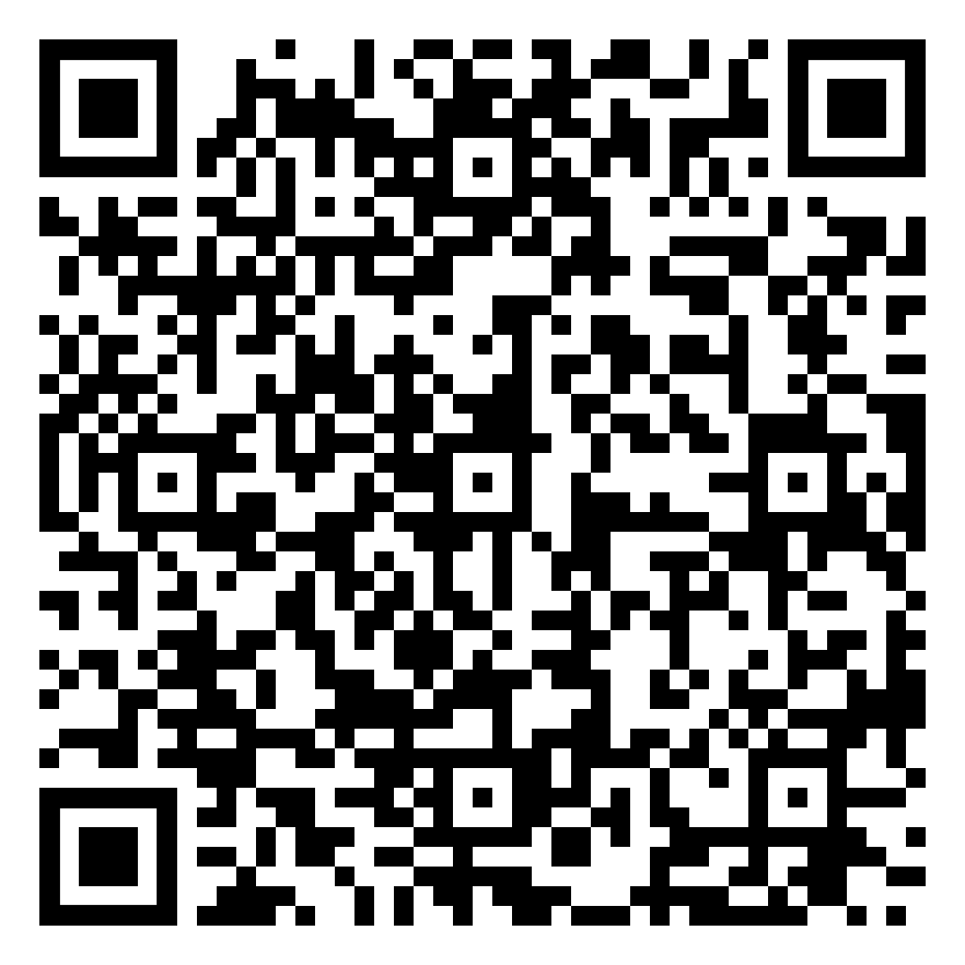


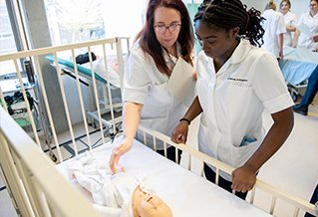
Online advice events at the University of Brighton
Sign up to our online sessions and learn more about applying to university and student life.
+ Tips on creating an online portfolio
+ Preparing for a university interview
+ Healthcare interview preparation
+ Student funding and finance explained
+ And more!

Slide 3


Forthcoming EVENTS
MINI UNDERGRADUATE OPEN DAY
Wednesday 17 December 2025, 11am - 2pm
Cheltenham and Gloucester Campuses
Bring your students who are still considering their options or finalising their choices
GEOGRAPHY & BIOSCIENCES EXPO DAY
Friday 23 January 2026, 10:30am-2:30pm
Francis Close Hall Campus, Cheltenham
An inspiring day of pioneering university research in Biosciences and Geography
BOOK www.glos.ac.uk/outreach

Slide 4

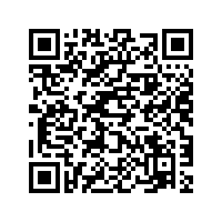
Leeds Futures
Are you a Year 12 or Level 1 student? Interested in getting a taste of what it's like to study a particular subject at the University of Leeds?
Develop your knowledge and understanding in your subject of interest
Learn what is involved in studying at university
Attend taster lectures, seminars and practical sessions
Meet current students and academics
Get to know the University campus
Benefit from support up to the point of applying to university
Find out about career opportunities after university
Find out more or apply

Slide 5


Slide 6

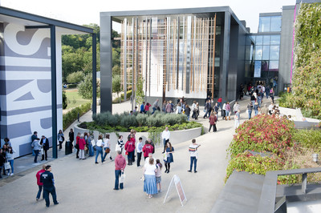

Visit Winchester!
Our Open Days and Campus Tours are a great opportunity to see our beautiful campus, take a tour of our stunning accommodation, and meet staff and students from the course you are looking to study.
Find out more at winchester.ac.uk/study/visit-us

Slide 7


Slide 8


Slide 9


Slide 10


Slide 11
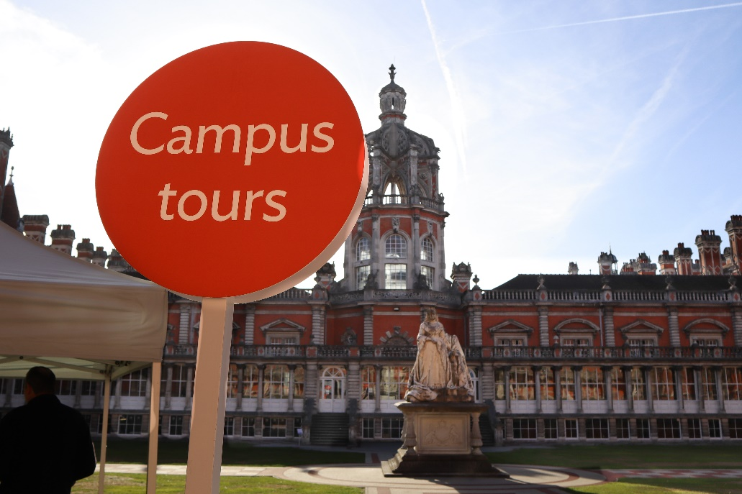
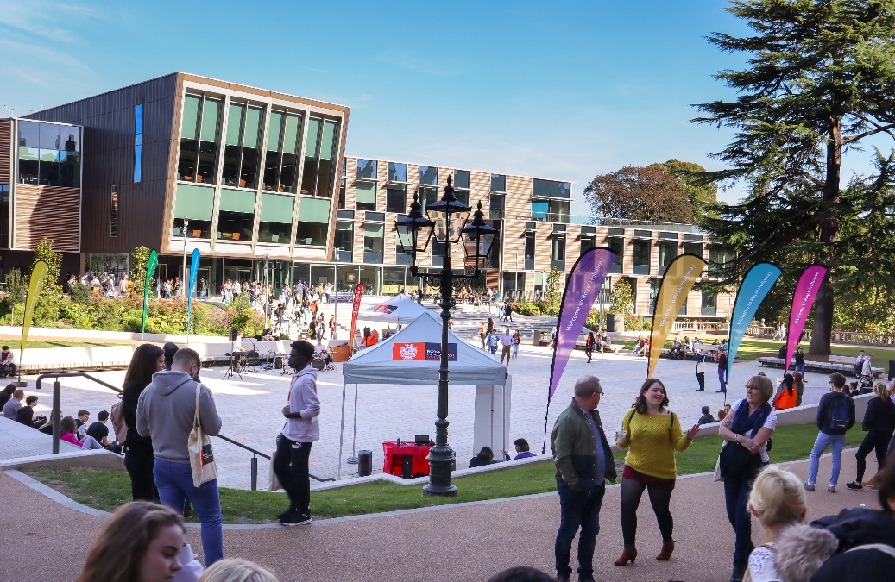
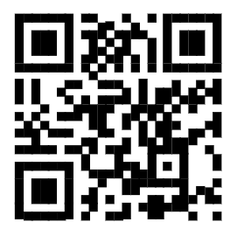

Visit
Royal Holloway
Our Open Days and Online Open Days are a perfect opportunity to discover more about Royal Holloway, University of London. Get a tour of our campus in Egham, chat to current students and hear directly from lecturers about the courses you are interested in.
Find out more and book your place
royalholloway.ac.uk/opendays

