Slide 1
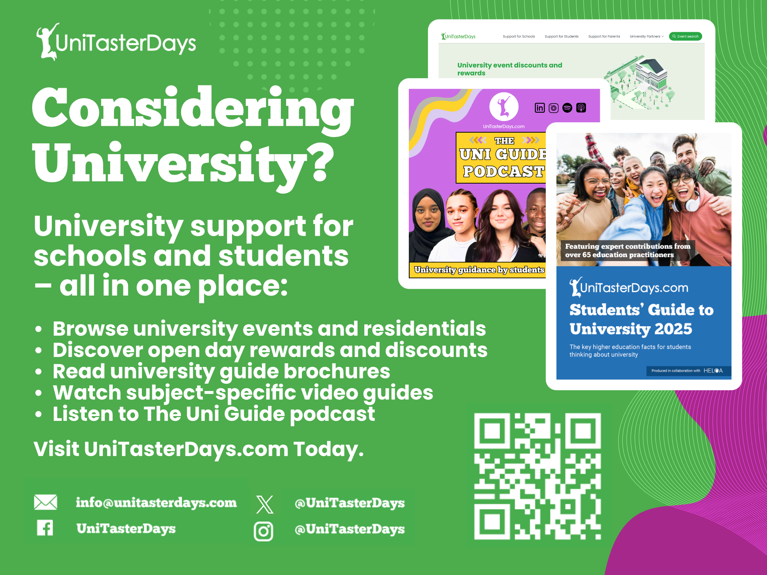


Slide 2


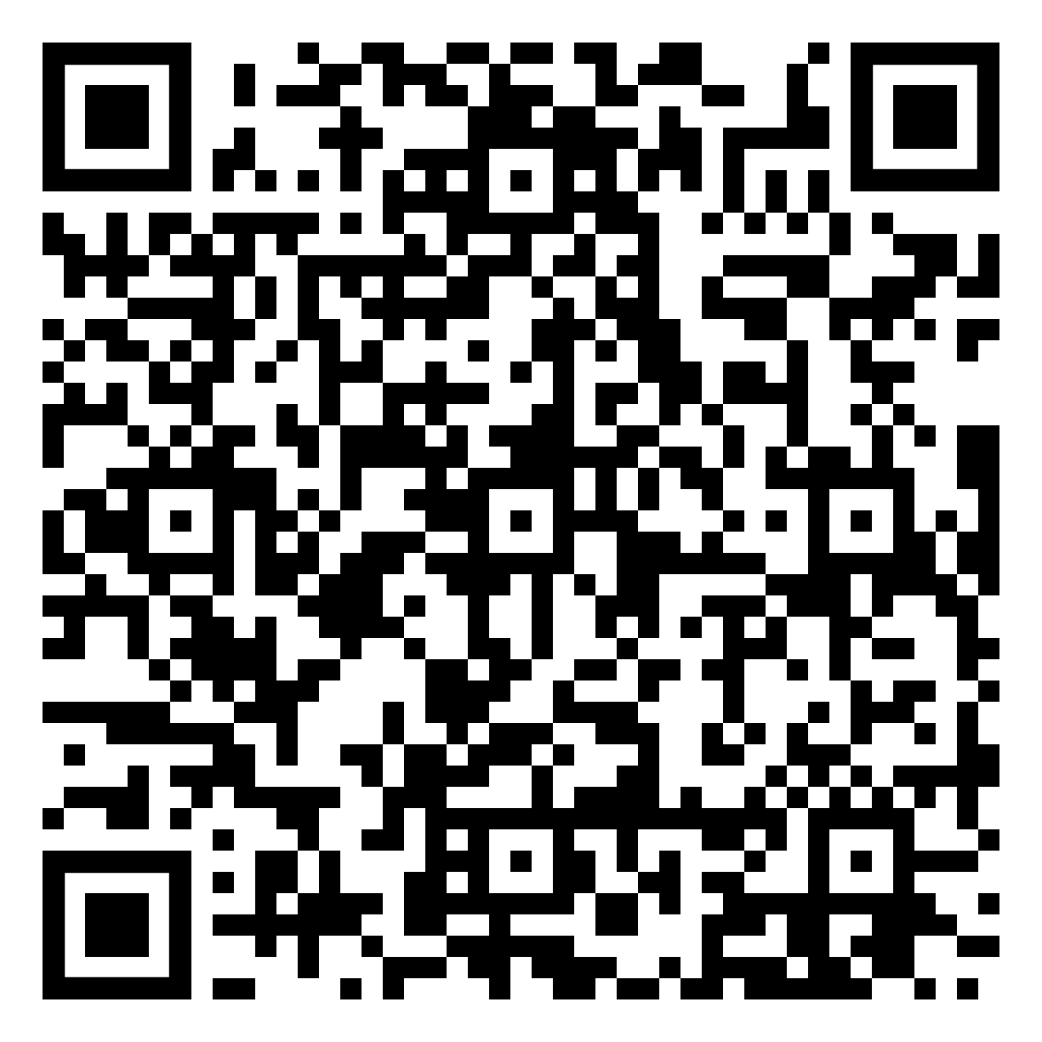

Online subject taster events at the University of Brighton
Want to see what university subjects are really like? Book your place on an online taster session and explore exciting topics with our academics.
+ Psychology
+ Pharmacy
+ Media
+ Podiatry and Physiotherapy
+ Product Design/Design Engineering
+ Space Law
+ Geography and the environment
+ Politics and Philosophy
+ Midwifery
+ Business and Marketing
+ Architecture

Slide 3
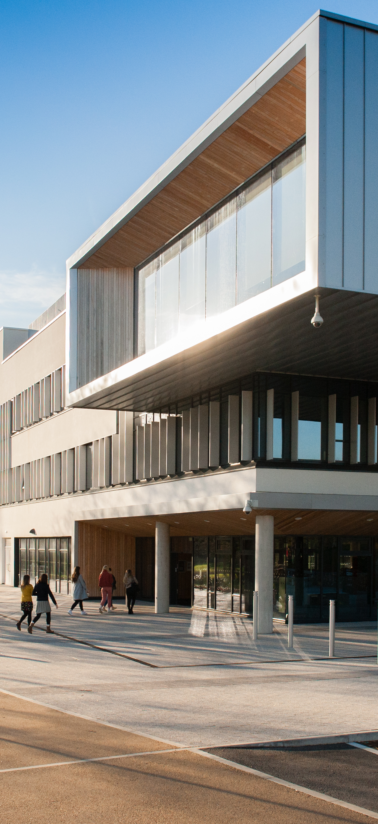

Connect Higher
Friday 12th June 10am – 2:30pm
Suitable for Years 12s (or equivalent)
Oxstalls Campus, Gloucester & Park Campus, Cheltenham
This event is all about supporting students to connect with higher education. The open day style experience means students choose from a range of sessions that best support their interests and progression needs.
Campus Tours with Student Ambassadors
Student Life Talks & Live Q&A
Subject Tasters and Workshops with Academic Staff
University Information Sessions
University Essentials
Personal Statement Top Tips
Affording University Life
Choosing your University and Course
*CPD and Networking opportunity for staff accompanying students
Book via the website or by emailing outreach@glos.ac.uk

Slide 4


Slide 5


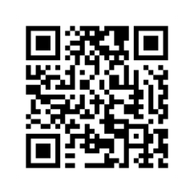
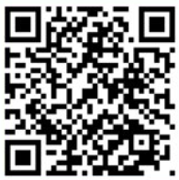
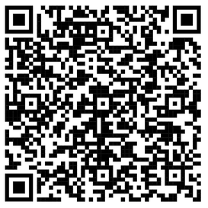
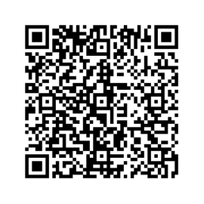

Stay in touch with us...
Drop us an email
Your Open Day visit awaits
Study@swansea.ac.uk
See it - feel it - find your place
Level Up and Join our Master Classes
Your future begins at Summer School
Experience a University lecture session
Your Summer, upgraded - get ahead and stand out

Slide 6
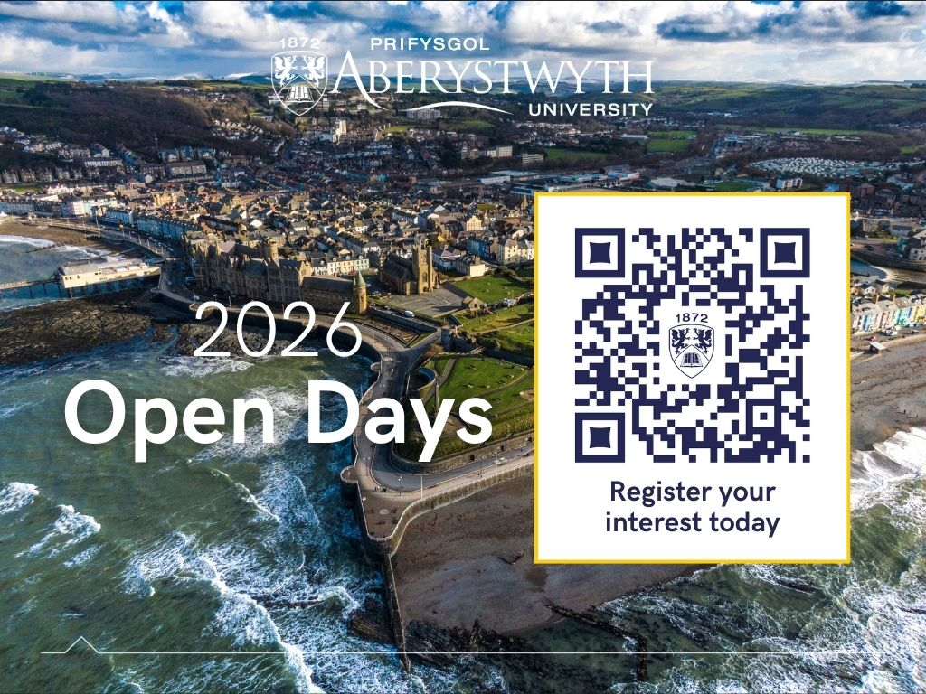

Slide 7

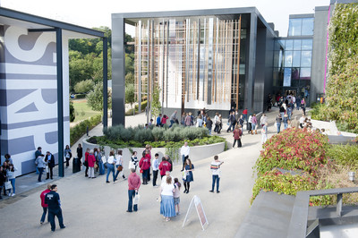

Visit Winchester!
Our Open Days and Campus Tours are a great opportunity to see our beautiful campus, take a tour of our stunning accommodation, and meet staff and students from the course you are looking to study.
Find out more at winchester.ac.uk/study/visit-us

Slide 8


Slide 9


Slide 10


Slide 11


Slide 12
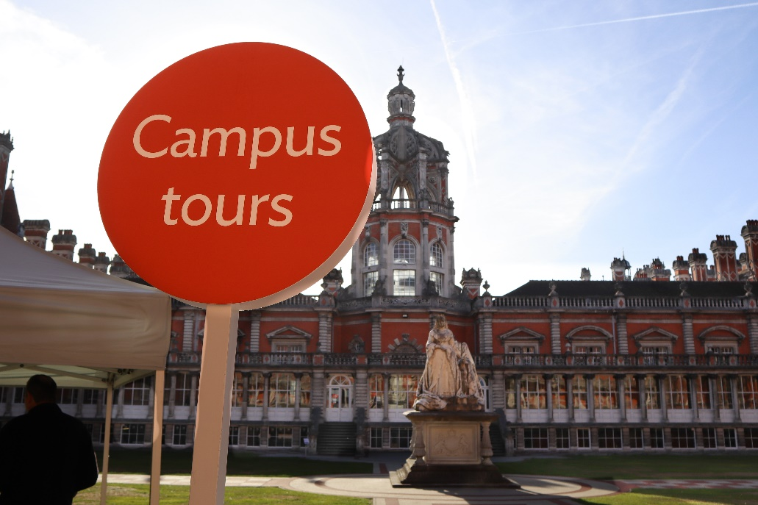
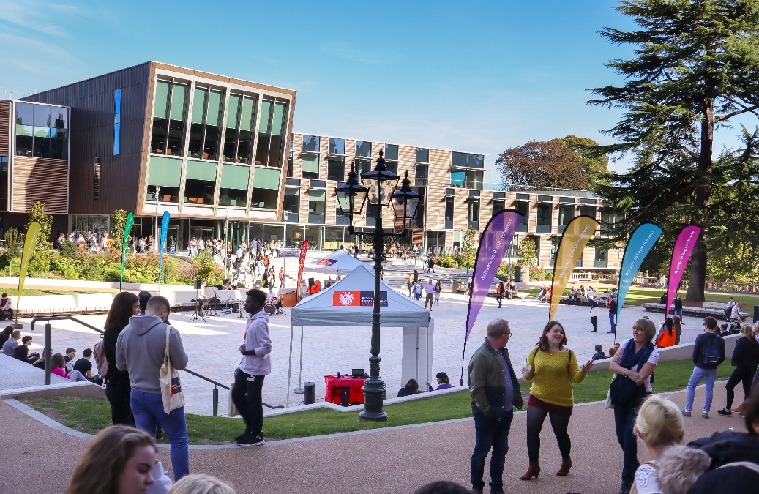
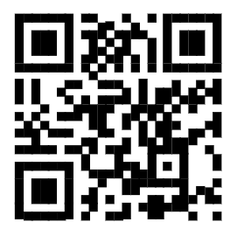

Visit
Royal Holloway
Our Open Days and Online Open Days are a perfect opportunity to discover more about Royal Holloway, University of London. Get a tour of our campus in Egham, chat to current students and hear directly from lecturers about the courses you are interested in.
Find out more and book your place
royalholloway.ac.uk/opendays

