Slide 1
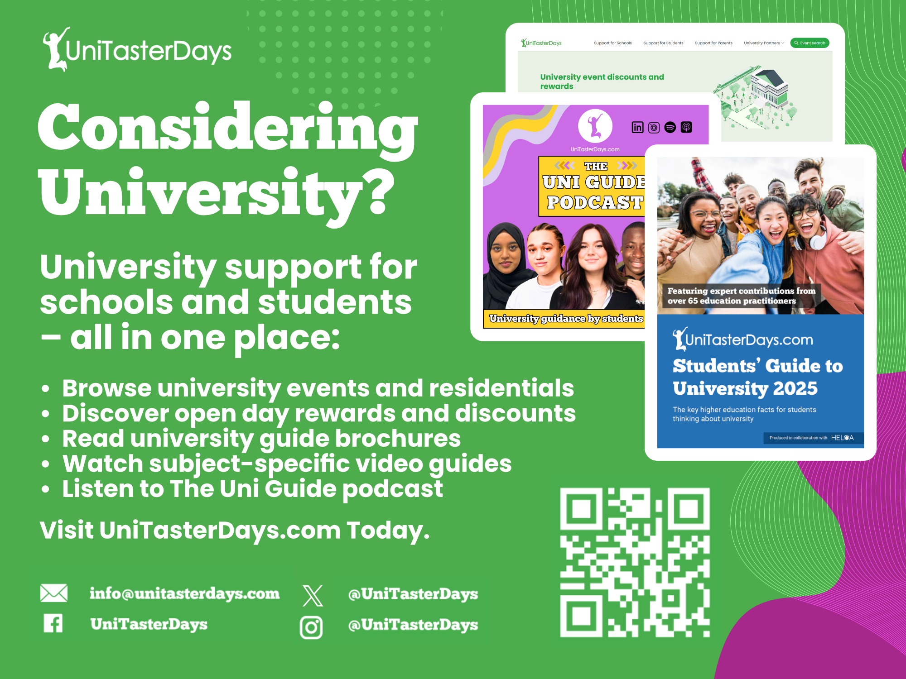


Slide 2
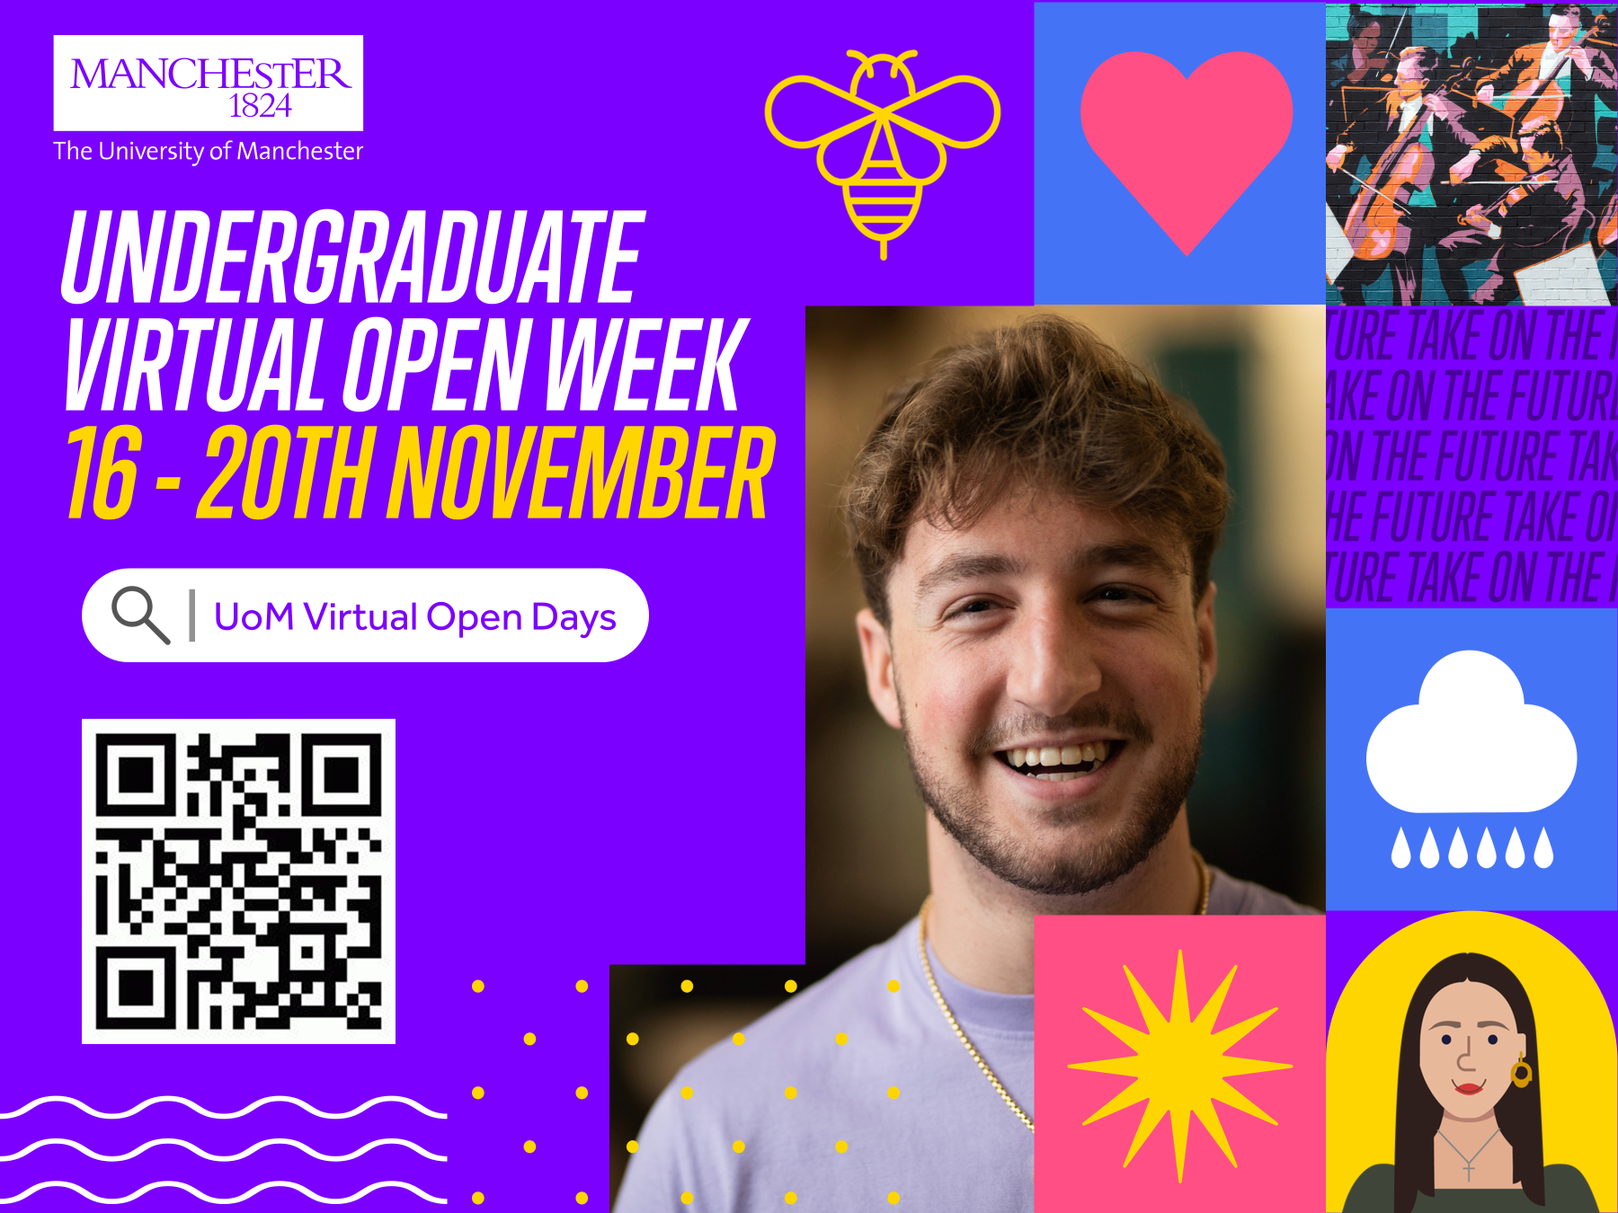

Slide 3


Slide 4


Slide 5


Slide 6
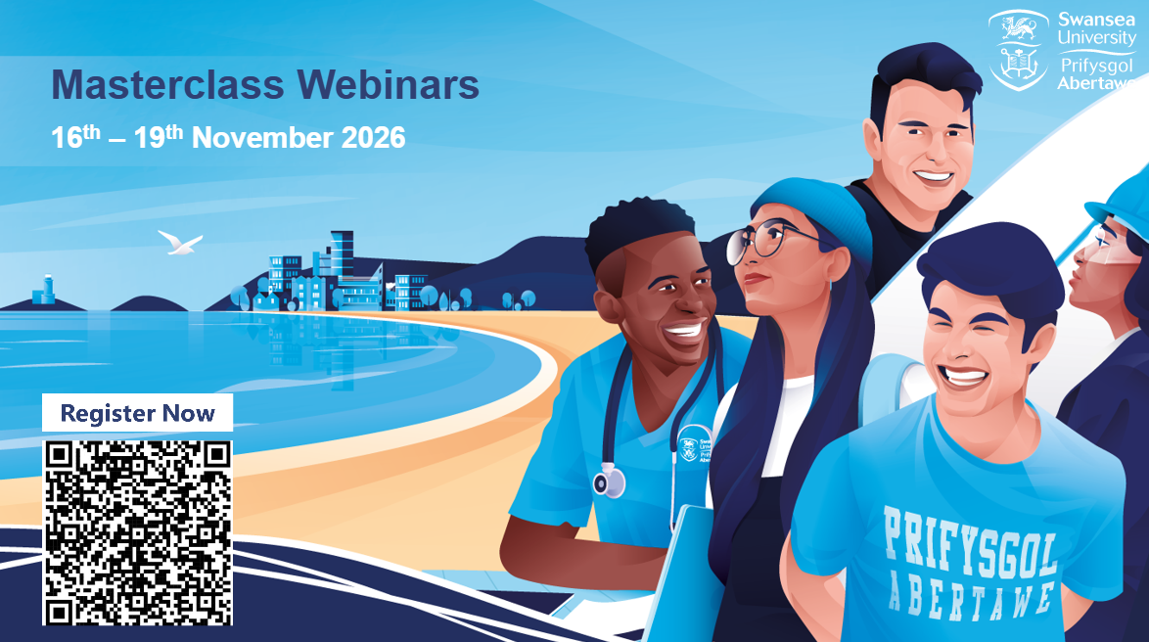

Slide 7
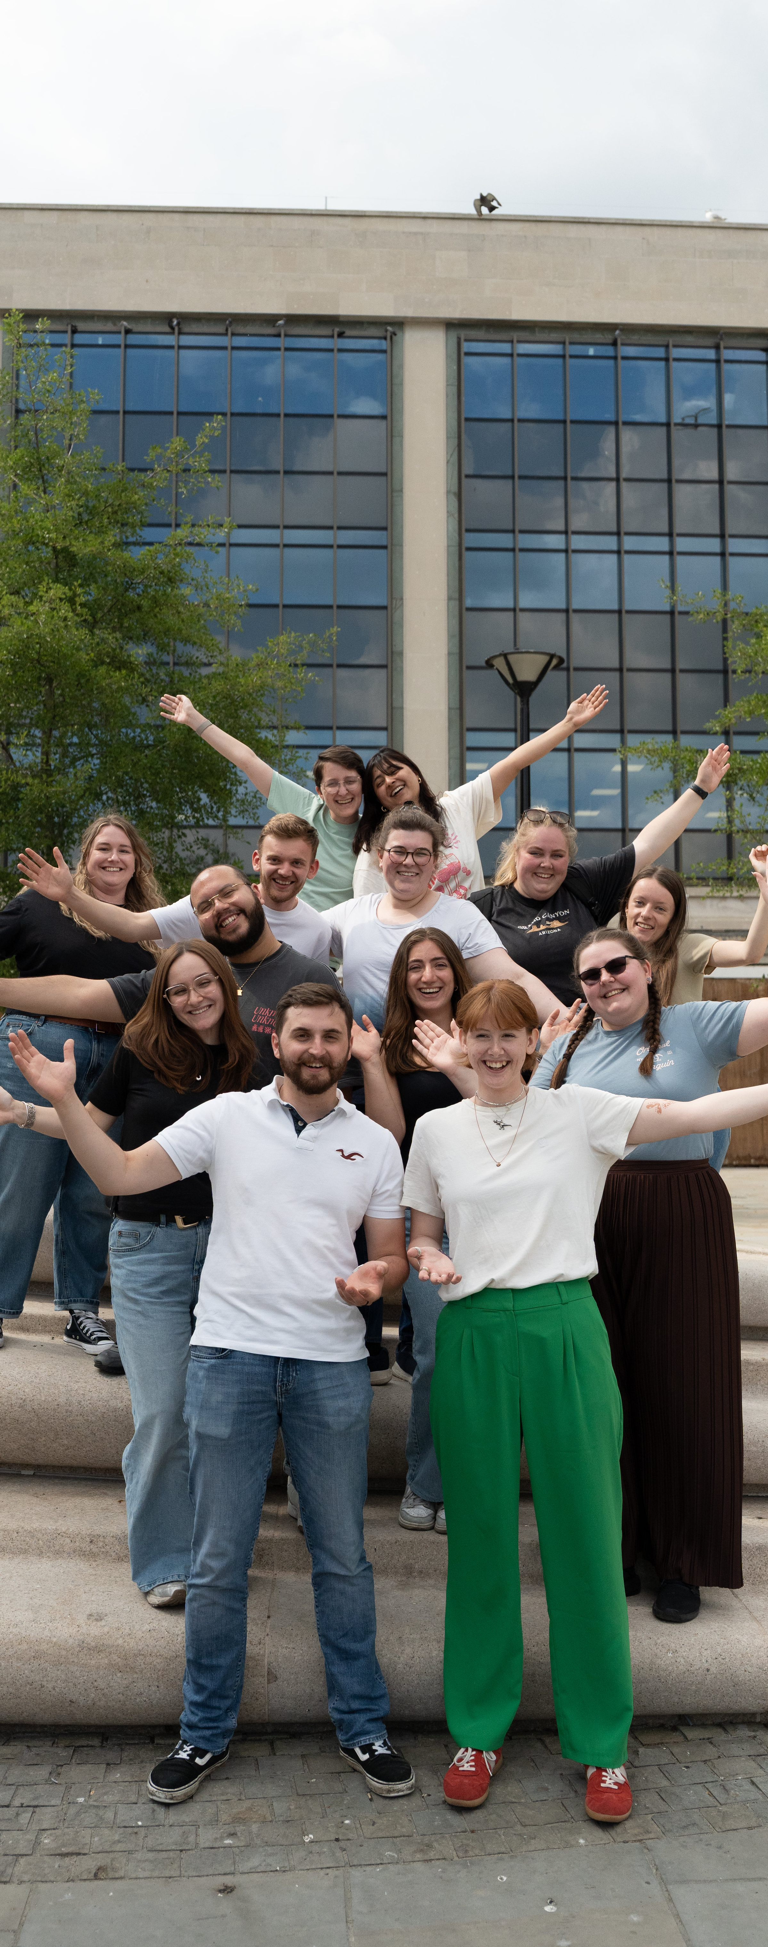
FREE SUBJECT TASTER DAYS
Great experience for Personal Statements
Take part in subject taster sessions, hear from experts, talk to current students and explore our campuses.
Travel funding available.
4 November Performing Arts Masterclass Day
10 November Education Taster Day
11 November Geography & Biosciences Taster Day
11 November Accounting & Finance Taster Day
11 November Cyber & Computing Taster Day
18 November Psychology Taster Day
25 November Marketing Taster Day
27 November Health & Social Care Taster Day
BOOK www.glos.ac.uk/outreach

Slide 8


Slide 9
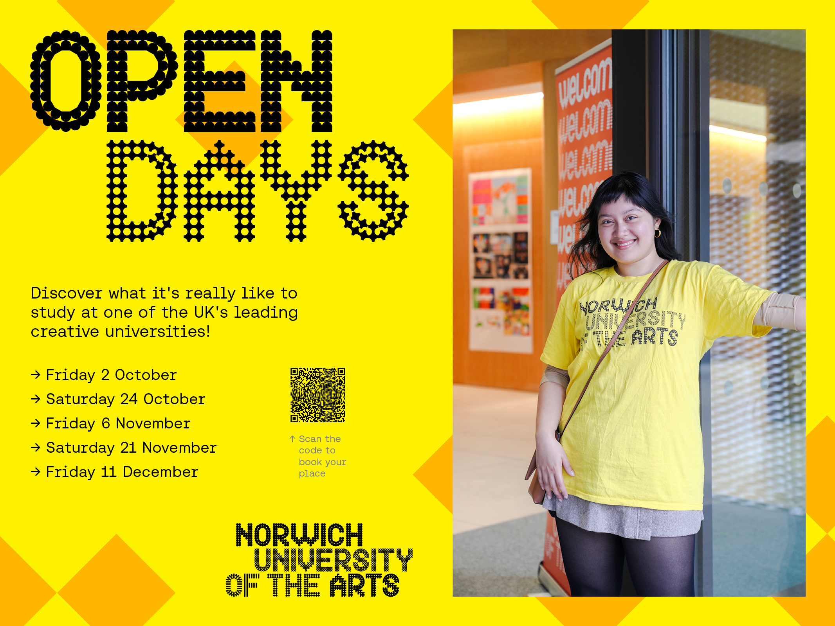

Slide 10



Study Your Way
Flexible Online & Campus Learning
Explore Arden

Slide 11


Slide 12


Slide 13
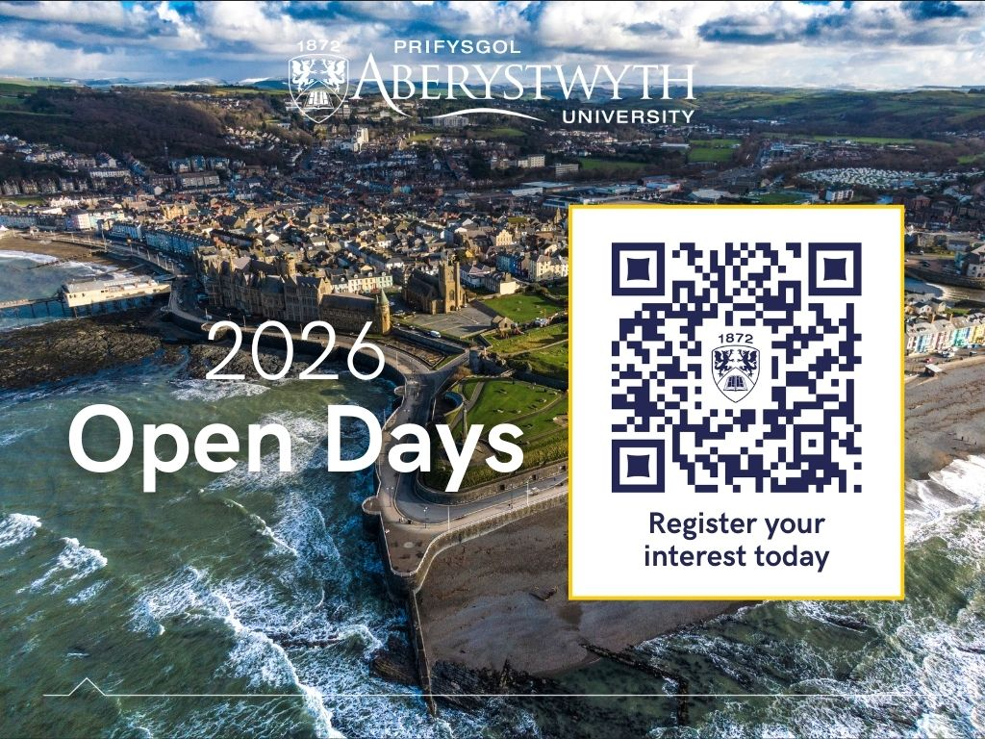

Slide 14

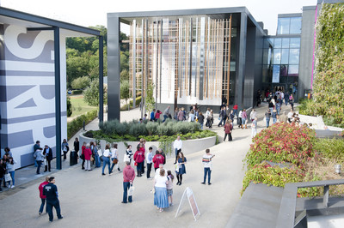

Visit Winchester!
Our Open Days and Campus Tours are a great opportunity to see our beautiful campus, take a tour of our stunning accommodation, and meet staff and students from the course you are looking to study.
Find out more at winchester.ac.uk/study/visit-us

Slide 15


Slide 16


Slide 17
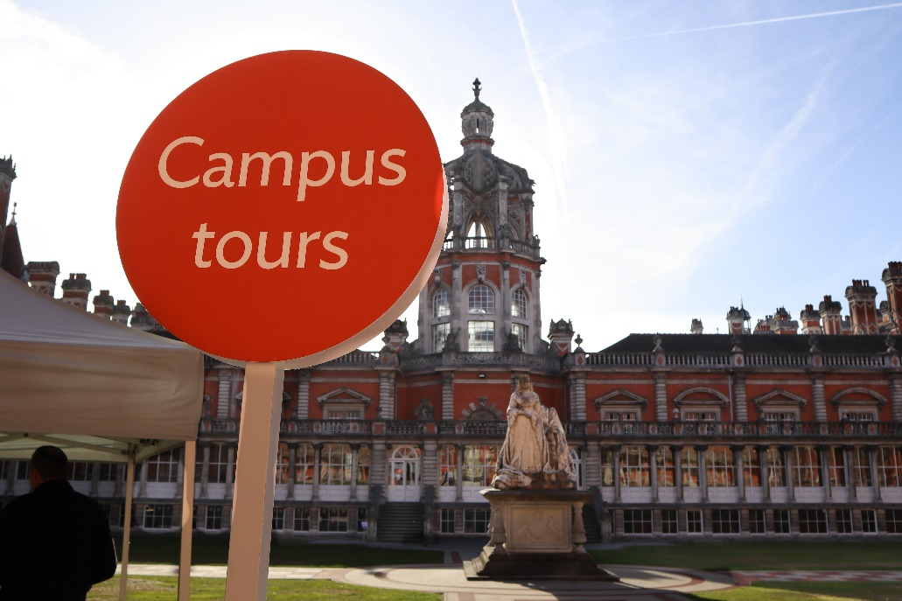
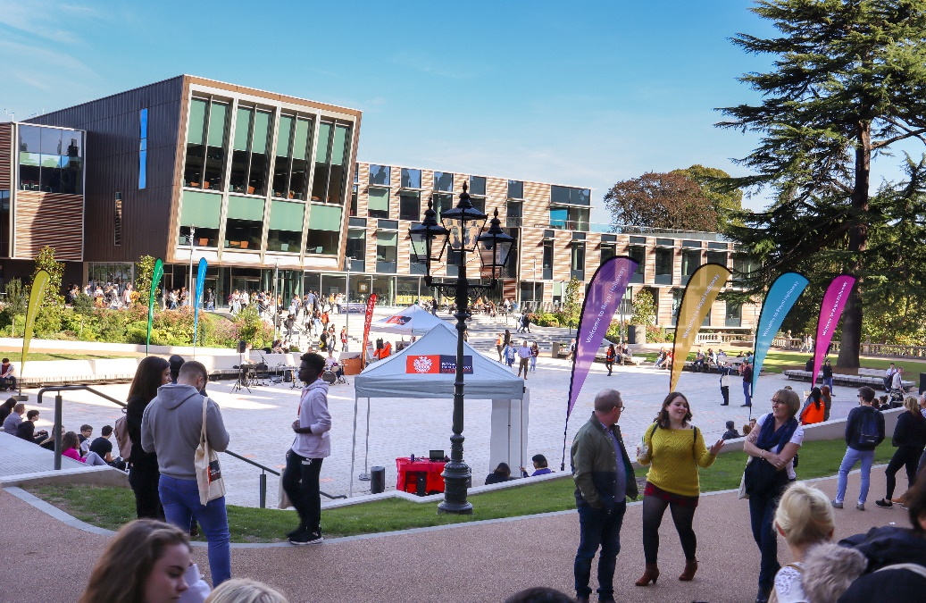
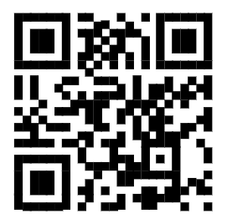

Visit
Royal Holloway
Our Open Days and Online Open Days are a perfect opportunity to discover more about Royal Holloway, University of London. Get a tour of our campus in Egham, chat to current students and hear directly from lecturers about the courses you are interested in.
Find out more and book your place
royalholloway.ac.uk/opendays

